Slide 1
Crystal field in multielectron ions
Marie-Anne ARRIO
CNRS / Sorbonne Universite (Paris)
Notes:
One electron :
symmetry : small letters for notation eg, a1g

Slide 2
Crystal field
Introduction / Definition
One electron (3d electron)
  Symmetries
  Hamiltonian
  Crystal field splitting of 3d electron
Multi-electrons ion (3d electrons)
  Hamiltonian
  Configurations/ spectroscopic terms
  Symmetry
  Exemples
Crystal field and magnetism
  Hamiltonian
  Magnetic moment (spin and orbit)
  Zeeman effect / paramagnetism
Notes:
One electron :
symmetry : small letters for notation eg, a1g

Slide 3
Crystal field : origin
Hans Bethe (1906-2005)
(Nobel Prize in Physics 1967)
In 1929 (University of Tübingen): Model to explain the properties of NaCl crystal.
Ions are considered to be undeformable charged spheres and the interaction between them simply results from the electric potential generated by these charges.
Notes:
One electron :
symmetry : small letters for notation eg, a1g

Slide 4
Crystal field : origin
NaCl crystal
Na⁺ ion surrounded by 6 Cl⁻ ions as nearest neighbors
• Ions = indeformable charged spheres
• Interaction results from the created electrostatic potential
Na⁺
Cl⁻
Electrostatic potential produced by a negative charge:
(r = distance between the centered charge and a point i)
Effect of the 6 negative charges:
Notes:
One electron :
symmetry : small letters for notation eg, a1g

Slide 5
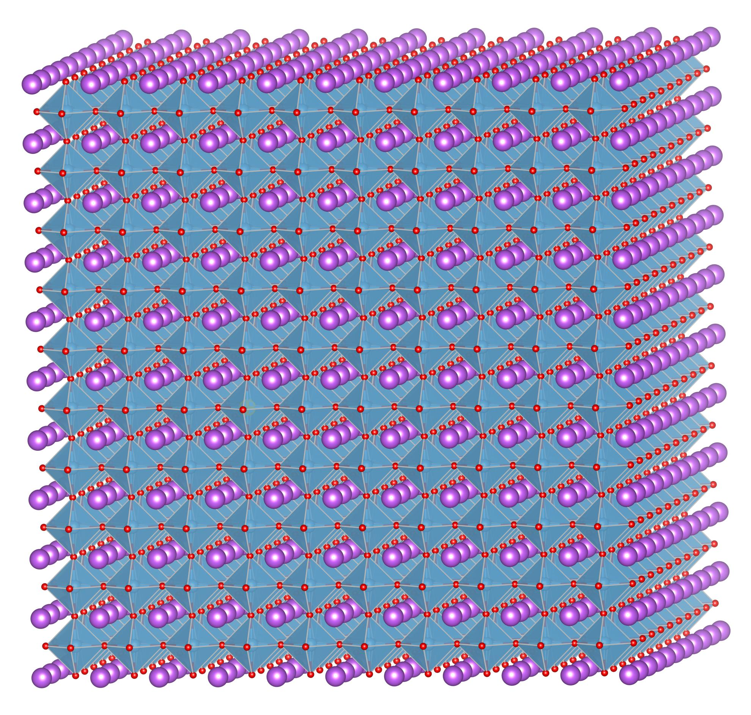
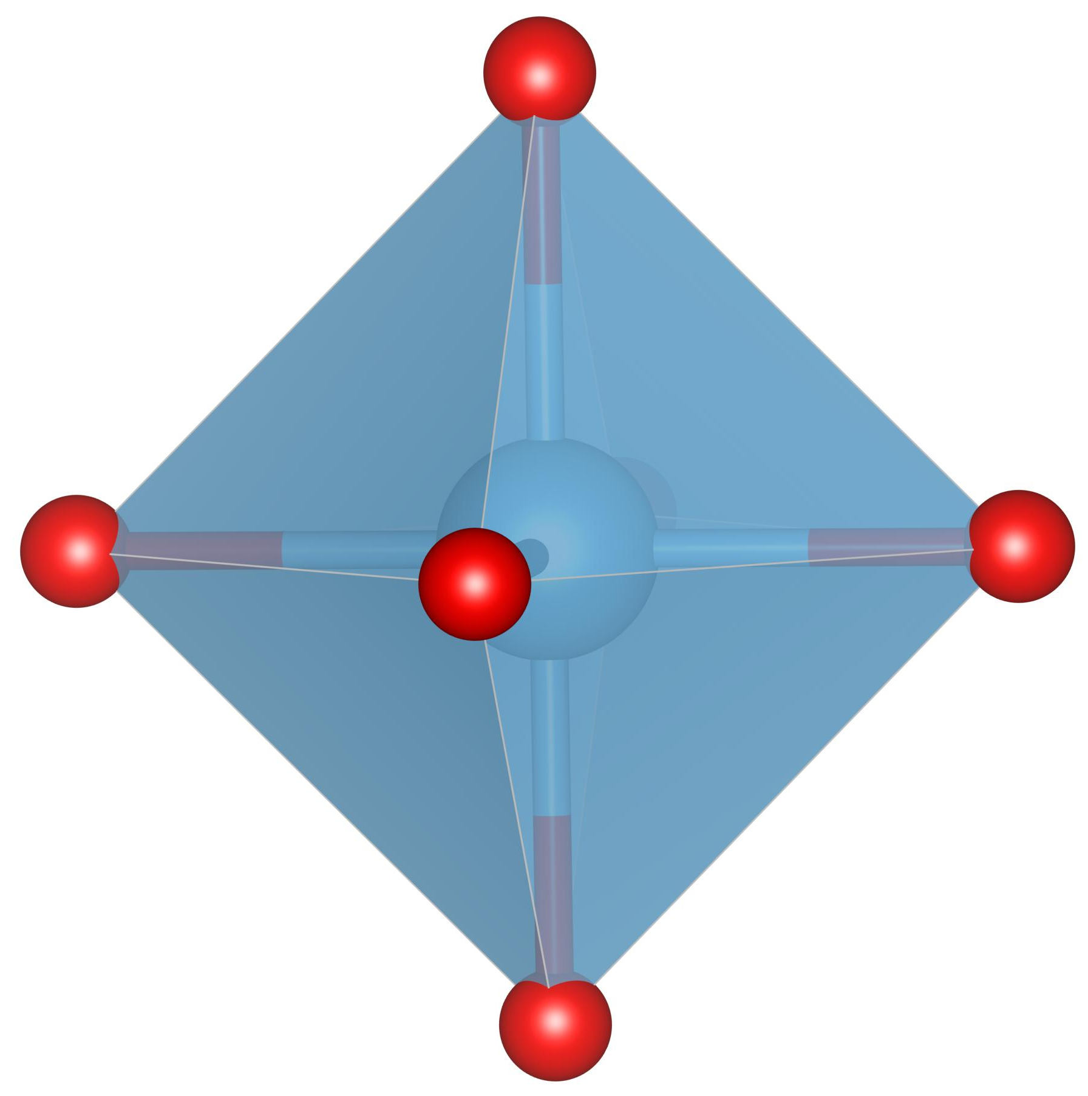
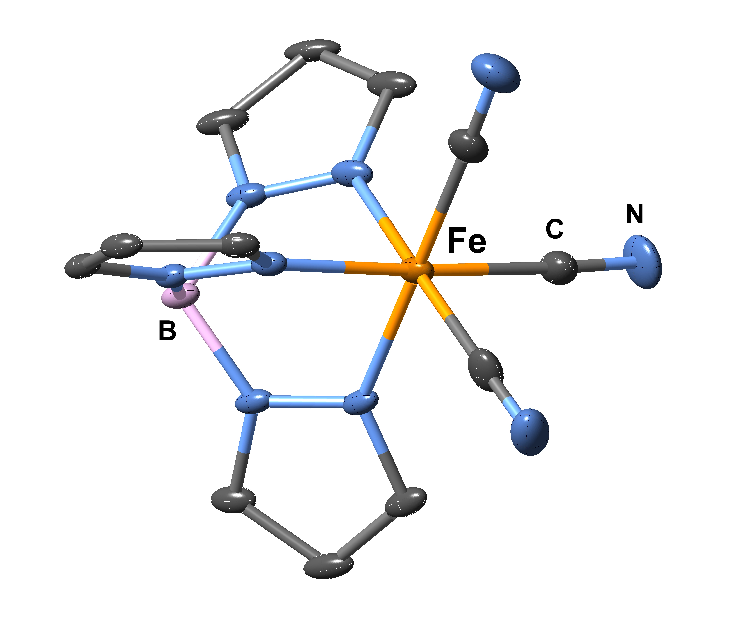
Crystal field : origin
Analogy for solid-state or coordination complex
Consider the ligands and the metal as charged spheres
Na⁺ ≈ metal ion - Cl⁻ ≈ ligand
Perovskite SrTiO₃
O²⁻
Fe³⁺
CN⁻
T^{i4+}
Tp⁻
^{Tp=tris-pyrazolyl borate}

Slide 6

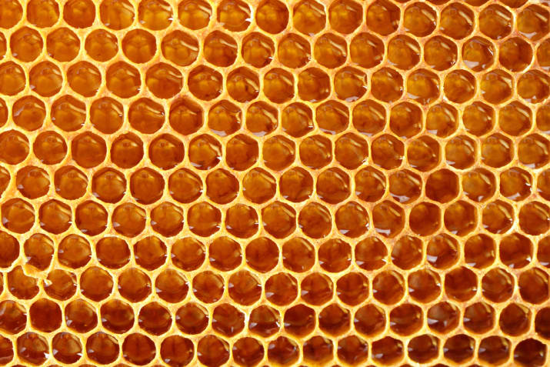

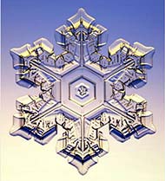
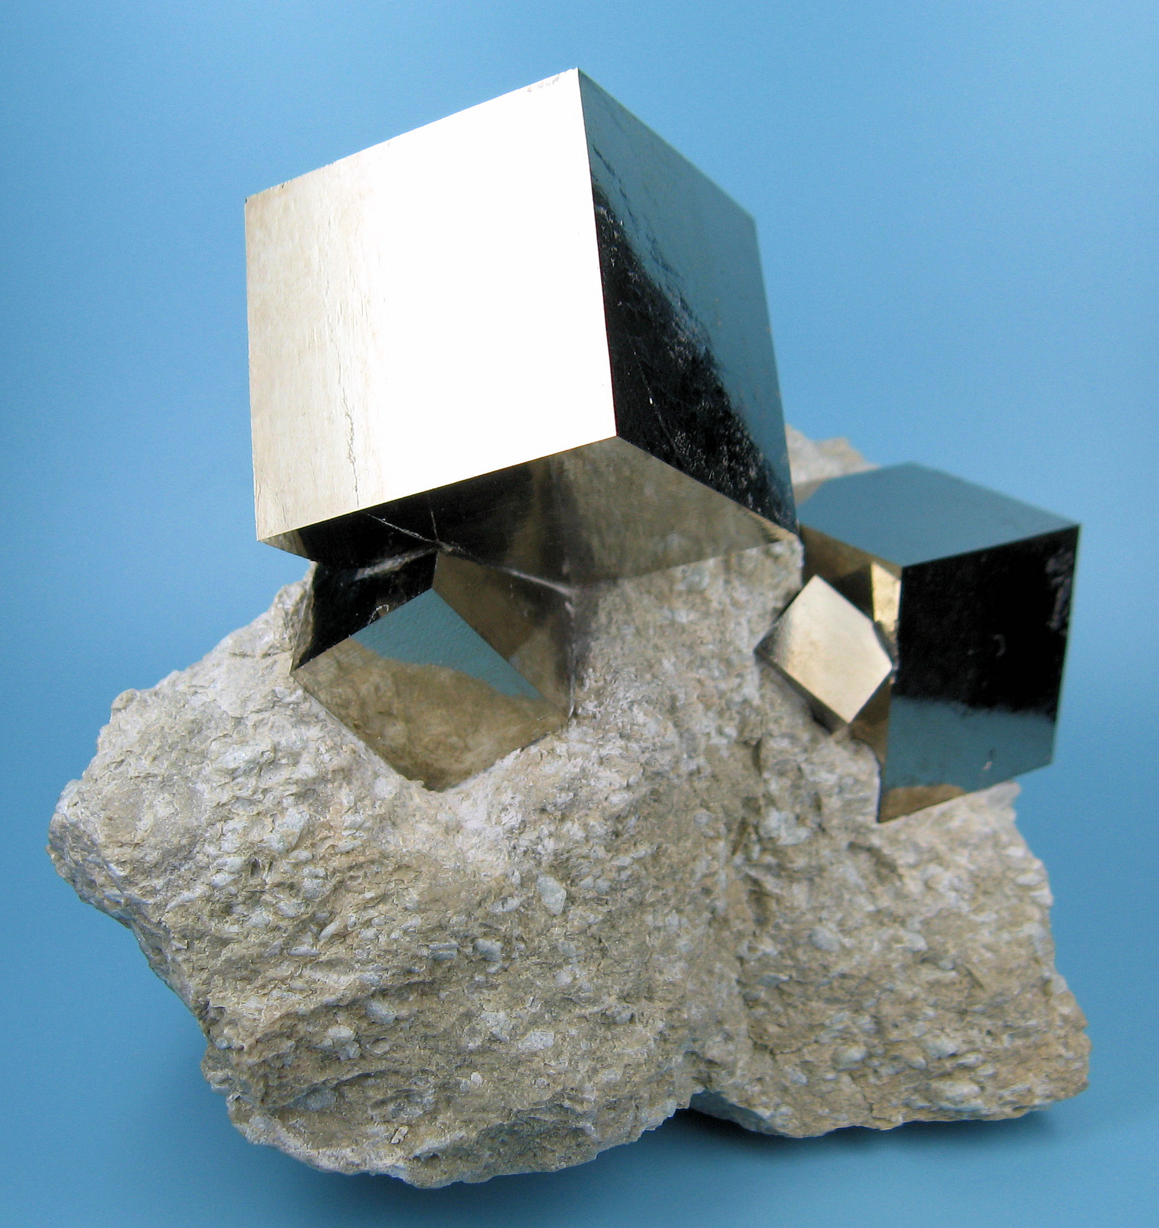

Symmetries
Symmetry is responsible for many physical and spectroscopic properties of compounds
Group theory is a powerfull tool, which not only allows one to simplify calculations, but also defines the language of labeling states and can predict without calculations if states couple under certain interactions or if certain transitions are allowed or not.
Notes:
One electron :
symmetry : small letters for notation eg, a1g

Slide 7
Symmetry operations : some notations to know
E, the identity
Cn, a rotation by an angle 2π/n;
σ reflection in a plane, classified as
  σh,reflectionthroughaplaneperpendiculartotheaxisofhighestrotationsymmetry, called principal axis
  σv, reflection through a plane to which the principal axis belongs
  σd, reflection through a plane to which the principal axis belongs, and bisecting the angle between the two-fold axes perpendicular to the principal axis.
Sn = σh ⊗Cn, improper rotation of an angle 2π/n
I = S2, the inversion.
Quanty mathematica : Quanty/guide/PointGroupSymmetry

Slide 8
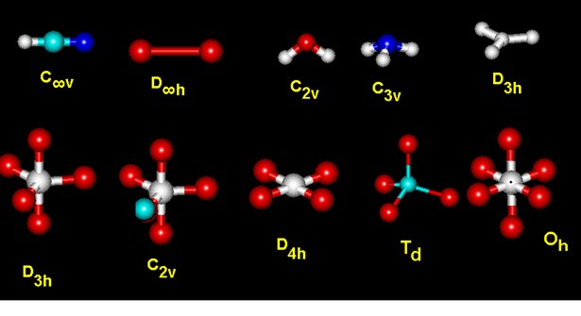
Symmetries : some point groups
Each group has a table of representations
Notes:
One electron :
symmetry : small letters for notation eg, a1g

Slide 9
Symmetries : O_{h}
O²⁻
T^{i4+}
Octahedral
Group : O_{h}
Notes:
One electron :
symmetry : small letters for notation eg, a1g

Slide 10
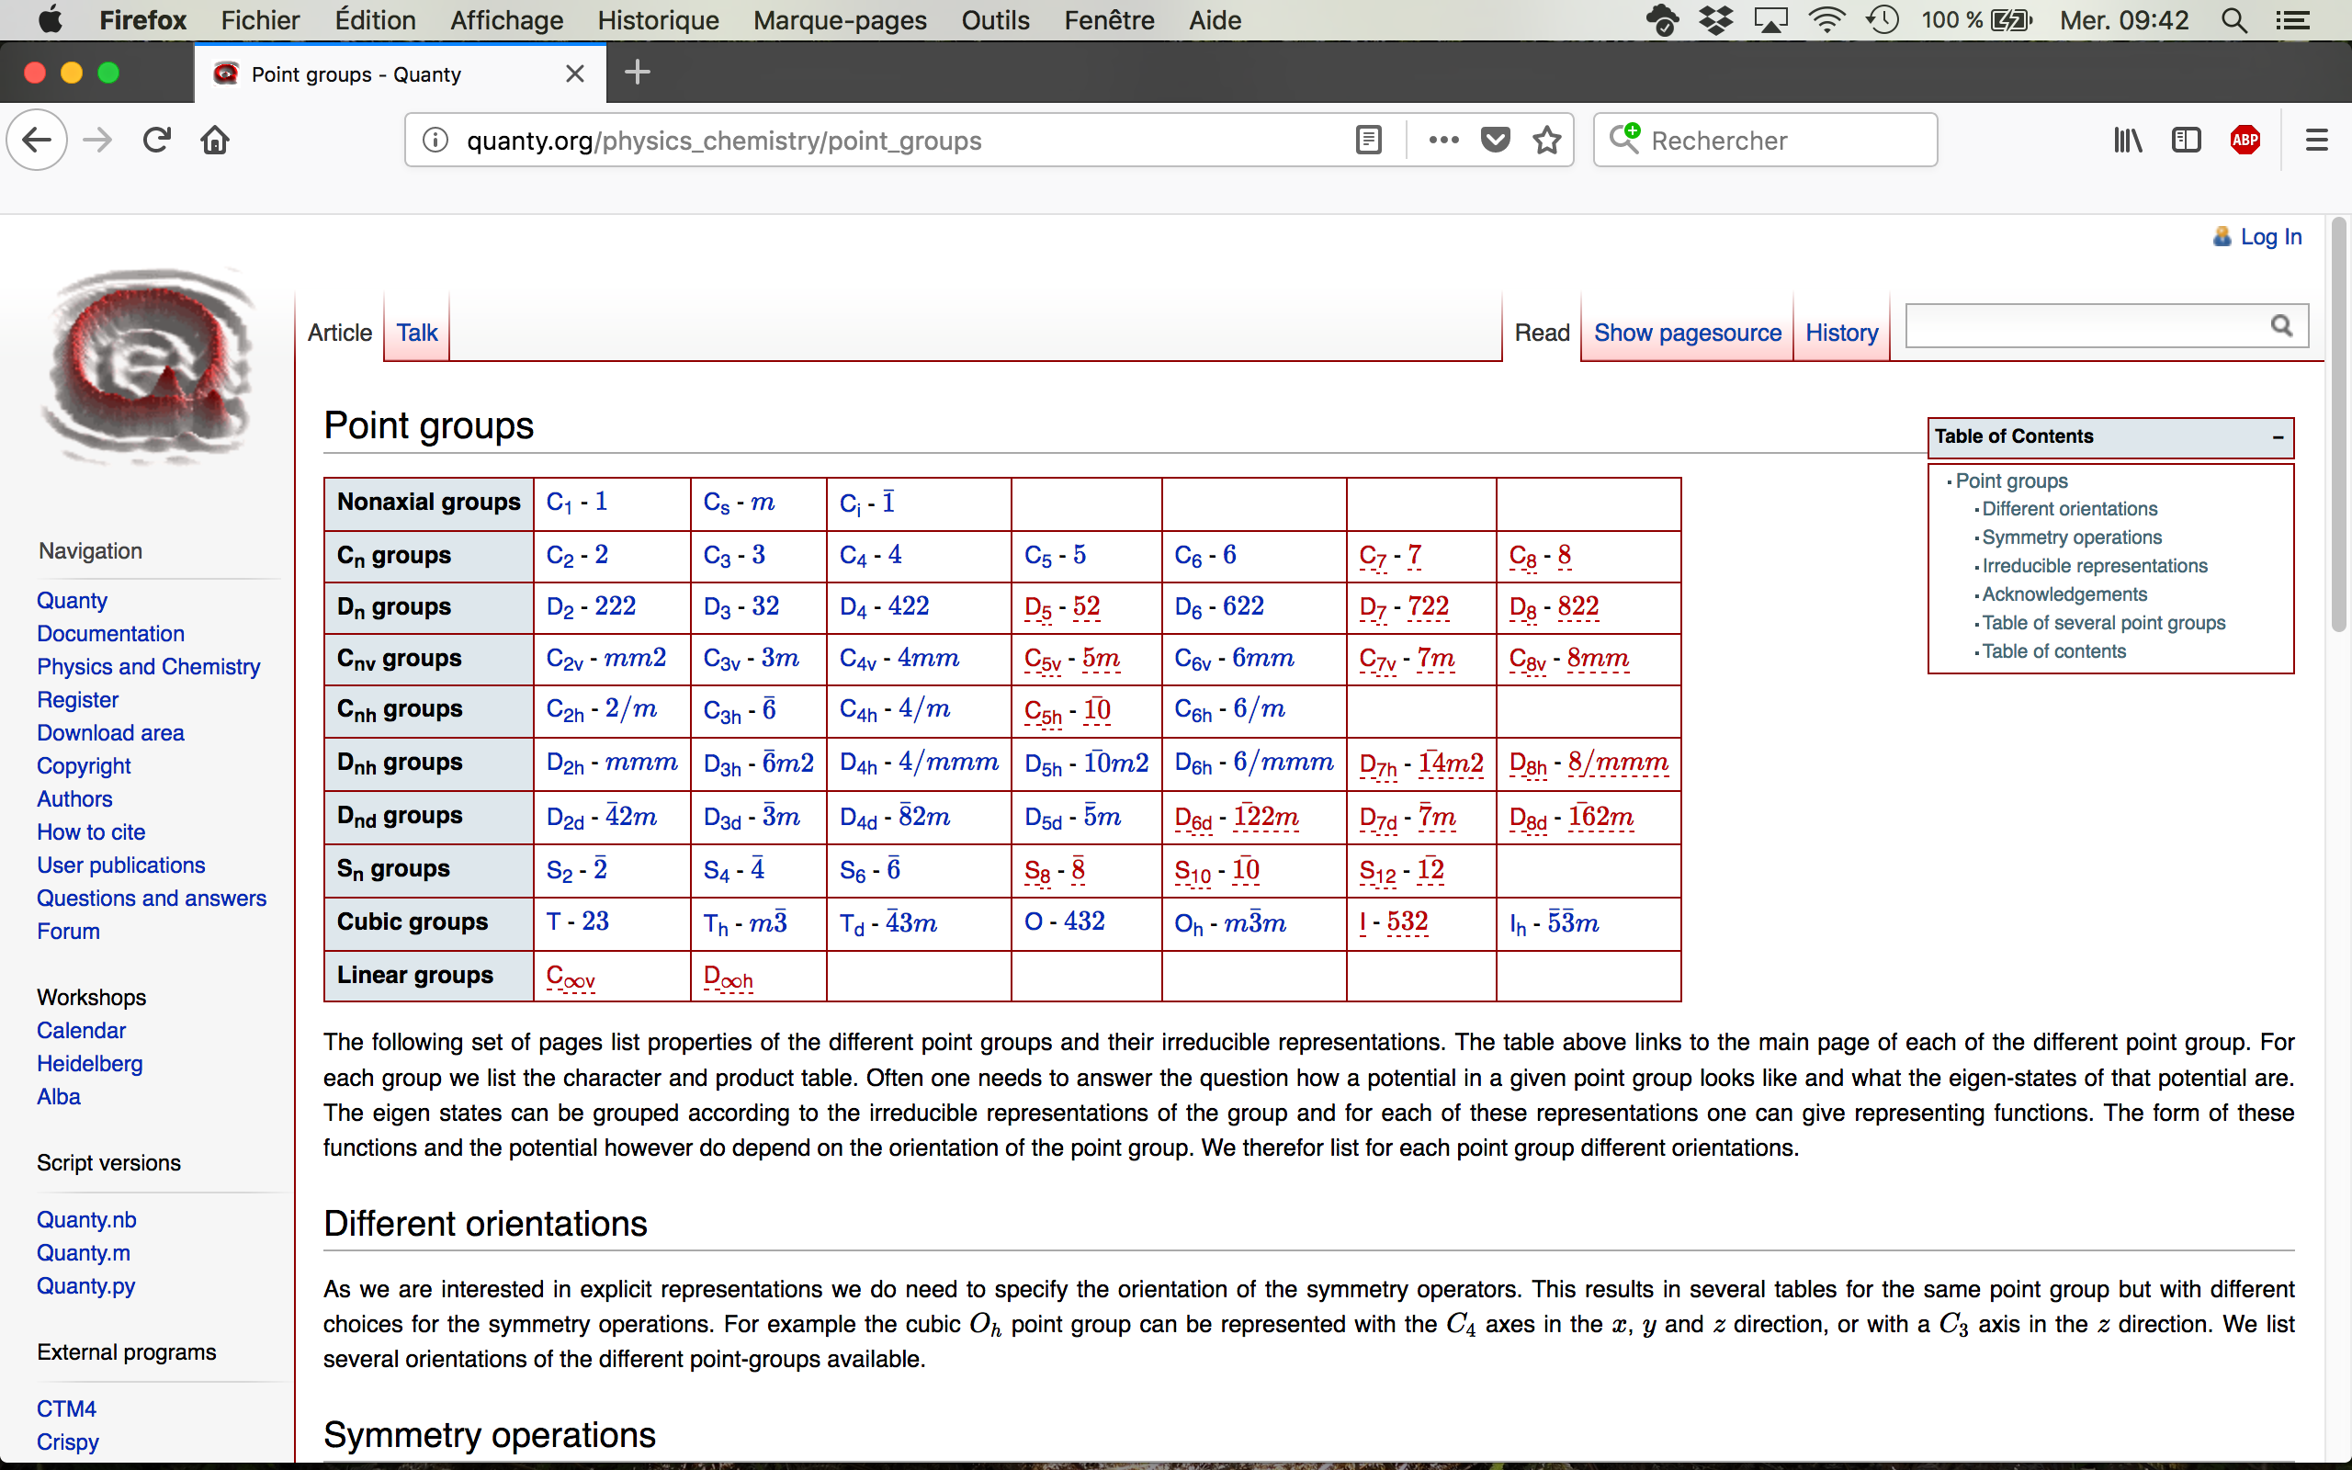
Crystal field hamiltonian and symmetry
All you need is in the web page Quanty.org
http://quanty.org/physics_chemistry/point_groups
Notes:
One electron :
symmetry : small letters for notation eg, a1g

Slide 11
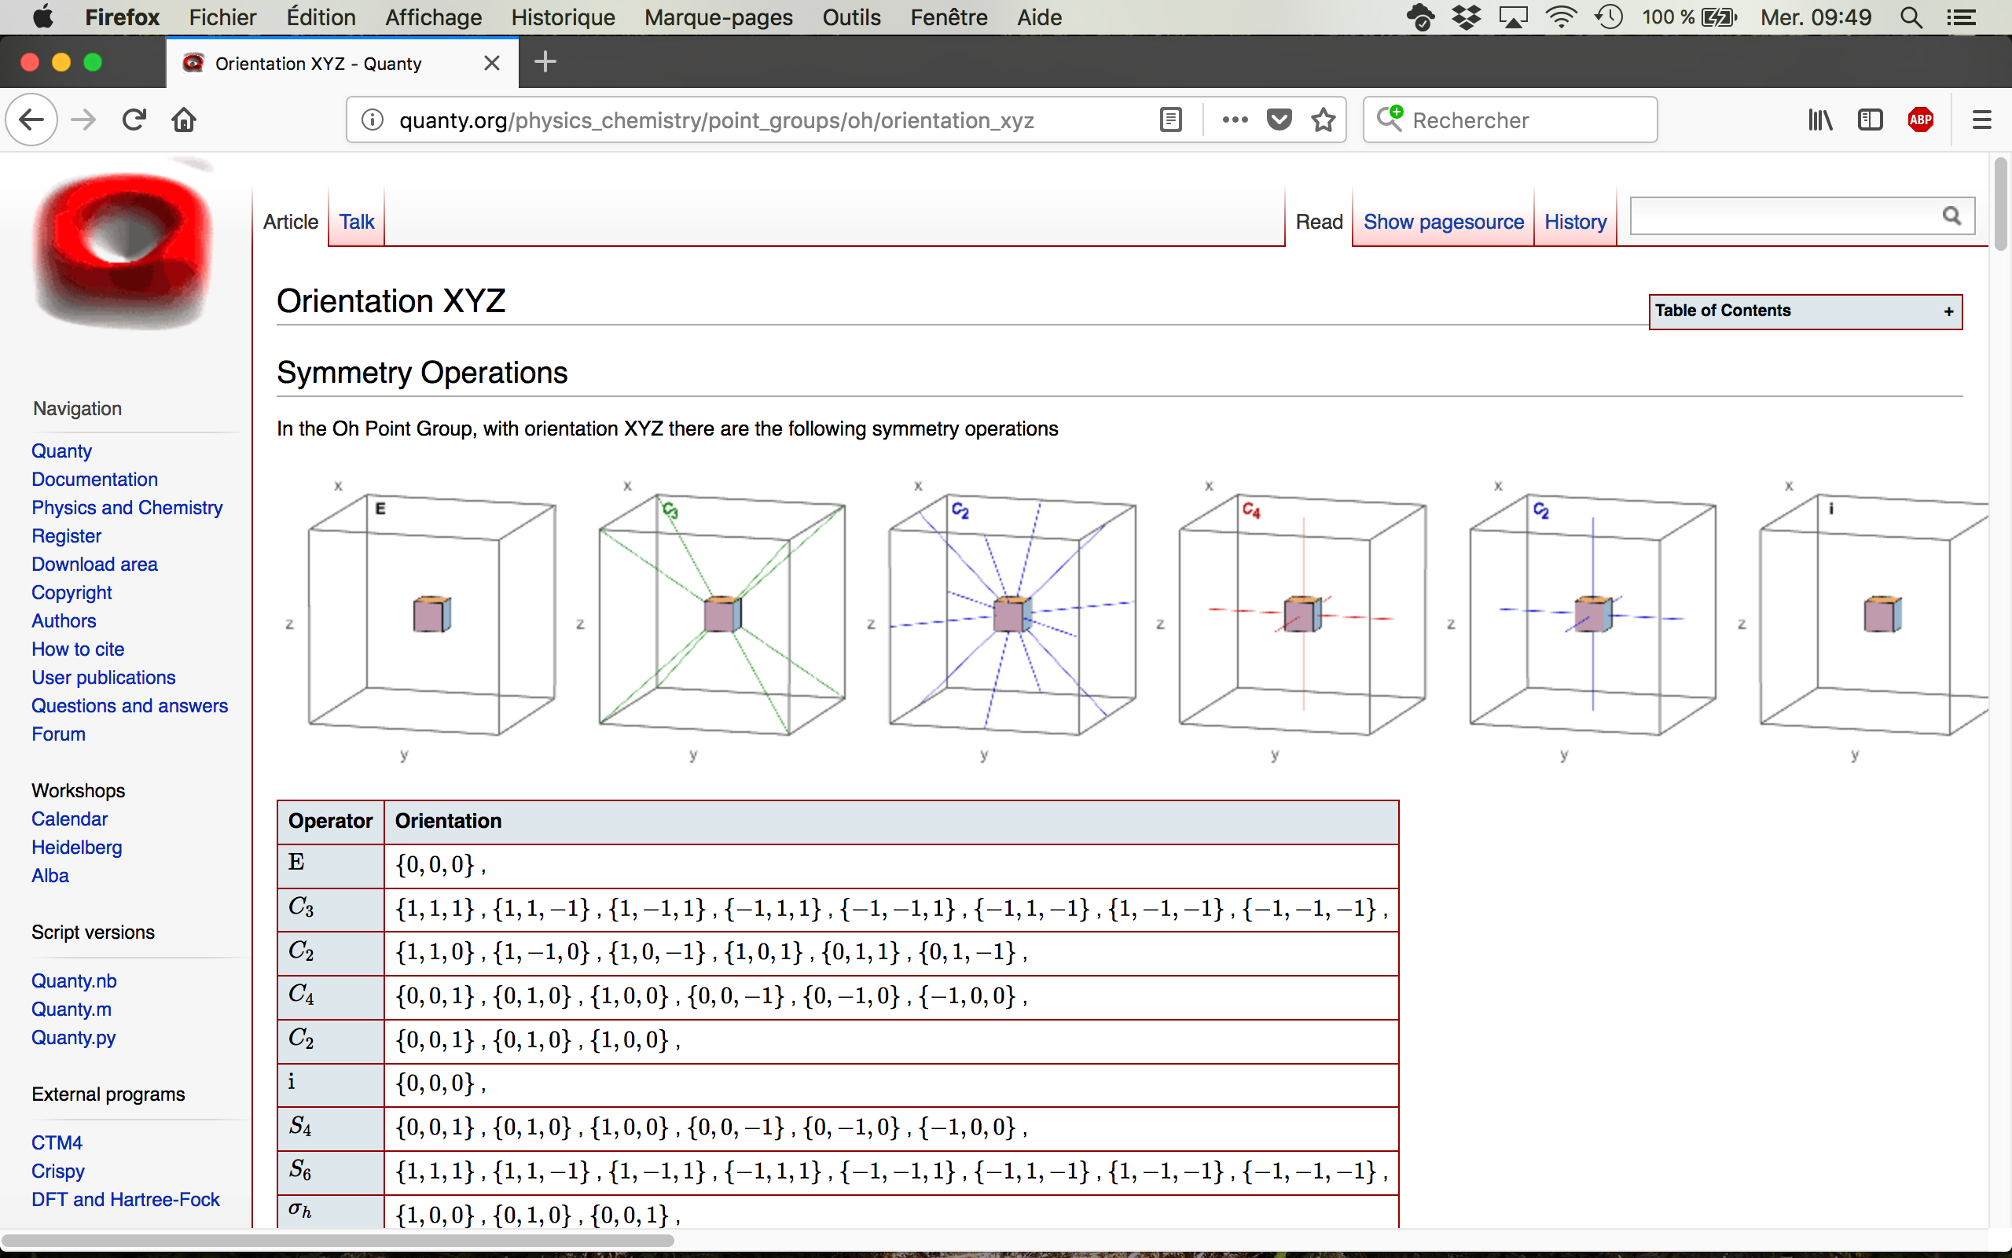
Crystal field hamiltonian and symmetry
http://quanty.org/physics_chemistry/point_groups/oh
Notes:
One electron :
symmetry : small letters for notation eg, a1g

Slide 12
Symmetries
O²⁻
Fe³⁺
CN⁻
T^{i4+}
Tp⁻
Octahedral
Group : O_{h}
Trigonal
Group : C_{3v}
Notes:
One electron :
symmetry : small letters for notation eg, a1g

Slide 13
Crystal field hamiltonian
The crystal field potential can be expanded on the normalized spherical harmonics
Notes:
One electron :
symmetry : small letters for notation eg, a1g

Slide 14
Crystal field hamiltonian
The crystal field potential can be expanded on the normalized spherical harmonics
Where to stop the expansion over k ?
➔Writing the CF matrix element on the basis functions. Depends on :
The crystal field Hamiltonian thus writes
with l the orbital momentum of the shell (2 for 3d ions, 3 for 4f ions)
(hermician hamiltonian)
Notes:
One electron :
symmetry : small letters for notation eg, a1g

Slide 15
Crystal field hamiltonian and symmetry
Not all values of A_{km} are allowed :
many are zero due to the local symmetry of the ion
Symmetry related:
For all symmetry operation (O_{i}) of the point-group G, we have
Notes:
One electron :
symmetry : small letters for notation eg, a1g

Slide 16
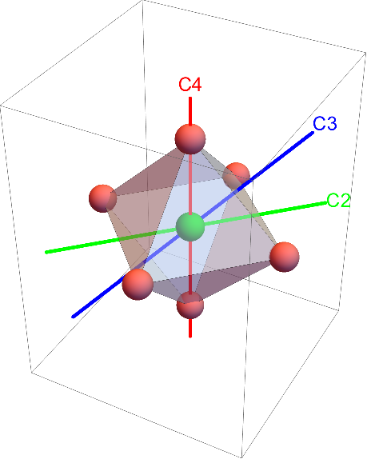
Crystal field hamiltonian and symmetry
Not all values of A_{km} are allowed : many are zero due to the symmetry around the ion
For all symmetry operation (O_{i}) of the point-group G,
Example : O_{h} symmetry
O_{i}
Only one non-zero A_{km} : A₄₀
http://quanty.org/physics_chemistry/point_groups/oh
Notes:
One electron :
symmetry : small letters for notation eg, a1g

Slide 17
Notations for crystal field parameters
The notations vary a lot from an author to the other
(Haverkort/QUANTY)
And symmetry dependent parameters like (Balhausen, König, Kremer,..)
10Dq for cubic
{10Dq, Ds, Dt} for tetragonal symmetry D4h
…. etc.
Notes:
One electron :
symmetry : small letters for notation eg, a1g

Slide 18
Crystal field
Introduction / Definition
One electron (3d electron)
  Symmetries
  Hamiltonian
  Crystal field splitting of one 3d electron
Multi-electrons ion (3d electrons)
  The spherical ion :
  Crystal field
  Core hole spectroscopy : examples
Crystal field and magnetism
  Hamiltonian
  Magnetic moment (spin and orbit)
  Zeeman effect / paramagnetism
Notes:
One electron :
symmetry : small letters for notation eg, a1g

Slide 19
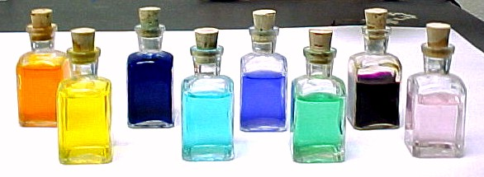
3d transitions metal ions
In material made of 3d transitions metal ions, a lot of physico-chemical properties are due to the crystal field
For example
Color
Magnetic properties
Ni²⁺
Notes:
One electron :
symmetry : small letters for notation eg, a1g

Slide 20
One electron function : Orbital
Basis of atomic orbitals
^{Radial part}
^{Spin part}
^{Angular part}
^{Spherical harmonics}
Notes:
One electron :
symmetry : small letters for notation eg, a1g

Slide 21
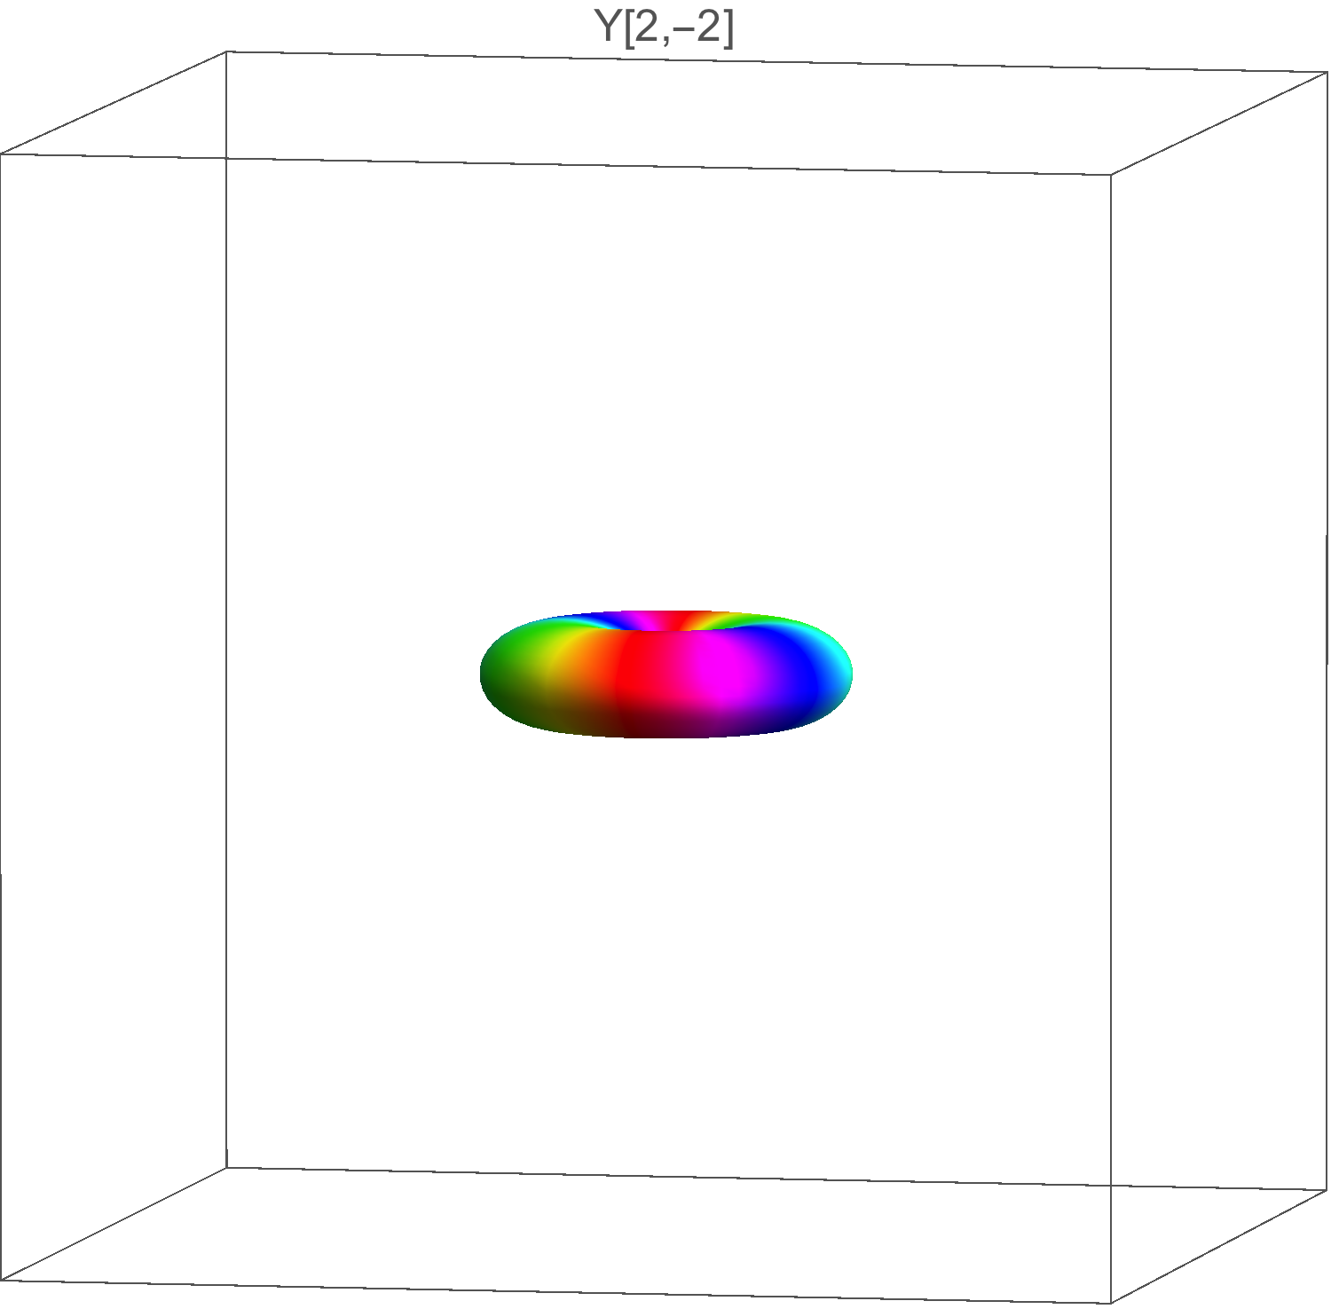
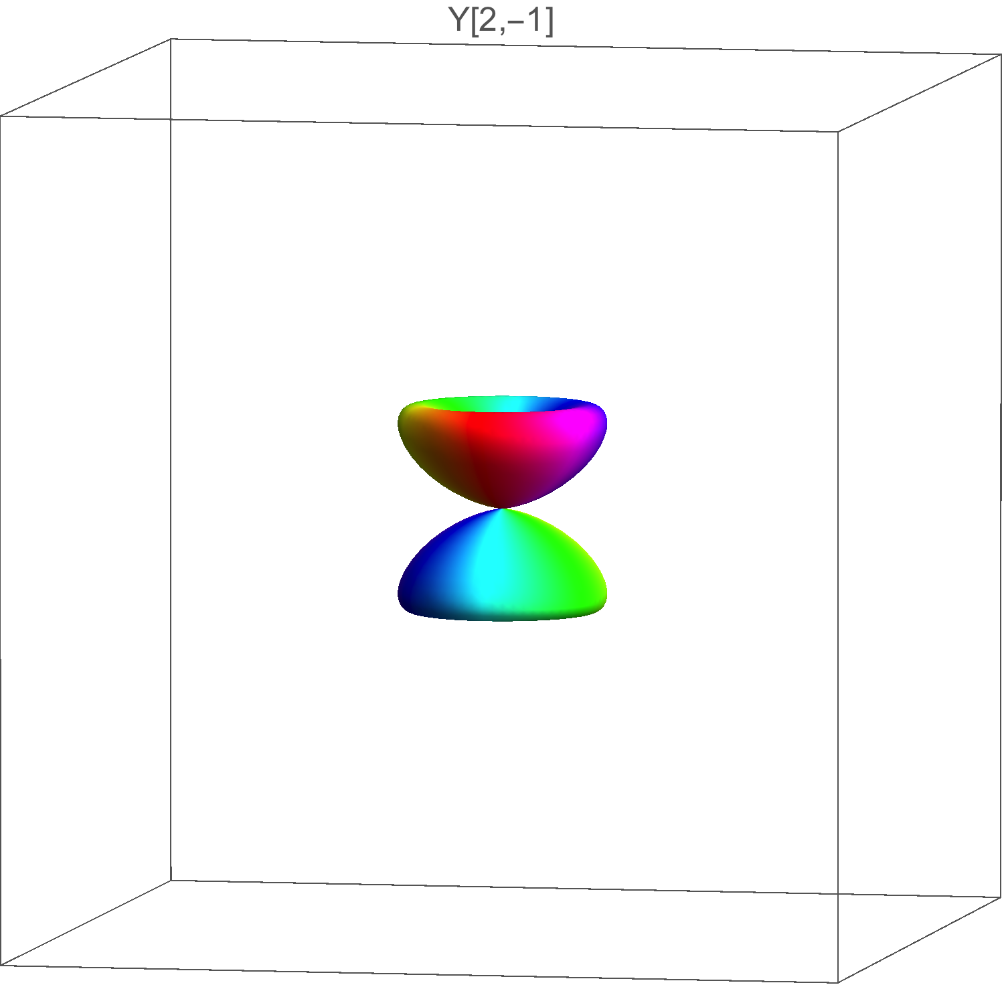
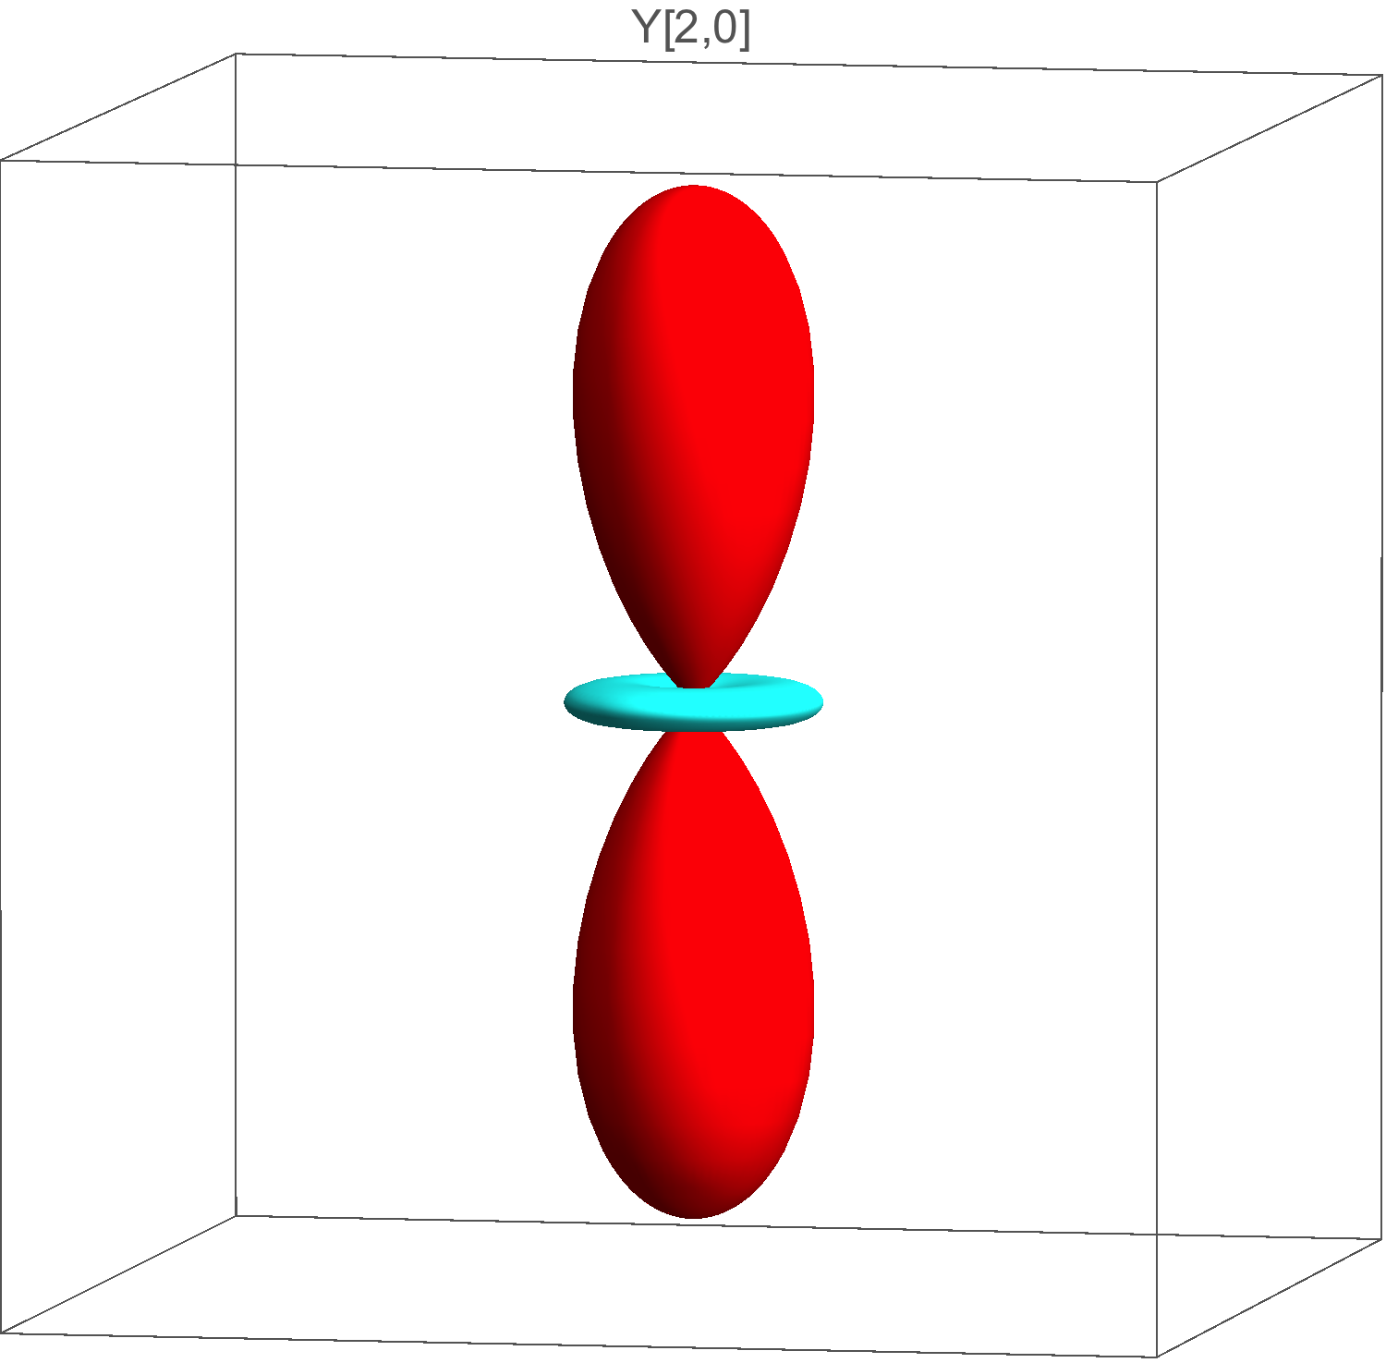
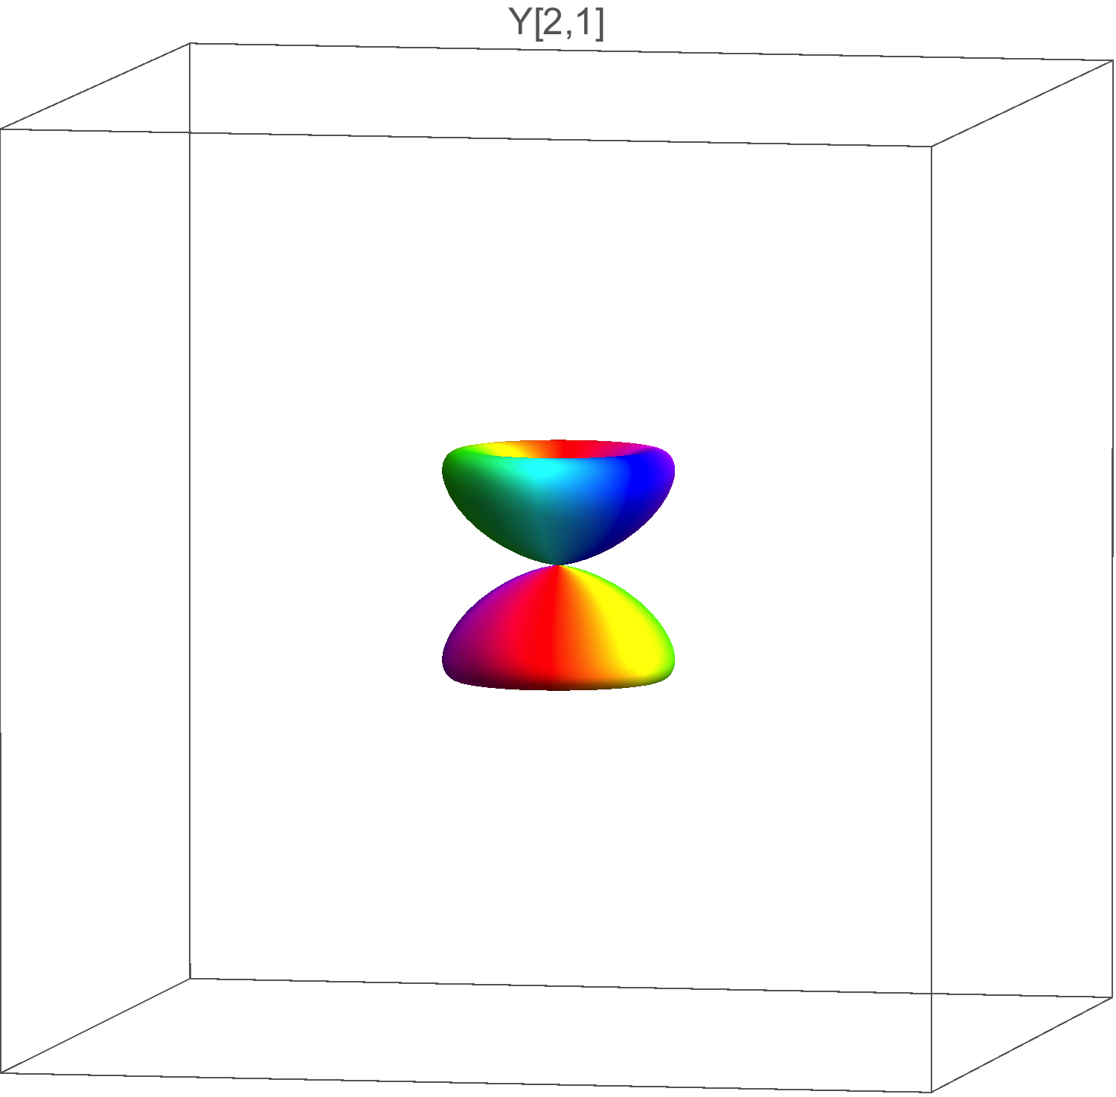
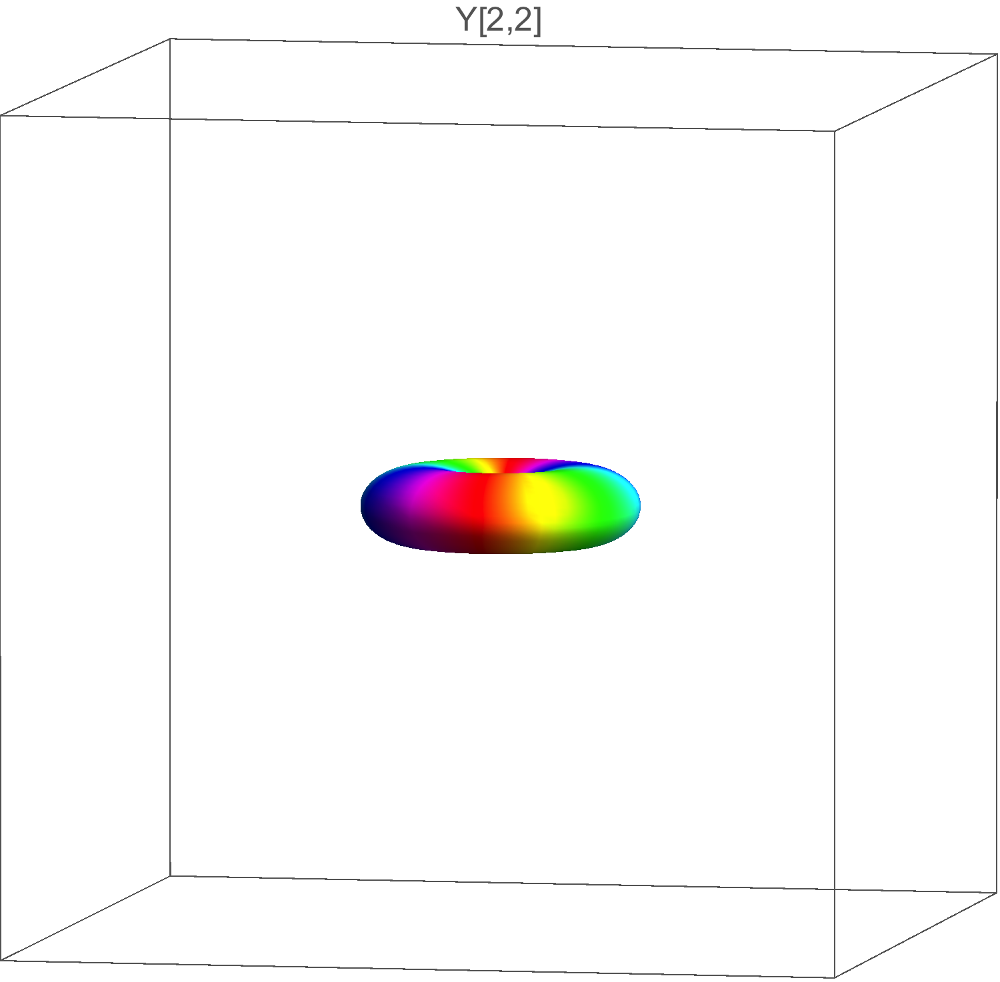
3d atomic orbitals
Basis of atomic orbitals
3d shells : n=3, l=2 2l+1=5 basis functions ( -2 ≤ l ≤ 2 )
3d orbitals are real functions, linear combination of
z
y
x
Notes:
One electron :
symmetry : small letters for notation eg, a1g

Slide 22
O_{h} crystal field splitting of 3d electron
Matrix elements
CF matrix in {Y_{2,m}} basis=
Diagonalization
O_{h} crystal field splits the d orbitals in two groups of orbitals
Notes:
One electron :
symmetry : small letters for notation eg, a1g

Slide 23
O_{h} Crystal field splitting of 3d electron
Use of group symmetry
From the Oh group properties, one could have guessed the splitting of the d orbitals
d orbitals are called e_{g} and t_{2g} *
^{(*)}N.B. : lower case letter (e_{g} and t_{2g}) for one electron
Notes:
One electron :
symmetry : small letters for notation eg, a1g

Slide 24
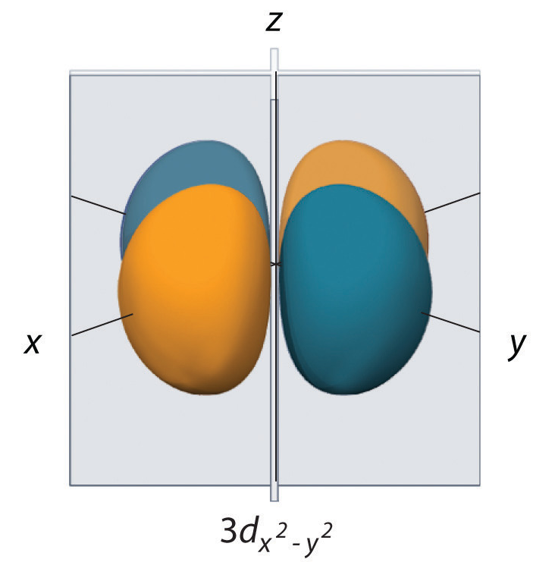
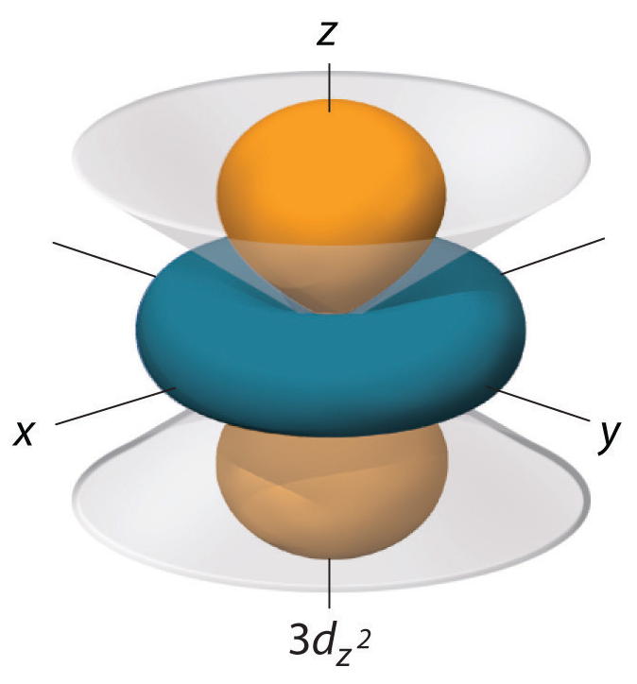
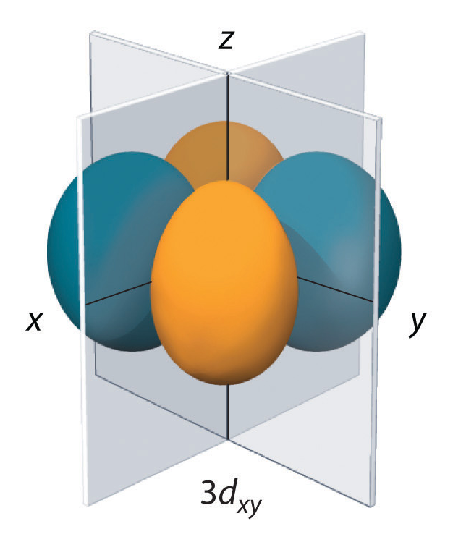
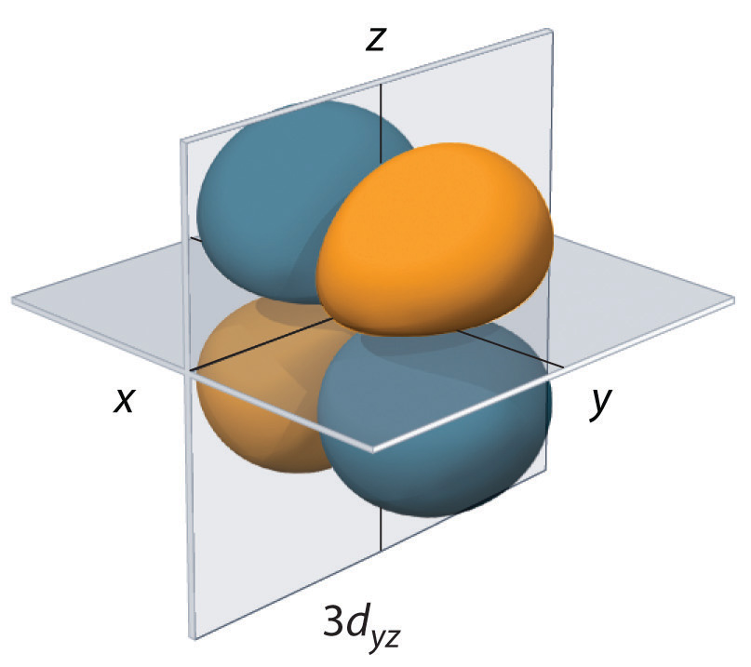
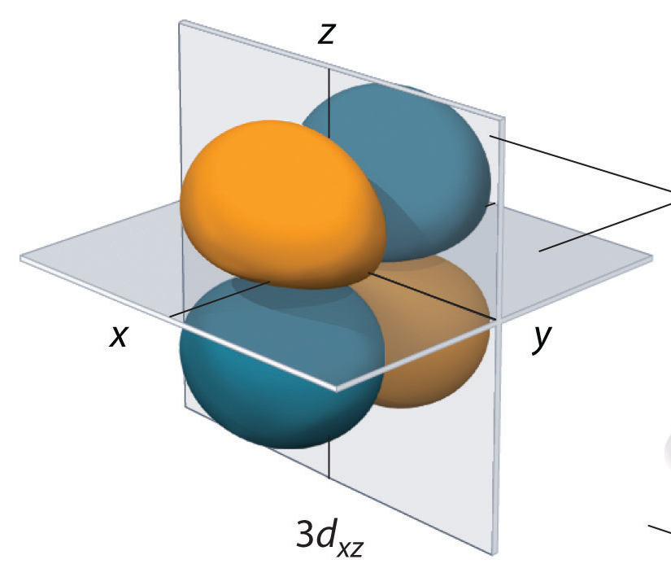
O_{h} Crystal field splitting of 3d electron
Parameters
From diagonalization
Towards the ligand : destabilized
Towards the ligand :
stabilized
adjustable parameter
In QUANTY, the A_{k,m} are defined in function the orbital energies (can be modified)
Notes:
One electron :
symmetry : small letters for notation eg, a1g

Slide 25
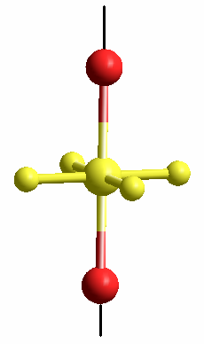
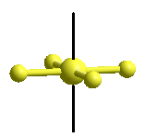
Tetragonal (D_{4h}) crystal field splitting of 3d electron
D_{4h}
Square planar
Elongated
or compressed O_{h}
along C₄ axis
From the D4h table, one can predict the 3d splitting in 4 groups
Notes:
One electron :
symmetry : small letters for notation eg, a1g

Slide 26
Tetragonal (D_{4h}) crystal field splitting of 3d electron
The CF matrix is diagonal in the {d} basis and the energies are :
with
The relation with Dq,Ds,Dt can be found in the book of König&Kremer « Ligand field. Energy diagram »
Notes:
One electron :
symmetry : small letters for notation eg, a1g

Slide 27
Tetragonal (D_{4h}) crystal field splitting of 3d electron
O_{h}
D_{4h} (elongation)
10Dq
10Dq
Notes:
One electron :
symmetry : small letters for notation eg, a1g

Slide 28
Crystal field hamiltonian in QUANTY
1) Pre-defined CF potential
Akm = PotentialExpandedOnYlm("Oh",2,{0.6,-0.4});
OpptenDq = NewOperator("CF", NFermion, dIndexUp, dIndexDn, Akm);
The Oh potential is defined by:
1) User made CF potential: Akm=
Akm = {{4,0,21/10},{4,-4,21/10sqrt(5/14)}, {4,4,21/10sqrt(5/14)}};
OpptenDq = NewOperator("CF", NFermion, dIndexUp, dIndexDn, Akm);
The parameter is 10Dq and the hamiltonian writes
Notes:
One electron :
symmetry : small letters for notation eg, a1g

Slide 29
Crystal field
Introduction / Definition
One electron (3d electron)
Multi-electrons ion (3d electrons)
  The spherical ion :
    Configuration
    Hamiltonian
    |(L,S),J> basis function
    Spectroscopic terms
  Crystal field
    Basis functions, hamiltonian and matrix element
    Energy diagram (Tanabe-Sugano)
  Core hole spectroscopy : examples
    Spin cross-over
    The limit of the crystal field model : towards ligand field
Crystal field and magnetism
Notes:
One electron :
symmetry : small letters for notation eg, a1g

Slide 30
Multi-electrons ions : configuration
Example of term splitting
Electronic configuration: complete simplified (open shell)
3d transition metal ions 1s²2s²2p⁶ 3d^{n} 3d^{n}
4f rare earth ions 1s²2s²2p⁶3s²3p⁶3d¹⁰ 4f^{n} 4f^{n}
Many possibility of filling of the 3d orbitals
2l+1=5 |l,m_{l}> angular functions
2s+1=5 |sm_{s}> spin functions
Nb states = C^{n}₁₀ =
Degeneracy = multiplets
10 functions
Example of a d² system (V³⁺, Cr⁴⁺) :
degenerate states : C²₁₀ = 45
Some possibilites:
m_{l}=-2 -1 0 1 2

Slide 31
Multi-electrons ions configuration and symmetry
d² ion in O_{h} symmetry
e_{g}
t_{2g}
Orbital degeneracy
Spin degeneracy
3
1 (S=0)
6
1 (S=0)
3x2=6
3 (S=1)
3x2=6
1 (S=0)
Notes:
One electron :
symmetry : small letters for notation eg, a1g

Slide 32
Hamiltonian of the ion with N electrons
H_{ion} = H_{cin} + H_{e-n} + H_{e-e} + H_{s-o} + H_{CF}
Free ion (spherical)
Crystal field
Total kinetic energy
Coulomb attraction nuclei-electrons
Electron-electron Coulomb repulsions
Spin-orbit coupling

Slide 33
Hamiltonian of the ion with N electrons
Basis functions |Ψ>
Multi-electron functions for N electrons
Ψ(r₁,r₂,...,r_{N})
Linear combination of Slater determinant built from the mono-electronic functions
Anti-symmetric function to satisfy the Pauli principle

Slide 34

Ion with N electrons : operators
!
Sum is coupling
!
somme ⇒ couplage d’opérateurs

Slide 35
Free ion with N electrons : basis functions
Fonctions |α(L,S)JM_{J}>
Common eigenfunctions with
H_{cin}+H_{e-n}+H_{e-e}+H_{s-o} commute with
(H_{cin}+H_{e-n}+H_{e-e} commute with )
The energy of |α(L,S) > does not depend on M_{L,} M_{S}
Degeneracy of |α(L,S)> = (2L+1)(2S+1)
The energy of |α(L,S)JM_{J}> does not depend on M_{J}
Degeneracy of |α(L,S)JM_{J}> = 2J+1
Spectroscopic terms |α(L,S)JM_{J}> =
^{2S+1} L_{J}
S spin
letter for L
Γ=S pour L=0
Γ=P pour L=1
Γ=D pour L=2
Γ=F pour L=3
35

Slide 36
Free ion : spectroscopic terms for 3d² ion
Split the 5 LS terms into 9 (L,S)J terms :
*only diagonal energy corrections here (neglect off diagonal coupling with other LS terms)
Landé interval rule
Ground state given by
Third Hund’s rule
Notes:
One electron :
symmetry : small letters for notation eg, a1g

Slide 37
Crystal field : basis function
Basis functions
Spherical symmetry:
|α(L,S) J M_{J}>
Local symmetry around the ion → point group G:
Basis functions of the representations of group G
|α(L,S) J Γ γ >
Γ irreducible representation of G
Γγ basis function of G
Thole’s code uses group theory and the {Γ} basis (TTMULT, CTM4XAS)
QUANTY
  uses group theory only for crystal field potential building
  does not use the {Γ} basis
  uses {Γ} to label the states (spectroscopic terms)
Notes:
One electron :
symmetry : small letters for notation eg, a1g

Slide 38
Crystal field and group theory
Free ion
O₃ is the group of the sphere
|α(L,S) J M_{J}> partners of irrep* J of O₃
Ion in solid/molecule
G is the subgroup of the sphere
|a(L,S) J Γ γ > partners of the irrep* Γ of G
Hamiltonian expanded on C_{k,m}
Hamiltonian expanded on C_{k,m}
and invariant over the symmetry operation of G
Ex: O_{h} symmetry
* irrep=irreducible representation
Notes:
One electron :
symmetry : small letters for notation eg, a1g

Slide 39
Crystal field and group theory
Matrix elements
(fully symmetric representation of group G)
* g only for centro-symmetric group
if
Crystal field mixes J states if
Notes:
One electron :
symmetry : small letters for notation eg, a1g

Slide 40
Ex: d¹ (d⁹) ion in O_{h} symmetry
Orbitals
O₃
O_{h}
e_{g}
e_{g}
t_{2g}
t_{2g}
L=2
S=1/2
J=3/2,5/2
²T_{2g}
²E_{g}
States (spectroscopic terms)
U’
²E_{g}
²D_{5/2}
²D
E’’
²T_{2g}
²D_{3/2}
U’
O₃
O_{h}
O_{h}
+ spin-orbit
O₃
+spin-orbit
J states mixed by CF and SO

Slide 41
Crystal field and group theory
Example of d² ion in O_{h} symmetry
Crystal field splitting of the ground state
From the group branching table (Butler)
e_{g}
t_{2g}
45 states
e_{g}
t_{2g}
Free ion
O₃
e_{g}
O_{h}
t_{2g}
!
(spin-orbit omitted for simplicity)
O_{h}
strong field
Simplified
orbital scheme
From the multi-electronic state, one can get the electron density on the orbitals of the group (it is not necessary integer)
Notes:
One electron :
symmetry : small letters for notation eg, a1g

Slide 42
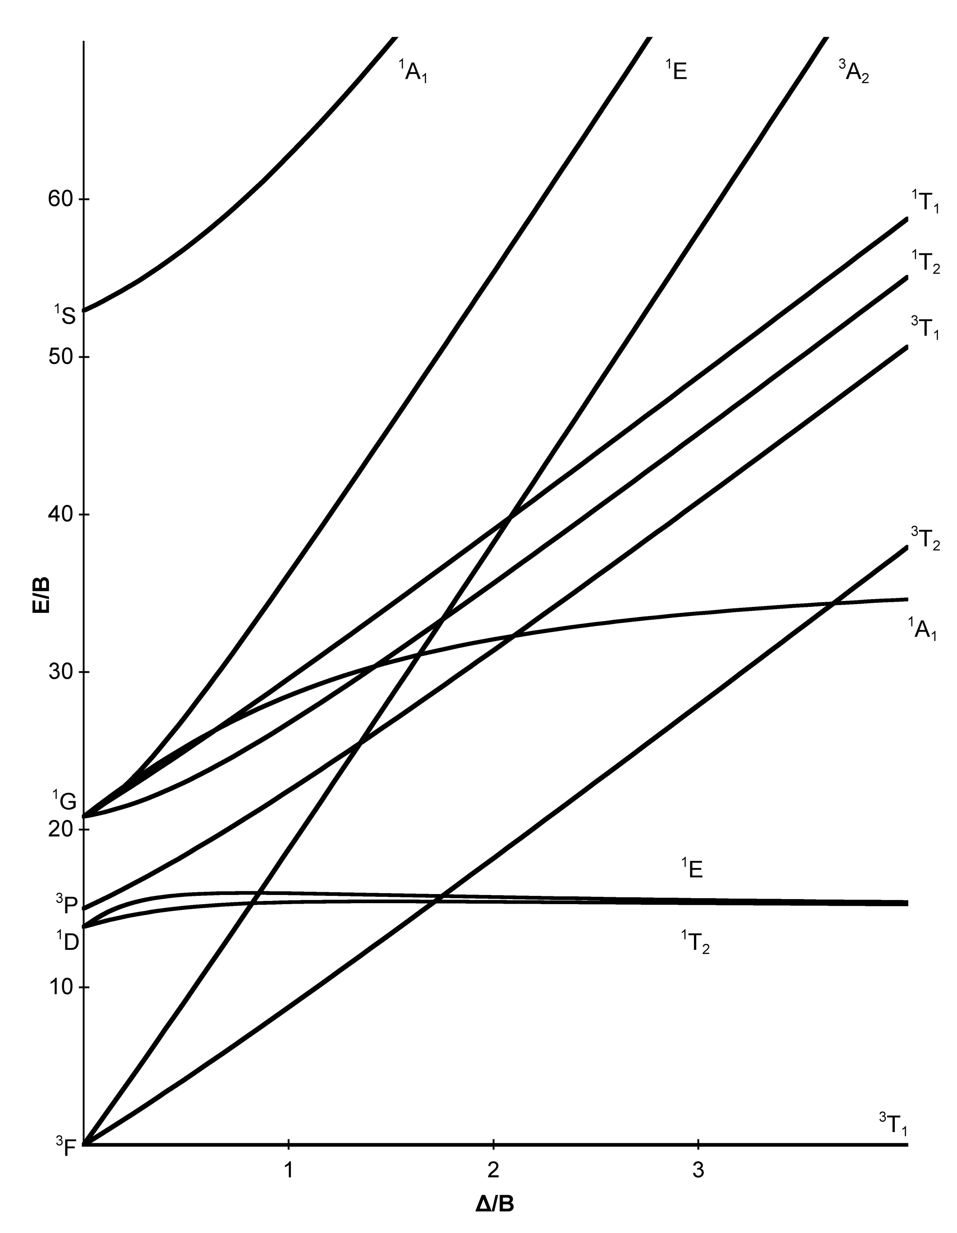
Crystal field : energy diagram
Plot of the energy of spectroscopic terms
as function of crystal field parameter (10Dq,Ds,…) (and B Racah parameter (*))
Tanabe-Sugano diagram (1954) König&Kremer (≈1970)
O_{h}(T_{d}) , no spin-orbit Low symmetries+spin-orbit
³A_{2g}
d²
³T_{2g}
³T_{1g}
³F
(*)B Racah parameters related to the slater integrals (electronic repulstions)
Notes:
One electron :
symmetry : small letters for notation eg, a1g

Slide 43
Crystal field : energy diagram
Plot of the energy of spectroscopic terms
as function of crystal field parameter (10Dq,Ds,…) (and B Racah parameter (*))
Tanabe-Sugano diagram (1954) König&Kremer (≈1970)
O_{h}(T_{d}) , no spin-orbit Low symmetries+spin-orbit
Tutorial Monday afternoon :
02_Energy_Level_Diagram_Tanabe-Sugano.Quanty
Notes:
One electron :
symmetry : small letters for notation eg, a1g

Slide 44
Crystal field : multi-electron and orbitals
Multi-electron ions
One electron/orbitals
Spectroscopic terms :
Term written with capital letter in Müliken notation. Ex :
or Koster notation :
Electron density / orbitals
ex :
L,S,J,M_{L},M_{S},M_{J} not « good » quantum numbers.
Expectation values:
Orbitals :
Small letter
ex:

Slide 45
Multiplet, crystal field applied to core hole spectroscopies
Calculations including the core-hole (ex : 2p⁵3d^{n+1}, 3d⁹4f^{n+1},…) and many kind of transitions (electric dipole, magnetic dipole…)
RACAH/BANDER, Thole’s code : core of CTM4XAS (Frank de Groot)
Based on group theory (Butler “Point group symmetry applications”)
Difficult to modified and adapt to new spectroscopies since Theo Thole died in1996
QUANTY, Haverkort’s code
Flexible for the need of the new spectroscopies/physical properties
Notes:
One electron :
symmetry : small letters for notation eg, a1g

Slide 46
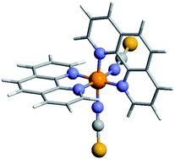
Example of crystal field : spin crossover
spin crossover
a well known crystal field effect
intensively studied and observed with many different spectroscopies and magnetic measurements
Ex : XAS at L_{2,3} edges
Fe^{II}(phen)₂(NCS)₂
T = 300K S = 2
High spin
T = 77K S = 0
Low spin
Absorption (a.u)
L₃
L₂
Notes:
One electron :
symmetry : small letters for notation eg, a1g

Slide 47
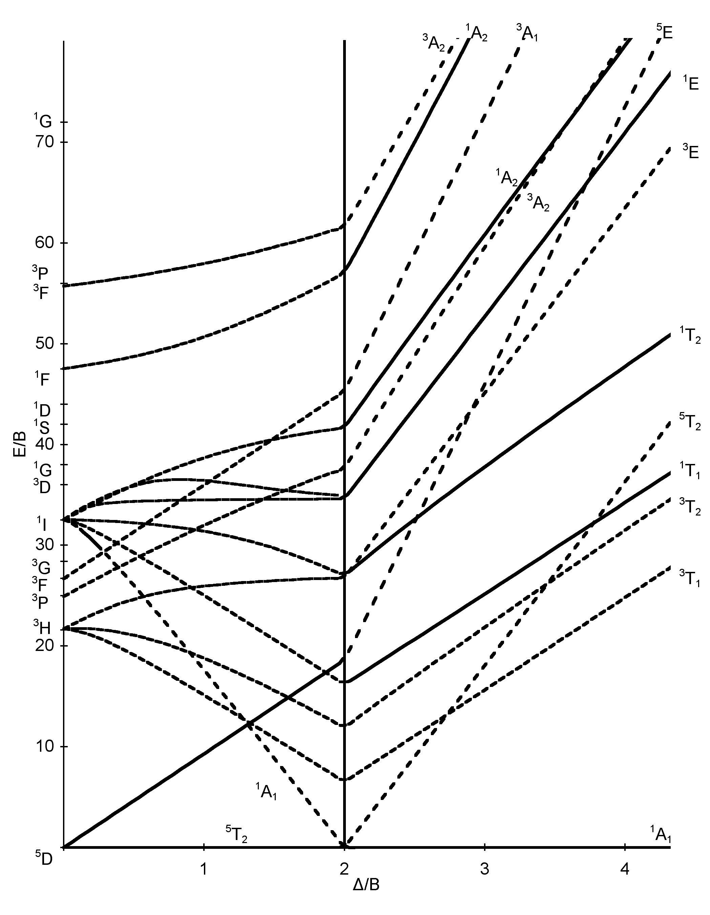
Crystal field effect : spin crossover
Fe²⁺ ion (3d⁶) in O_{h} symmetry
When 10Dq increases, the ground state changes
e_{g}
e_{g}
Energy/B
t_{2g}
t_{2g}
S=2
High spin
S=0
Low spin
10Dq
The magnetic properties goes from paramagnetic to non-magnetic
Good candidate for many applications like molecular spintronic
Notes:
One electron :
symmetry : small letters for notation eg, a1g

Slide 48
Crystal field effect : spin crossover
XAS at Fe L_{2,3} edges (2p->3d)
Fe²⁺ ion (3d⁶) in O_{h} symmetry
e_{g}
Experiment
Calculations
t_{2g}
10Dq=1eV
S=2
High spin
10Dq=2.2eV
e_{g}
When 10Dq increases, the ground state changes
t_{2g}
S=0
Low spin
Notes:
One electron :
symmetry : small letters for notation eg, a1g

Slide 49
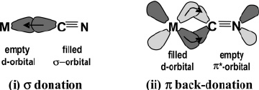
Limit of the crystal field model: towards ligand field model
Example : prussian blue analogues
Cs^{I}[Ni^{II}Cr^{III}(CN)₆].xH₂O
Cr^{III}
Ni^{II}
(covalent) Cr^{III}-C≡N-Ni^{II} (ionic)

Slide 50
Weak covalent bond
CN-Ni^{II} in Cs[NiCr(CN)₆]
Ni^{II} L_{2,3} edges (2p to 3d)
Cr^{III}
experiment
Ni^{II}
Calculation
d⁸ O_{h}
Oh crystal field 10Dq = 1.4 eV
( ≡ optical spectro.)
κ = 0.8 (weak covalent bond)
L₃
L₂

Slide 51
Weakness of crystal field theory
Strong crystal field
Cr^{III}
Cr^{III} L_{2,3} edges
Ni^{II}
experiment
Exp.
Ligand field calc.
Crystal field calc.
κ = 0.5
Crystal field : Oh, large 10Dq (=3.5eV) + strong slater reduction (50%)
Incomplete model due to the strong metal to ligand charge transfer
Ligand field : metal to ligand charge transfer
d³d⁰ + d²d¹
Arrio et al. J. Am. Chem. Soc. 1999, 121, 6414-6420.

Slide 52
Crystal field and magnetism
Hamiltonian
Magnetic moment (spin and orbit)
Zeeman effect / paramagnetism
Notes:
One electron :
symmetry : small letters for notation eg, a1g

Slide 53
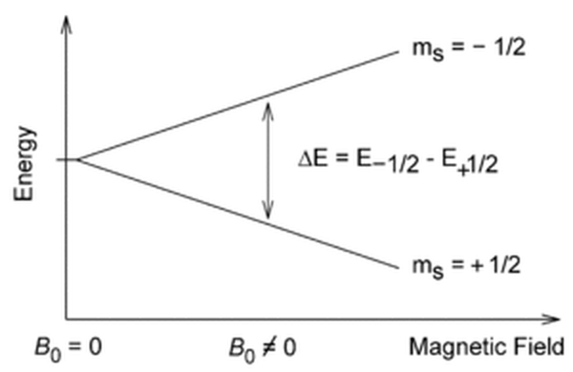
External magnetic field effect : Zeeman effect
Hamiltonian
H_{ion} = H_{cin} + H_{e-n} + H_{e-e} + H_{s-o} + H_{CF} +H_{Zeeman}
Free ion (spherical)
Crystal field
Matrix element depend on the magnetic moment
Splitting of states that depends on (m_{L},m_{S})
d¹ S=1/2
m_{S}=+1/2
1 electron (S=1/2)
spherical
m_{S}=-1/2
Notes:
One electron :
symmetry : small letters for notation eg, a1g

Slide 54
Magnetic moments
Definitions
Crystal field effect:
|(L,S)J Γγ> (Γ term) are not eigenfunctions of
Linear combination of m_{L}
For 3d ions, the orbital magnetic moment is quenched (nul) in most cases.
Some 3d ions have significant orbital magnetic moment (Co²⁺, low spin Fe³⁺, Fe²⁺)
→ atomic magnetic anisotropy
Notes:
One electron :
symmetry : small letters for notation eg, a1g

Slide 55
Magnetic moments and spectroscopies
Magnetic spectroscopies : XMCD, RIXS-MCD, XMLD
More operators involved like T_{z} (magnetic sum rules)
Notes:
One electron :
symmetry : small letters for notation eg, a1g

Slide 56
Magnetic moments in QUANTY
QUANTY any operator ( ) and its expectation values
Notes:
One electron :
symmetry : small letters for notation eg, a1g

Slide 57
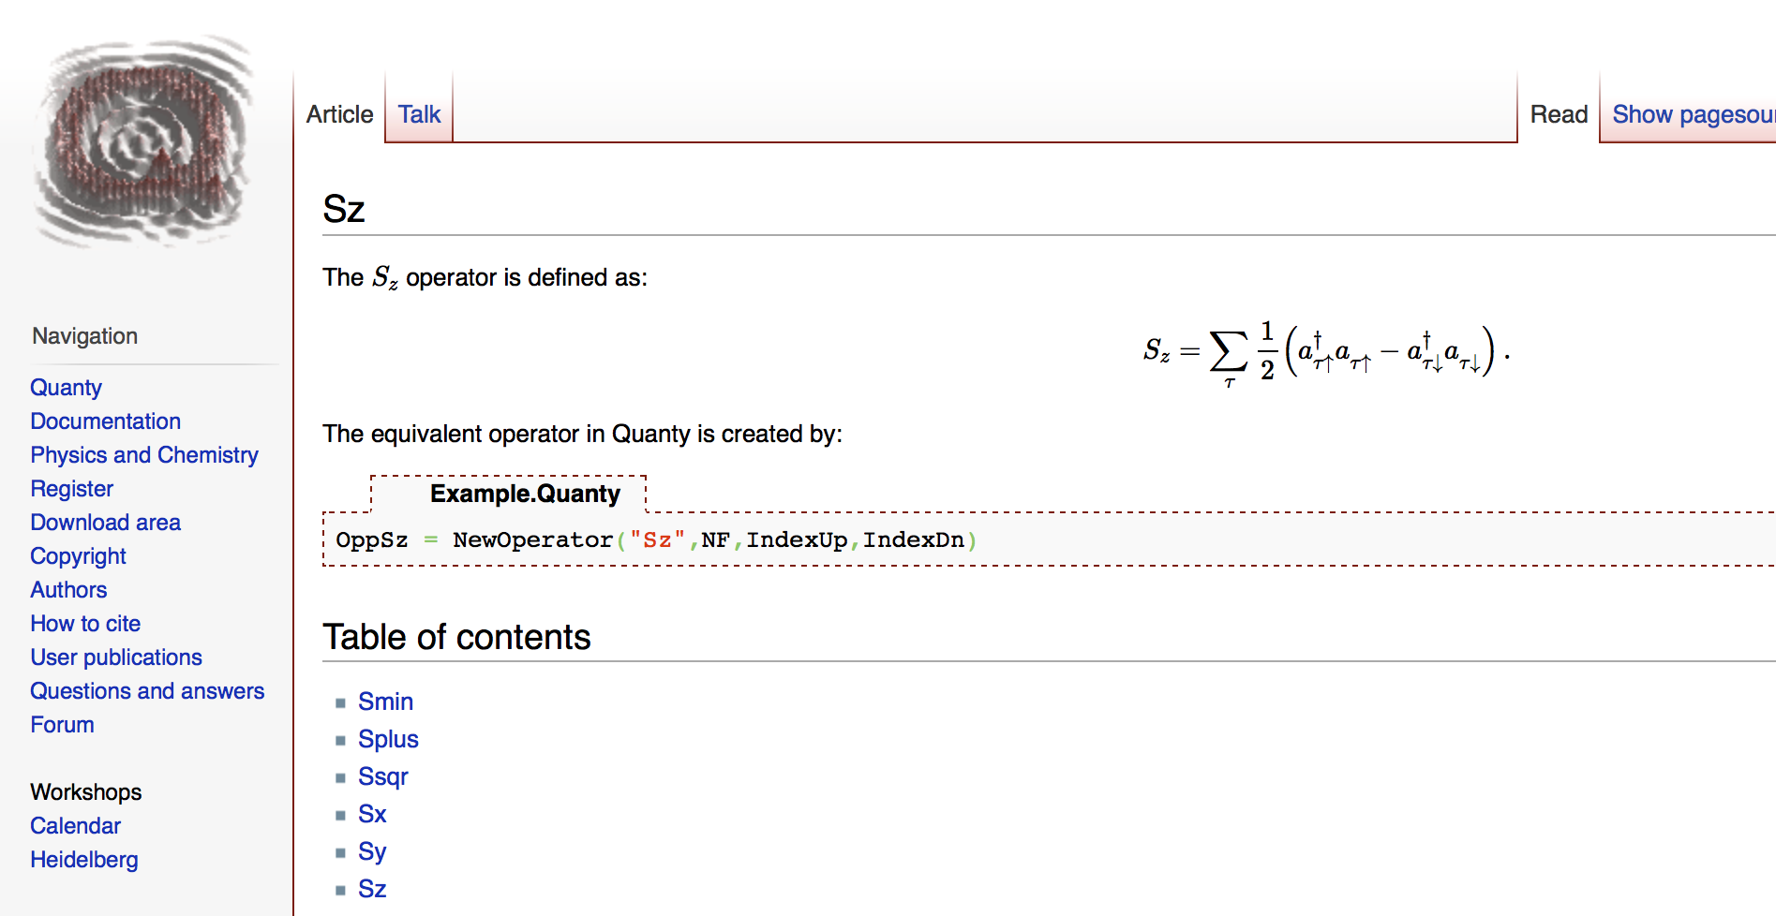
Magnetic moments in QUANTY
QUANTY any operator ( ) and its expectation values
Ex : spin operator
Tutorial 07_Expectationvalues.Quanty
(Monday morning)
Notes:
One electron :
symmetry : small letters for notation eg, a1g

Slide 58
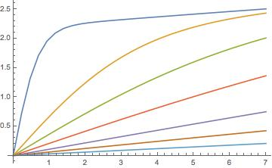
Magnetization of paramagnetic 3d ion
(Zeeman effect)
Magnetic moment of state
Magnetic moment at temperature T in the magnetic field H_{z}
With Z the partition function
Magnetization curve for a paramagnetic ion
Co²⁺ (d⁷) O_{h} (QUANTY)
H_{z(}tesla)
Notes:
One electron :
symmetry : small letters for notation eg, a1g

Slide 59
Conclusion / remarks
It can be difficult and sometime false to use a single electron model for the multi-electron ion
Other {d} basis than {d_{xy},d_{xz},d_{yz},d_{z2},d_{x2-y2}} can be chosen for complex symmetries (ex: C_{3v}, D_{5d})
Crystal field is an empirical model (parameter dependent) but it can be linked to more ab-initio methods (tight-binding, DFT, CASSCF,… )
Lecture: Maurits Haverkort
Crystal field will make angular dependences in transitions
Lecture : Amélie Juhin
Crystal field affect the magnetic properties of 4f rare earth ions (not discussed here)
Notes:
One electron :
symmetry : small letters for notation eg, a1g

Slide 60
Appendix
Notes:
One electron :
symmetry : small letters for notation eg, a1g

Slide 61
Naming point groups:
The name of the point group has information about the symmetry elements present. The letter is the rotational group and the subscript number after the letter indicates the order
of the principal rotational axis (e.g. 3-fold or 4 fold etc.):
A ‘D’ indicates an n-fold
principal rotation axis
plus n 2-fold axes at
right angles to it
A ‘C’ indicates only one rotational axis
C₃ C_{3v} D_{4d} D_{4h}
3-fold rotational has σ_{v} but 4-fold d = no ‘h’ indicates
axis no σ_{h} mirror principal σ_{h} mirror a σ_{h} mirror
planes in a C group axis plane plane

Slide 62
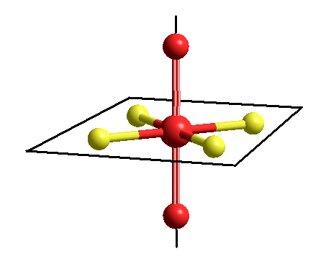
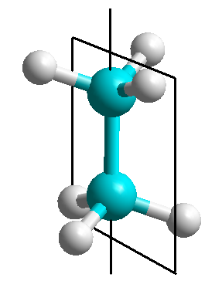
Naming point groups (contd.):
A subscript ‘h’ means that there is a σ_{h} mirror plane at right angles to the n-fold principal axis:
C₄ principal axis
C₃ principal axis
only one
of the three
σ_{v} planes
is shown
σ_{h}
σ_{v}
D_{4h}
D_{3d}
A subscript ‘d’ (or v for C groups) means there is no σ_{h} mirror
plane, but only n σ_{v} mirror planes containing the principal C_{n} axis.

Slide 63
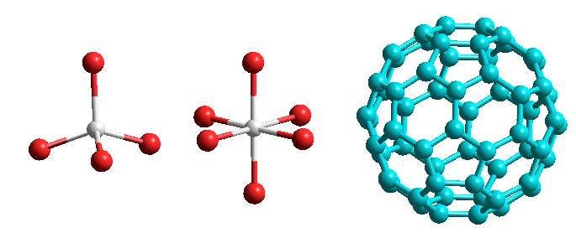
Naming platonic solids:
Platonic solids:
T = tetrahedral = 4 three-fold axes
O = octahedral = 3 four-fold axes
I = icosahedral = 6 five-fold axes
C₆₀
‘bucky-ball’
or ‘Fullerene’
T_{d} O_{h} I_{h}

Slide 64
Magnetic sum rules for XMCD at 3d L_{2,3} edges
Number of 3d electrons (3d^{n})

