Slide 1
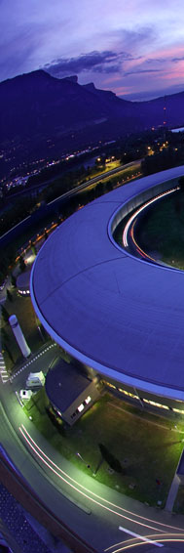
Crispy: a Python Based User Interface for Core-Level Spectroscopy Calculations
Marius Retegan

Slide 2
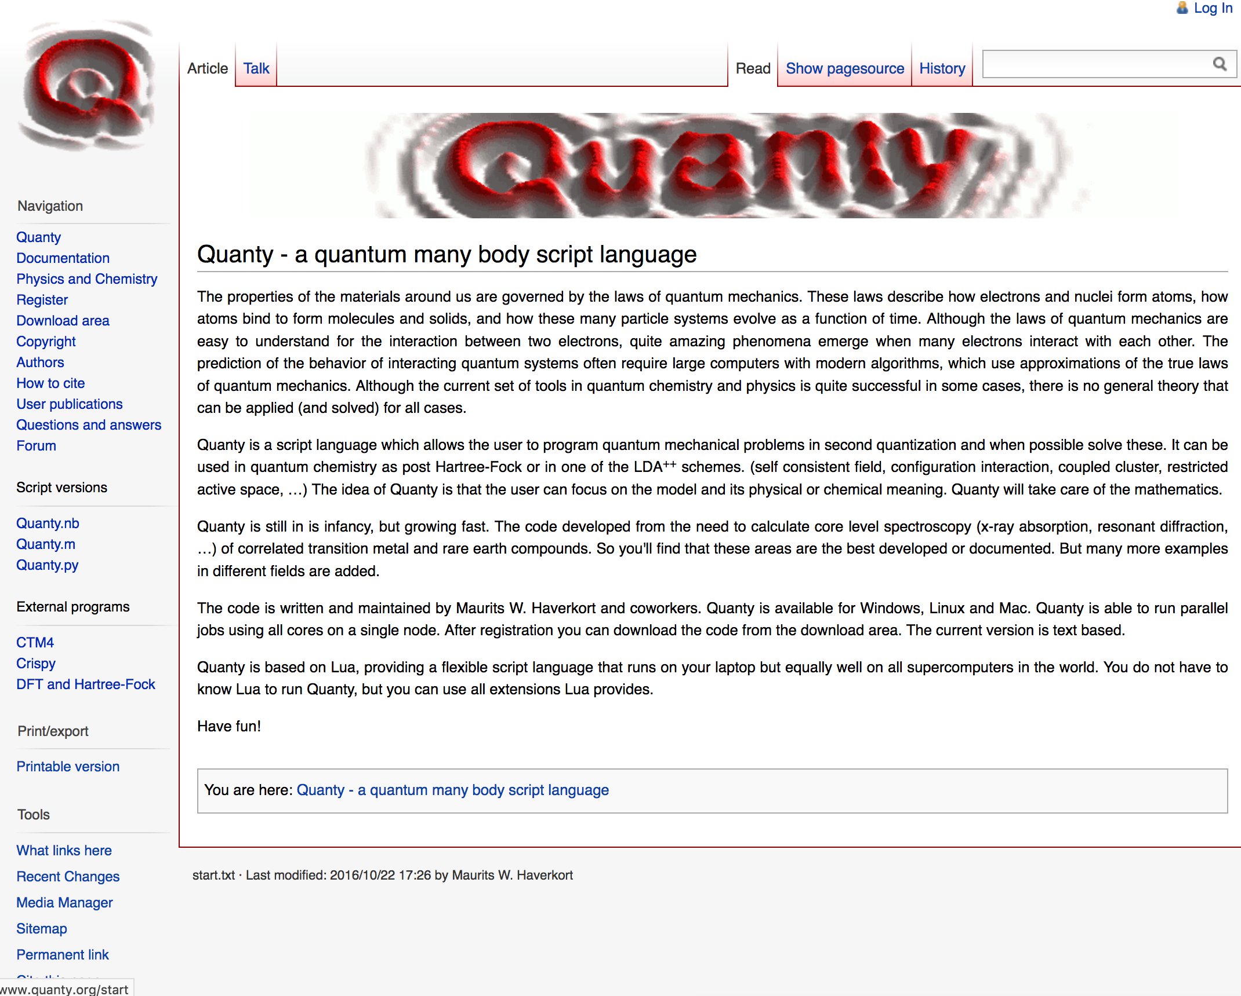
Multiplet Calculations with Quanty
http://quanty.org

Slide 3
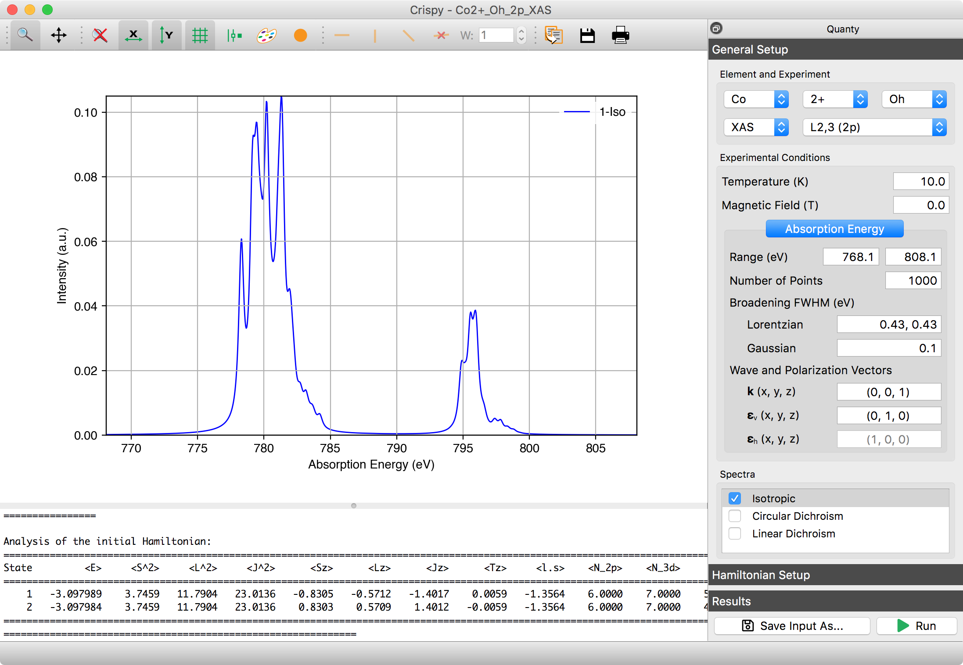
Crispy: User Interface For Multiplet Calculations

Slide 4



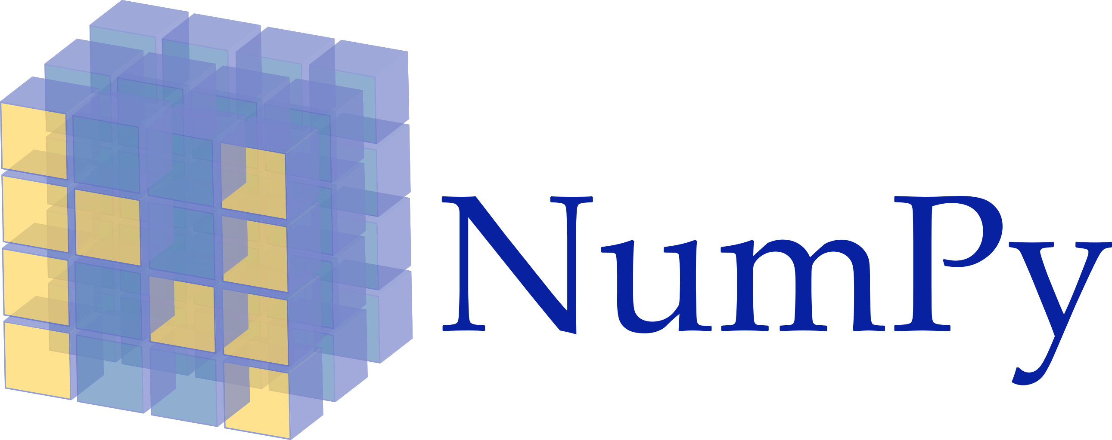
How Is Crispy Developed?

Slide 5
silx: Scientific Library for Experimentalists
… a collection of Python packages to support the development of data assessment, reduction and analysis at synchrotron radiation facilities.
https://www.silx.org

Slide 6
Crispy: Features
Quanty calculations:
  transition metals, lanthanides, and actinides
  XAS, XES, XPS, and RIXS
  a large number of edges
  O_{h}, D_{4h}, C_{3v}, T_{d}, and D_{3h} symmetries
The interface:
  save and load functionality
  logging console to display the progress of a calculation
  a details dialog showing the details of a calculation
  interactive broadening using FFT
  runs on all major operating systems
  easy-to-use installers for Windows and macOS

Slide 7


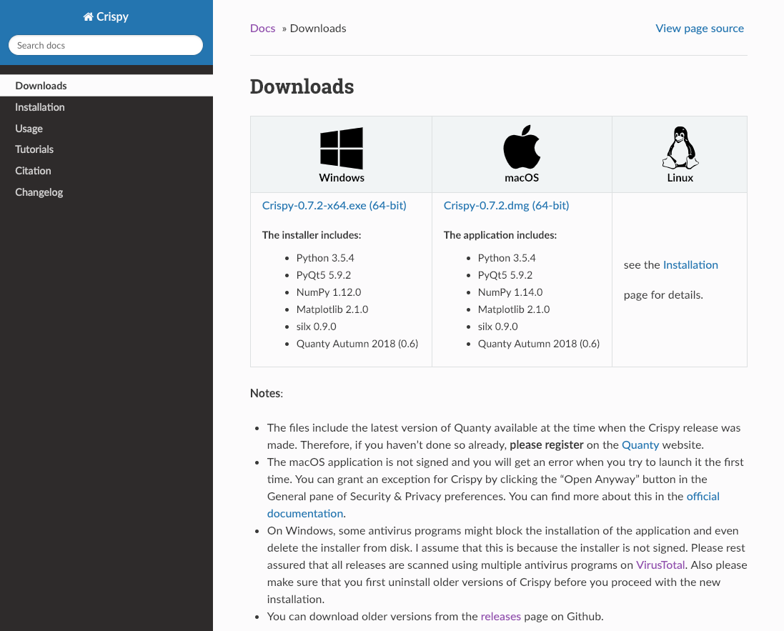
Getting the Program
http://esrf.eu/computing/scientific/crispy
crispy + esrf

Slide 8


I Want a New Feature, I Found a Bug, …
marius.retegan@esrf.fr
https://github.com/mretegan/crispy
https://etherpad.net/p/crispy

Slide 9
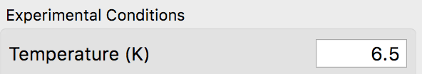
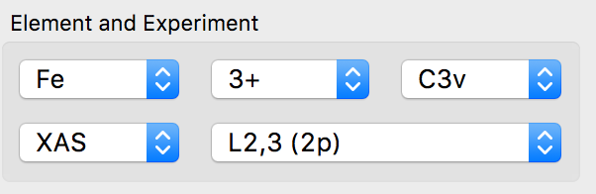
Things to Remember!
Always press Return (Enter) after changing a value in any of the input boxes.
Any modification to the combo boxes will reset all parameters to default values.

Slide 10
Calculating the L_{2,3} XAS Spectrum of NiO

Slide 11
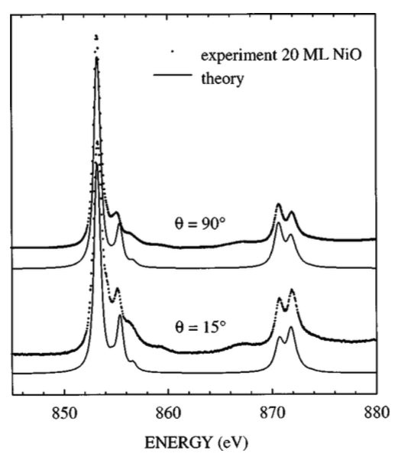
Calculating the L_{2,3} XAS Spectrum of NiO
Experimental details:
  20 monolayer NiO(100) thin film
  temperature (T = 298 K)
  θ = 90° normal incidence
Measured spectrum:
http://tiny.cc/multiplets
Alders et al., Phys. Rev. B, 1998, 57 (18), 11623–11631

Slide 12
Crystal Field Multiplet Calculations
  Calculate the spectrum using the default parameters, but increase the Gaussian broadening to 0.4. Identify the L₂ and L₃ edges in the calculated spectrum.
  Run a calculation with the scaling of the 2p spin orbit coupling constant, ζ(2p), set to 0.5. After the calculation finishes, set this value back to 1.0, and run a second calculation with the 3d spin orbit coupling, ζ(3d) set to 0.5. Which interaction affects the most the energy separation between the L₂ and L₃ edges? Check that the energy separation between the two edges is close to 3/2·ζ(2p).
  Change the default scaling of the Slater integrals (κ) to 0.6, 0.4, and 0.2 and rerun the calculation. Overlay the four spectra to see the evolution of the main peak and its high energy shoulder when the scaling parameter is decreased.

Slide 13
Ligand Field Multiplet Calculations
  Load the experimental spectrum (Tools ➝ Load experimental data) from the NiO folder.
  Run a calculation using the following parameters:
      κ = 0.9, U(3d,3d) = 7.5 eV, U(2p,3d) = 8.5 eV (Atomic)
      10Dq(3d) = 0.7 eV (Crystal Field)
      Δ(3d,Ld) = 4.3 eV, Veg(3d,Ld) = 2.0 eV, Vt2g(3d,Ld) = 1.0 eV, 10Dq(Ld) = 1.4 eV (3d-Ligands Hybridization (LCMT) )
  Repeat the above calculation while varying Δ between 0.0 and 10.0 eV. Notice the changes in the number of the metal 3d and the ligand electrons (<N_3d> and <N_Ld> in the logging window). What happens if Δ is negative?
  Try to get a better agreement with the experimental spectrum by varying the crystal field parameters, 10Dq(3d) and 10Dq(Ld), and the hopping integrals, Veg(3d,Ld) and Vt2g(3d,Ld).

Slide 14
Spin Transitions in Iron Compounds

Slide 15
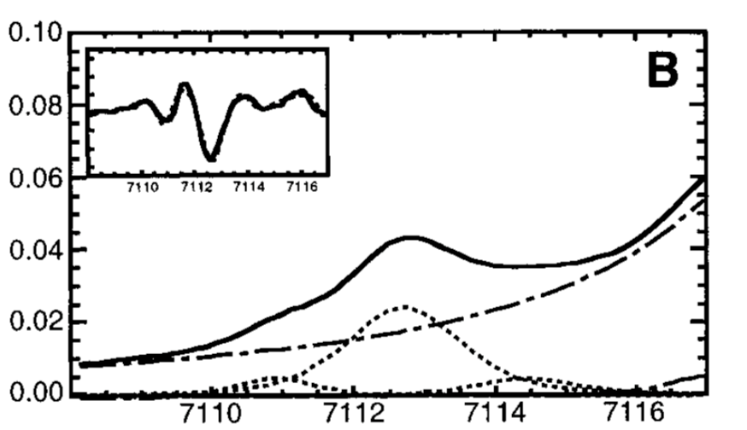
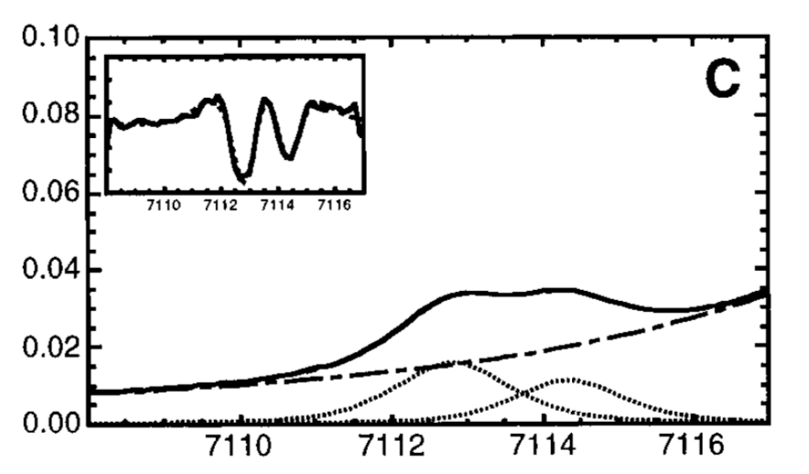
Following Spin Transition in Fe³⁺
Westre et al., J. Am. Chem. Soc., 1997, 119 (27), 6297–6314
Write the electronic configuration of Fe³⁺. Show that there are two ways to fill the 3d orbitals, leading to a high spin (S = 5/2) and a low spin ground state (S = 1/2).
Run two K pre-edge calculations for Fe³⁺ in an octahedral crystal field, one with 10Dq set to 2.0 eV and 3.3 eV.
Change the 10Dq value from 2.6 to 3.6 eV in steps of 0.1 eV. At what value do you observe the spin transition?

Slide 16
XMCD and Sum Rules

Slide 17
Application of the Sum-Rules to FeTp
Jafri et al., Inorg. Chem., 2016, 55 (14), 6980–6987

Slide 18


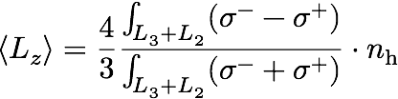
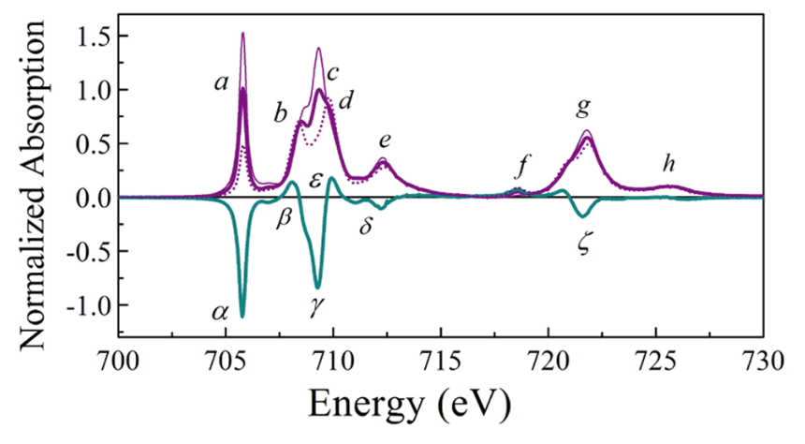
The Magneto-Optical Sum Rules

Slide 19
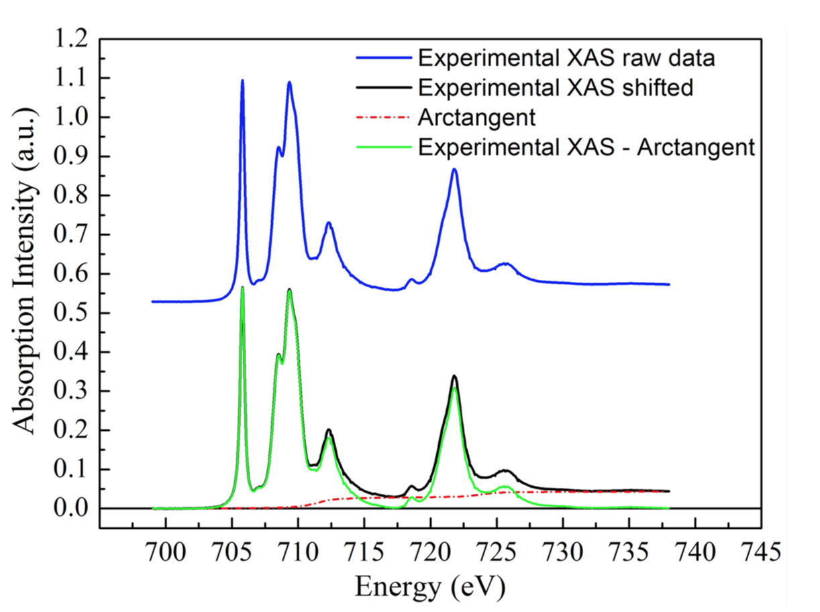
Sum Rules in Practice
The sum rules can provide very useful information on the magnetic electronic
structure by separating the orbit and spin parts of the magnetization.
Origin of problems in the application of the sum rules:
Removal of the transitions towards continuum states is done by subtracting parameterized arctangent functions.
The cutoff energy between L₃ and L₂ edges in the XMCD spectrum.
Intermixing of L₃ and L₂.

Slide 20
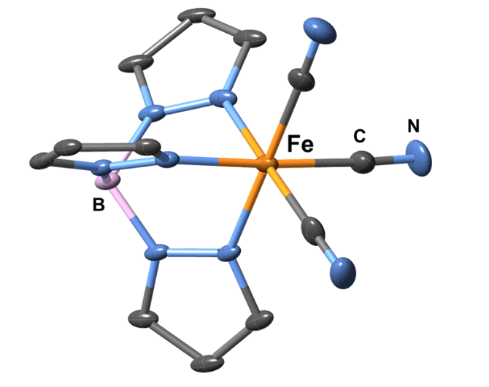
Experimental Data
Experimental details:
  the metal atom in FeTp is Fe³⁺
  temperature (T = 2 K)
  magnetic field (B = 6.5 T)
Measured spectra:
http://tiny.cc/multiplets

Slide 21
Calculations Using Octahedral (Oh) Symmetry
Calculate the spectrum using the following parameters:
    Lorentzian FWHM: 0.5 for L₃ and 1.0 for L₂
    Gaussian FWHM: 0.24
    scale factors: Fk = Gk = 0.7, zeta = 1.0
After the first calculation, open the “Details” dialog and normalize the spectrum to the maximum. Load the experimental spectrum (FeTp_Iso.dat)
Increase the 10Dq value in steps of 0.5. Note the effect on the calculated spectrum. Are there any feature that start to appear in the spectrum for larger 10Dq?
Note the expectation values of the spin (S), orbital (L), and magnetic dipole (T) operators for 10Dq = 2.8 eV. How do they compare with the calculations from the original publication?
 | ⟨S_{z}⟩ | ⟨L_{z}⟩ | ⟨T_{z}⟩
Jafri et al. | −0.1786 | −0.8521 | −0.0523

Slide 22
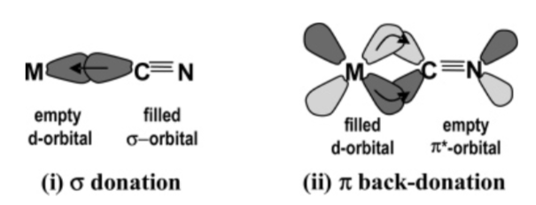
Ligand Field Calculation in Octahedral Symmetry
Add the metal-ligand hybridization (MLCT term) with the following parameters: Δ_{i} = 3.0, Δ_{f} = 3.4, V(e_{g}) = −0.8, V(t_{2g}) = 1.8.
Note the additional features appearing in the spectrum and the changes in the expectation values; compare them with the ones from the original publication.
Hocking et al., J. Am. Chem. Soc., 2006, 128 (32), 10442–10451
 | ⟨S_{z}⟩ | ⟨L_{z}⟩ | ⟨T_{z}⟩
Jafri et al. | −0.1704 | −0.7754 | −0.0594

Slide 23
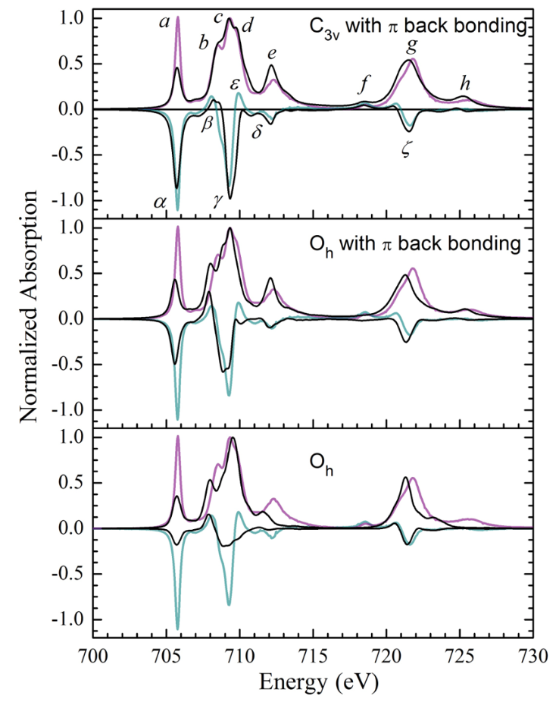
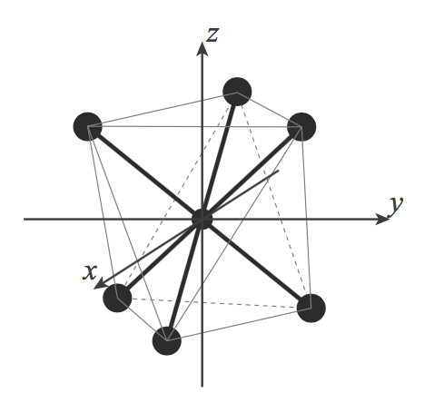
In Search of the Missing Peak
Change the symmetry to C_{3v} and rerun the calculation using the following parameters for the crystal field:
  Dq = 0.28 eV (≡ 10Dq = 2.8 eV)
  Dσ = 0.07 eV
  Dτ = 0.12 eV
Do you manage to reproduce the feature f?
e
e_{g}
a₁
t_{2g}
e

Slide 24
Utility of Multiplet Calculations
What is the value of ⟨T_{z}⟩?
Test the validity of the sum rules and determine the origin of their potential failures.

