Slide 1
X-ray Absorption Spectroscopy
Introduction to XAS
XAS detection techniques
XAS spectral shape
multiplet calculations

Slide 2
X-ray Absorption Spectroscopy
Element specific
Sensitive to low concentrations
Applicable under extreme conditions
SPACE: Combination with x-ray microscopy
TIME: femtosecond XAS
RESONANCE: RIXS, RPES, R diffraction
Notes:
XAS is element specific because each element has specific binding energies for its core levels.
The XAS edge energy is essentially given by the core level binding energy.

Slide 3
Interaction of x-rays with matter
X-ray Absorption Spectroscopy
Photo-electric
(X-ray annihilation)
Elastic X-ray scattering
Inelastic X-ray scattering
Mn

Slide 4
X-ray absorption edges
X-ray Absorption Spectroscopy
Label
Orbital
eV
K
1s
6539
L _{I}
2s
769.1
L _{II}
2p_{1/2}
649.9 [3]
L _{III}
2p_{3/2}
638.7 [3]
M _{I}
3s
82.3 [3]
M _{II}
3p_{1/2}
47.2 [3]
M _{III}
3p_{3/2}
47.2 [3]

Slide 5
X-ray absorption edges
X-ray Absorption Spectroscopy
Label
Orbital
eV [literature reference]
K
1s
6539 [1]
L _{I}
2s
769.1 [3]
L _{II}
2p_{1/2}
649.9 [3]
L _{III}
2p_{3/2}
638.7 [3]
M _{I}
3s
82.3 [3]
M _{II}
3p_{1/2}
47.2 [3]
M _{III}
3p_{3/2}
47.2 [3]
BarKLa
The Nobel Prize in Physics 1917 was awarded to Charles Glover Barkla "for his discovery of the characteristic Röntgen radiation of the elements."

Slide 6
X-ray absorption edges
X-ray Absorption Spectroscopy
Label
Orbital
eV [literature reference]
K
1s
6539 [1]
L _{I}
2s
769.1 [3]
sharp
principal
diffuse
fundamental
L _{II}
2p_{1/2}
649.9 [3]
L _{III}
2p_{3/2}
638.7 [3]
M _{I}
3s
82.3 [3]
M _{II}
3p_{1/2}
47.2 [3]
J. Chem. Educ. 84, 757 (2007)
M _{III}
3p_{3/2}
47.2 [3]
BarKLa
The Nobel Prize in Physics 1917 was awarded to Charles Glover Barkla "for his discovery of the characteristic Röntgen radiation of the elements."

Slide 7
X-ray absorption
X-ray Absorption Spectroscopy
4sp
3d
O2p
O2s
3p
Excitation of 3p to 3d state
Lifetime of excitation is short
Lifetime broadening ~200 meV
Notes:
7

Slide 8
X-ray absorption & x-ray emission
X-ray Absorption Spectroscopy
Decay of 3d electron to 3p core state
X-ray emission
Notes:
8

Slide 9
X-ray absorption & Auger
X-ray Absorption Spectroscopy
Decay of 3d/valence electron to 3p core state
Energy used to excite a 3d/valence electron
Auger electron spectroscopy
Notes:
9

Slide 10
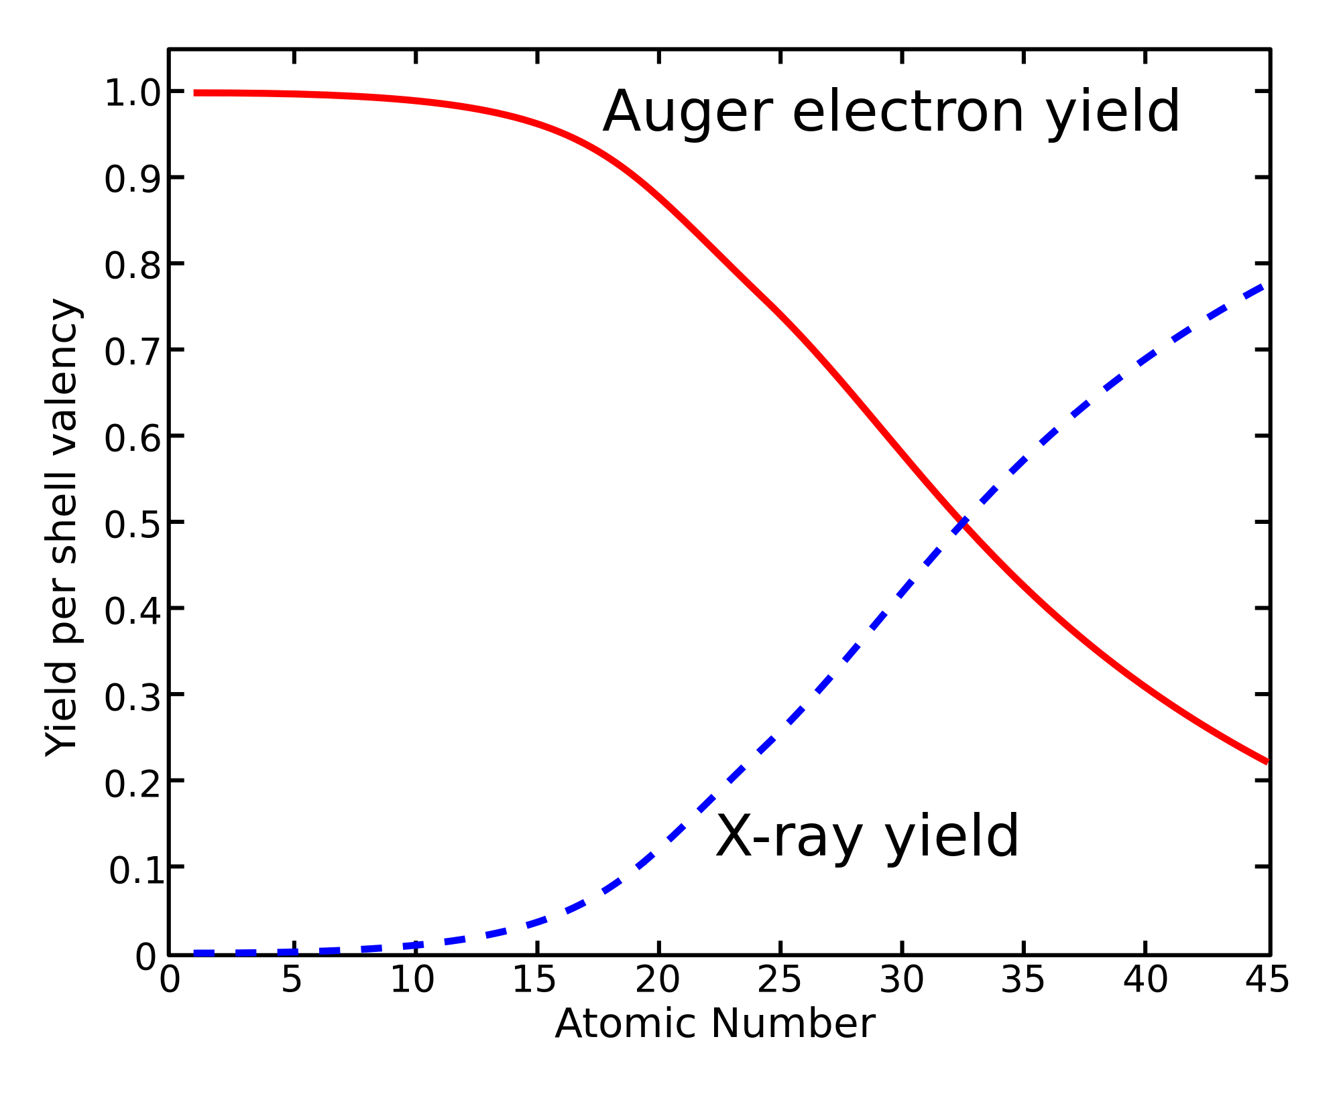
X-ray Absorption Spectroscopy
1s core state
Notes:
10

Slide 11
XAS: detection techniques

Slide 12
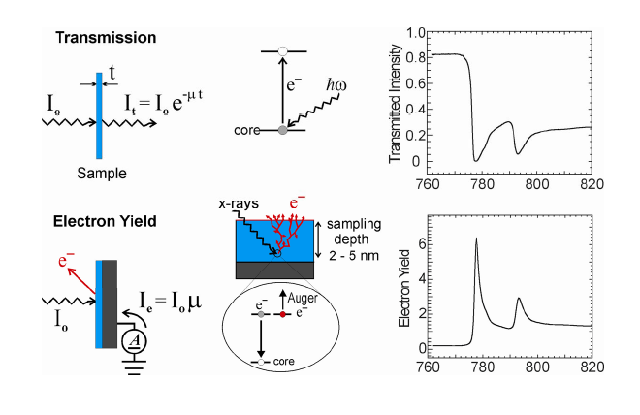
XAS: detection techniques
Use decay channels as detector
Uniform thickness
Uniform concentration of absorbing element
Thin enough for photons

Slide 13
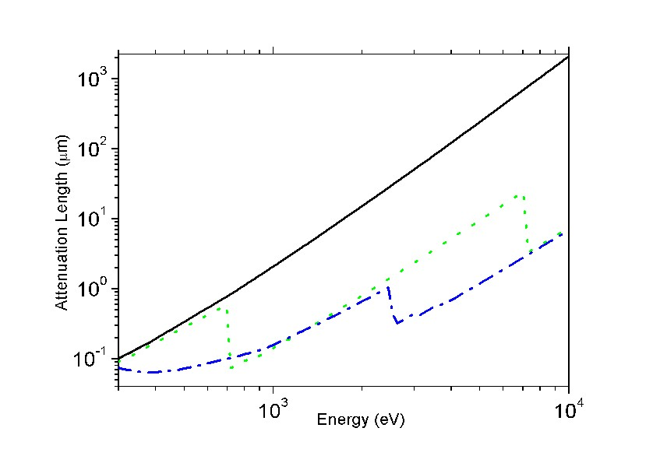
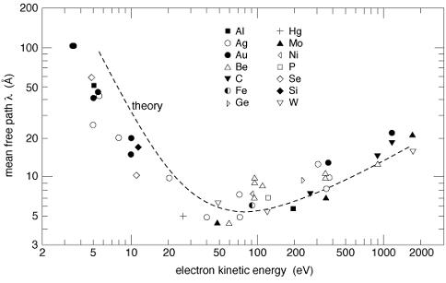
XAS: detection techniques
X-ray penetration lengths &
electron escape depths
100-1000 nm
(CXRO, but 20 nm for L edges)
1-5 nm

Slide 14
XAS: detection techniques
Use decay channels as detector
X-ray penetrate 1000 nm (λ_{X})
Electrons escape from 5 nm (λ_{E})
Number of core holes created in first 5 nm is proportional to μ and angle of incidence (α)
I_{TEY} ~ 1 / λ_{X} = μ_{X}

Slide 15
XAS: detection techniques
Transmission
(pinhole, saturation > thin samples)
Electron Yield
(surface sensitive)
Fluorescence Yield
(saturation & self-absorption:
> dilute samples)
[L edges are intrinsically distorted]

Slide 16
XAS: spectral shape
Interpretation of spectral shapes
Notes:
16

Slide 17
XAS: spectral shape
Excitations of core electrons to empty states
The XAS spectra are given by the
Fermi Golden Rule
exciton
edge jump

Slide 18
XAS: spectral shape (O 1s)
Fermi Golden Rule
↓
Excitations to
empty states as calculated by DFT
X
O 1s
Notes:
18

Slide 19
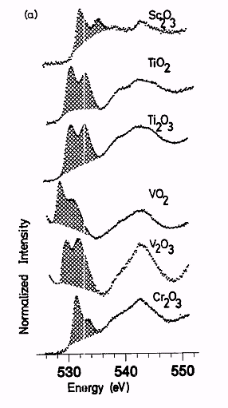
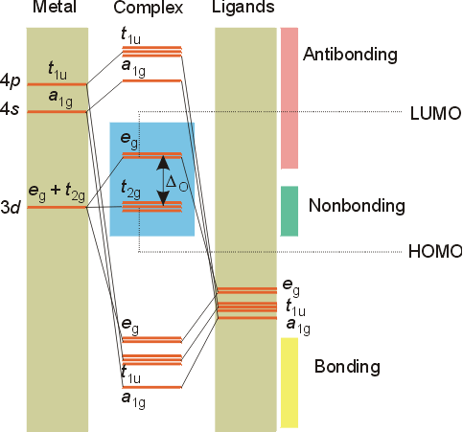
XAS: spectral shape (O 1s)
2p
2s
Phys. Rev. B.40, 5715 (1989)

Slide 20
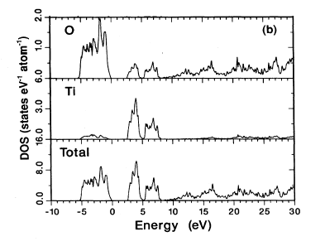
XAS: spectral shape (O 1s)
oxygen 1s > p DOS
Phys. Rev. B.40, 5715 (1989); 48, 2074 (1993)

Slide 21
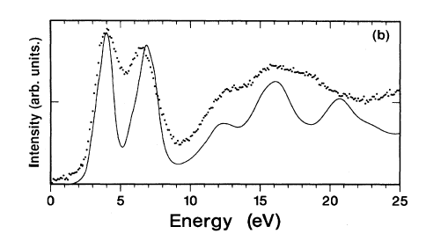
XAS: spectral shape (O 1s)
Phys. Rev. B. 40, 5715 (1989); 48, 2074 (1993)

Slide 22
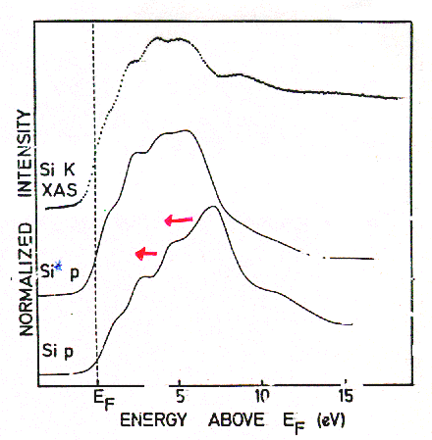
XAS: spectral shape
TiSi₂
Final State Rule: Spectral shape of XAS looks like final state DOS
Phys. Rev. B. 41, 11899 (1991)

Slide 23
XAS: spectral shape
TiSi₂
XAS codes:
Multiple scattering: FEFF, FDMNES, etc.
Band structure:
WIEN2K, Quantumespresso, etc.
Real-space DFT:
ADF, etc.
Phys. Rev. B. 41, 11899 (1991)

Slide 24
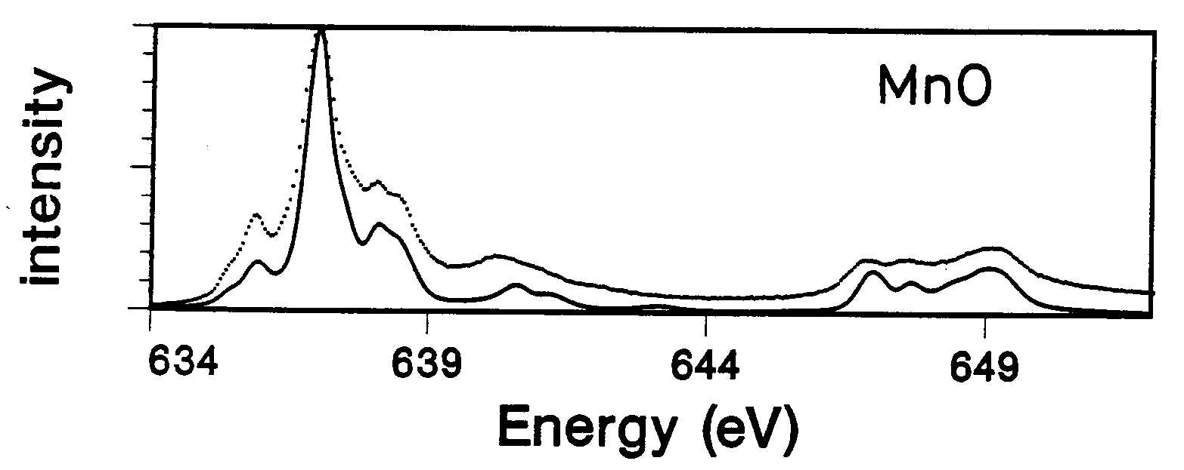
2p XAS of transition metal ions
Iron 1s XAS
exciton
2p > 3d
(3d⁵ > 2p⁵3d⁶, self screened)
X
edge jump
2p > s,d DOS
[Phys. Rev. B. 42, 5459 (1990)]
Notes:
24

Slide 25
XAS: spectral shape
XAS: multiplet effects
Overlap of core and valence wave functions
→ Spectral shape NOT improved in last 30 years!
3d
<2p3d|1/r|2p3d>
2p_{3/2}
2p_{1/2}
[Phys. Rev. B. 42, 5459 (1990)]

Slide 26
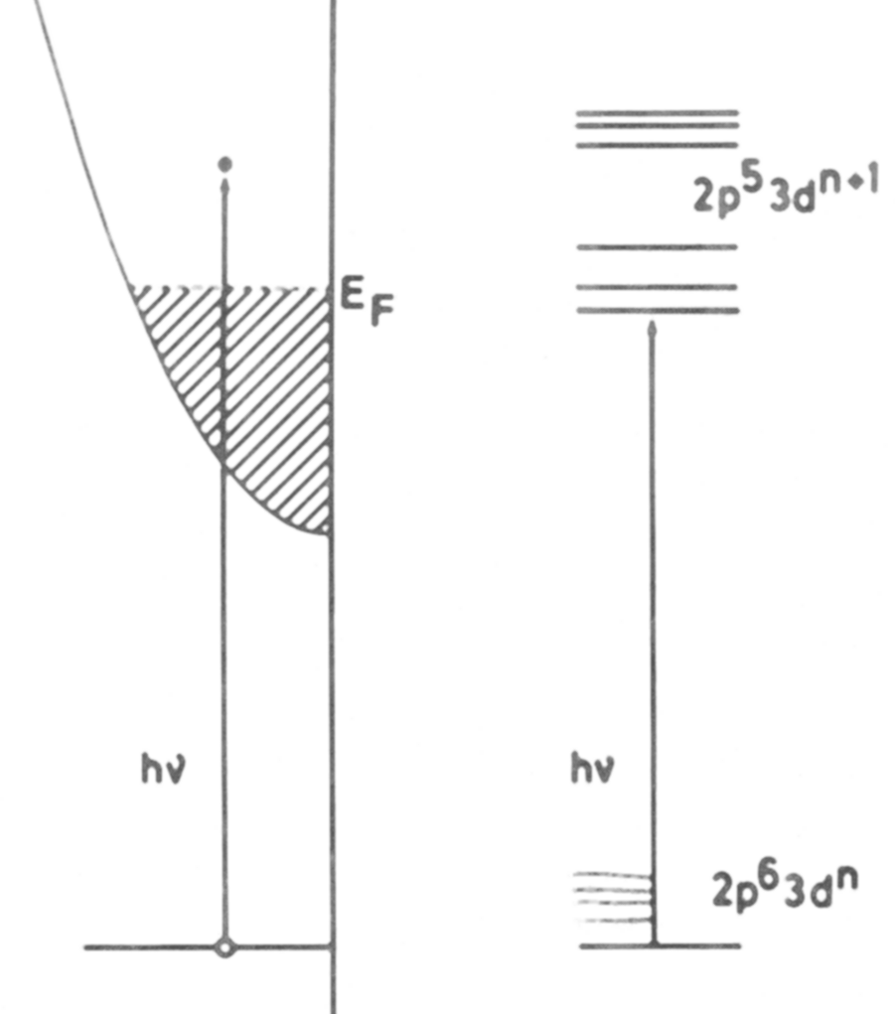
XAS: spectral shape
Interpretation of XAS
1-particle:
1s edges
(DFT + core hole +U)
many-particle:
open shell systems
(CTM4XAS)
Notes:
26

Slide 27
XAS: spectral shape
XAS
1s
DFT
pre-edge
of 3d system
2p, 3p,
3d, 4d
multiplets

Slide 28
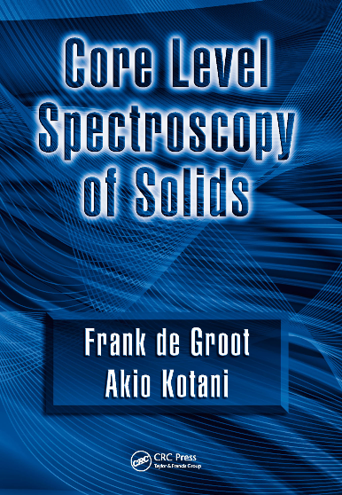
CHARGE TRANSFER MULTIPLETS
Charge Transfer Multiplet program
Used for the analysis of XAS, EELS,
Photoemission, Auger, XES
involving d and f-shells
ATOMIC PHYSICS
⇓
GROUP THEORY
⇓
MODEL HAMILTONIANS
Notes:
The TT-multiplets program can be used to explain the spectral shapes of all core level spectroscopies. XAFS, photoemission, auger, etc.
The program combines three advanced computer codes, an atomic physics code to describe all atomic interactions, a group theory code to describe the local symmetry (think of crystal fields) and model Hamiltonians to describe many body effects correlated systems.
AS A SIDE REMARK I WOULD LIKE TO MENTION that the active site in a catalyst is a perfect example of a correlated system. (in biocatalysis this is often realised)
The integrated program gives accurate descriptions of core level spectra, from a set of uniform electronic structure parameters.
The program is important for all of the new spectroscopies that I will describe.
The program is distributed from my homepage and it is used at some 50 institutes worldwide.

Slide 29
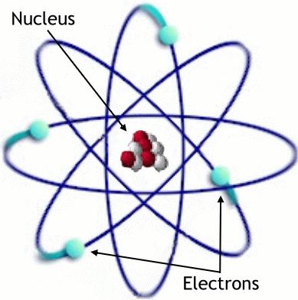
ATOMIC MULTIPLETS
Atomic Multiplet Theory
ΗΨ=EΨ
Kinetic Energy
Nuclear Energy
Electron-electron interaction
Spin-orbit coupling

Slide 30
ATOMIC MULTIPLETS
Atomic Multiplet Theory
ΗΨ=EΨ
X X
Kinetic Energy
Nuclear Energy
Electron-electron interaction
Spin-orbit coupling

Slide 31
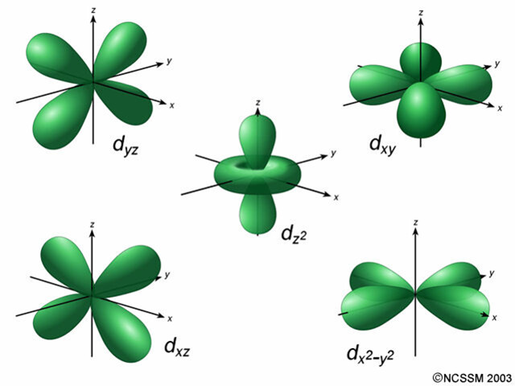
ATOMIC MULTIPLETS 3d¹
5 orbitals (each spin-up or spin-down) >> total 10 states
No electron-electron interaction: all states have the same energy
Quantum numbers: L=2 and S=½, notation as term symbol: ^{2S+1}L= ²D

Slide 32
ATOMIC MULTIPLETS 3d¹
Spin-orbit coupling couples L and S quantum numbers to a total quantum number J
J_{max}= L+S = 5/2, J_{min}= |L-S|= 3/2, Integer steps of J.
Two term symbols: L=2, S=½, and J = 5/2 >> notation as term symbol: ^{2S+1}L_{J}= ²D_{5/2}
L=2, S=½, and J = 3/2 >> notation as term symbol: ^{2S+1}L_{J}= ²D_{3/2}

Slide 33
ATOMIC MULTIPLETS 3d¹
Atomic Multiplet Theory
electron-electron
interaction
spin-orbit
coupling
3d¹
²D
²D_{3/2}
²D_{5/2}
(~50 meV)

Slide 34
ATOMIC MULTIPLETS 3d²
5 spin-up orbitals give 4 + 3 + 2 + 1 = 10 paired 3d² states
5 spin-down orbitals give 10 paired down-down 3d² states
There are 5x5 = 25 up-down states
In total 10+10+25 = 45 states
Can also be calculated as 10 x 9 / 2 = 45 states
Electron-electron interaction is different for different orbital combinations
There will be a number of different states with different energies.
Analysis shows that the states are ¹S, ³P, ¹D, ³F and ¹G

Slide 35
ATOMIC MULTIPLETS 3d²
Atomic Multiplet Theory
electron-electron
Interaction
(~2 eV)
spin-orbit
coupling
(~50 meV)
3d²
¹S
³F
¹G
³P
¹D
¹S₀
³P₂
¹G₄
³P₁
³P₀
³F₄
³F₂
³F₃
¹D₂
    Ground state:
    Given by Hunds rules
    max S
    max L
    min J (if less than half full)

Slide 36
ATOMIC MULTIPLETS 3d⁸
Atomic Multiplet Theory
electron-electron
Interaction
(~2 eV)
spin-orbit
coupling
(~50 meV)
3d⁸
¹S
³F
¹G
³P
¹D
¹S₀
³P₂
¹G₄
³P₁
³P₀
³F₄
³F₂
³F₃
¹D₂
    Ground state:
    Given by Hunds rules
    max S
    max L
    max J (if more than half full)

Slide 37
X-ray absorption from 3d⁸ to 2p⁵3d⁹
Atomic Multiplet Theory
2p⁵3d⁹
¹P
³F
¹D
³P
³D
¹P₁
³P₂
¹D₂
³P₁
³P₀
³F₄
³F₂
³F₃
³D₃
¹F
¹F₃
³D₁
³D₂
Dipole selection rule:
ΔJ=-1, 0 or +1
3d⁸
¹S
³F
¹G
³P
¹D
¹S₀
³P₂
¹G₄
³P₁
³P₀
³F₄
³F₂
³F₃
¹D₂

Slide 38
X-ray absorption from 3d⁸ to 2p⁵3d⁹
Atomic Multiplet Theory
2p⁵3d⁹
¹P
³F
¹D
³P
³D
¹P₁
³P₂
¹D₂
³P₁
³P₀
³F₄
³F₂
³F₃
³D₃
¹F
¹F₃
³D₁
³D₂
Dipole selection rule:
ΔJ=-1, 0 or +1
3d⁸
¹S
³F
¹G
³P
¹D
¹S₀
³P₂
¹G₄
³P₁
³P₀
³F₄
³F₂
³F₃
¹D₂

Slide 39
2p XAS of NiO with atomic multiplets
Atomic multiplets

Slide 40
3d XAS of rare earths
4f electrons are localized
No effect of surroundings (crystal field < lifetime broadening)
3d XAS is self screened > no charge transfer effect
Initial state
electron-electron interaction.
Valence spin-orbit coupling
Final state
+ core hole – valence hole ‘multiplet’ interaction.
+ core hole spin-orbit coupling

Slide 41
3d XAS of rare earths
Nd³⁺ 4f³ system: ground state is ⁴I_{9/2}

Slide 42
2p XAS of NiO with atomic multiplets
Atomic multiplets

Slide 43
2p XAS of 3d transition metal oxides
3d electrons are less localized
Effect of surroundings (crystal field effect)
3d XAS is self screened > weak charge transfer effect
Initial state
electron-electron interaction.
valence spin-orbit coupling
crystal field effect
Final state
core hole – valence hole ‘multiplet’ interaction.
core hole spin-orbit coupling
crystal field effect

Slide 44
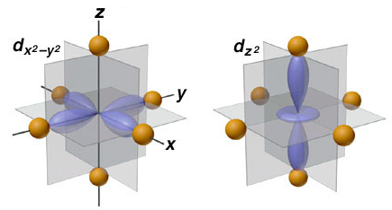
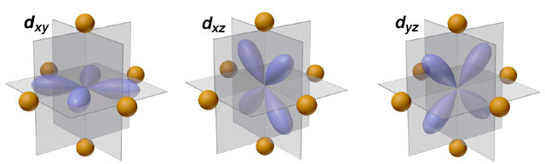
crystal field effect
Crystal Field Effects
e_{g} states
t_{2g} states

Slide 45
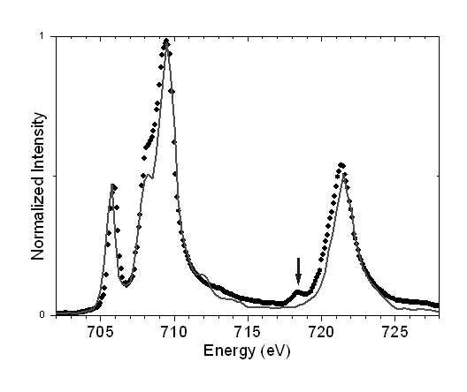
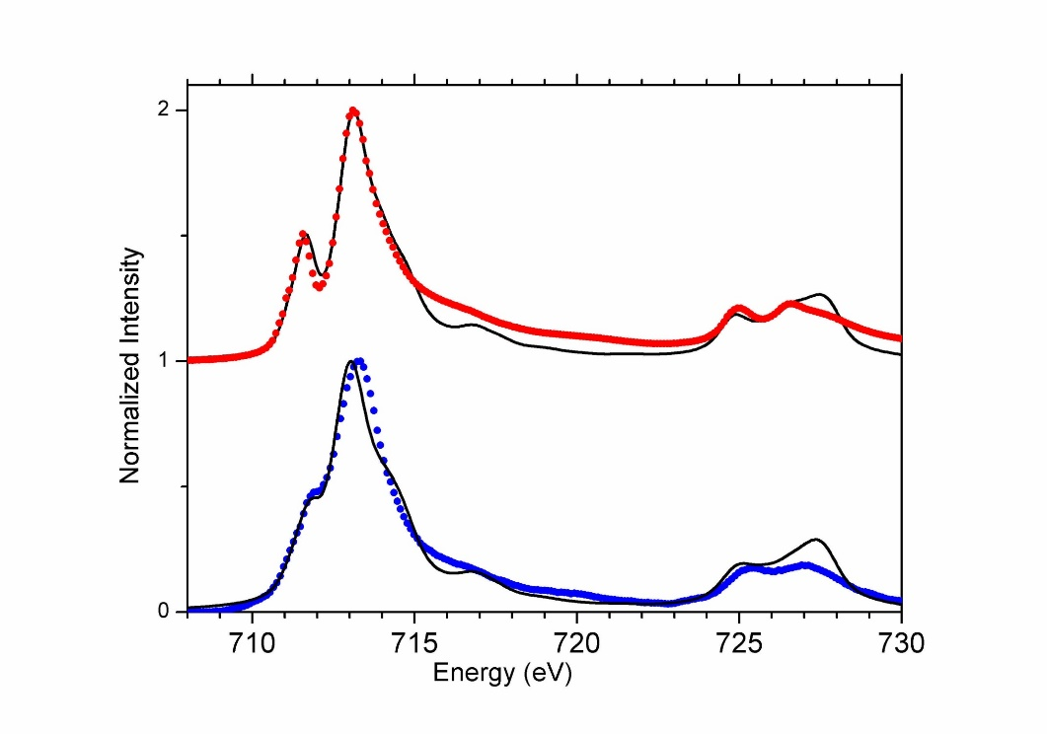
crystal field effect: spin state
High-spin or Low-spin
More in the lecture of Marie-Anne Arrio
E
T₂
E
T₂
High-spin 3d⁵
Low-spin 3d⁵

Slide 46
Multiplet calculations
valence e-e interactions F_{dd}
core-valence e-e F_{pd} G_{pd}
core & valence spin-orbit ζ
crystal field 10Dq, Ds, Dt
molecular field, M or H
e-e screening κ
charge transfer Δ, U, Q
hopping T_{Γ}
ionic 3d
(4d, 5d)
4f, 5f
covalent 3d
mixed valence f
ATOMIC
SYMMETRY
BONDING

Slide 47
Multiplet calculations
valence e-e interactions F_{dd}
core-valence e-e F_{pd} G_{pd}
core & valence spin-orbit ζ
crystal field 10Dq, Ds, Dt
molecular field, M or H
e-e screening κ
charge transfer Δ, U, Q
hopping T_{Γ}
ionic 3d
(4d, 5d)
4f, 5f
3d ions
covalent 3d
mixed valence f
ATOMIC
SYMMETRY
BONDING

Slide 48
Charge transfer effects
Charge Transfer Effects
Hubbard U for a 3d⁸ ground state:
U= E(3d⁷) + E(3d⁹) – E(3d⁸) – E(3d⁸)
Ligand-to-Metal Charge Transfer (LMCT):
Δ= E(3d⁹L) – E(3d⁸)

Slide 49
Charge transfer effects
Charge Transfer Effects
Main screening mechanism in XAS of oxides:
Ligand-to-metal charge transfer
Charge transfer energy Δ is important for XAS
Hubbard U is NOT important for XAS spectral shape

Slide 50
Charge transfer effects in XAS and XPS
transition metal oxides
Ground state: 3d⁸ + 3d⁹L
Energy of 3d⁹L: Charge transfer energy Δ
3d⁹L
Δ
3d⁸
Ground State

Slide 51
Charge Transfer Effects
3d⁹L
Δ
3d⁸

Slide 52
Charge Transfer Effects
9
3d⁹L
Δ
8
3d⁸

Slide 53
Charge Transfer Effects
β 3d⁸ - α 3d⁹L
α 3d⁸ + β 3d⁹L
3d⁹L
Δ
3d⁸

Slide 54
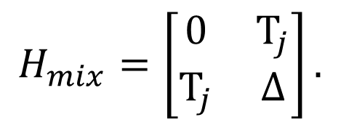
Charge Transfer Effects
$$H_{mix}=\left[\begin{matrix}0 & T_{j} \\ T_{j} & ∆\end{matrix}\right].$$
3d⁹L
E_{1,2} = ½ [Δ±√(Δ²+4T²)]
Δ=2 and T=0
E_{1,2} = ½ [2±√(2²+0)] = 0 and 2
Δ
3d⁸

Slide 55
Charge Transfer Effects
$$H_{mix}=\left[\begin{matrix}0 & T_{j} \\ T_{j} & ∆\end{matrix}\right].$$
3d⁹L
E_{1,2} = ½ [Δ±√(Δ²+4T²)]
Δ=2 and T=1
E_{1,2} = ½ [2±√(2²+4)] = 1 ± √2
Δ
3d⁸

Slide 56
Charge Transfer Effects in NiO
E(3d⁹L) – E(3d⁸) = Δ
E(3d¹⁰LL‘) – E(3d⁸) = 2Δ
X

Slide 57
Charge Transfer Effects in NiO
E(3d⁹L) – E(3d⁸) = Δ
E(3d¹⁰LL‘) – E(3d⁸) = 2Δ +U

Slide 58
Charge Transfer Effects

Slide 59
Charge Transfer Effects in XAS
Δ+U-Q
Δ

Slide 60
Charge transfer effects
Charge Transfer Effects
NiO: Ground state: 3d⁸ + 3d⁹L
Energy of 3d⁹L: Charge transfer energy Δ
3d⁹L
3d⁸
2p⁵3d¹⁰L
2p⁵3d⁹
Δ
Δ+U-Q ≈ Δ

Slide 61
β 3d⁸ - α 3d⁹L
α 3d⁸ + β 3d⁹L
β’ c3d⁹ – α’ c3d¹⁰L
α' c3d⁹ + β’ c3d¹⁰L
Charge transfer effects
~0
~1
Δ
Δ+U-Q ≈ Δ
Intensity bonding combination: [α α’+ β β’]²
α ≈ α’ ≈ (α²+ β²⁾² =1

Slide 62
β 3d⁵ - α 3d⁶L
α 3d⁵ + β 3d⁶L
β’ c3d⁶ – α’ c3d⁷L
α' c3d⁶ + β’ c3d⁷L
Charge transfer effects
~0
~1
Δ
Δ+U-Q ≈ Δ
Intensity anti-bonding combination: [α β’- β α’]²
α ≈ α’ ≈ (αβ – βα)² =0

Slide 63
Charge transfer effects
Charge Transfer Effects
Neutral experiments are self-screened
XAS, optical, EPR, EELS, RIXS
>> small screening satellites
>> crystal field theory can be used
Ionising experiments are not self-screened
XPS, Auger,
>> large screening > large satellites
>> crystal field theory can not be used

Slide 64
Charge transfer effects in XAS and XPS
Charge transfer effects in XAS and XPS
Transition metal oxide: Ground state: 3d⁵ + 3d⁶L
Energy of 3d⁶L: Charge transfer energy Δ
3d⁶L
XPS
2p⁵3d⁵
XAS
2p⁵3d⁷L
Δ
3d⁵
Δ-Q
Ground State
Δ+U-Q ≈ Δ
2p⁵3d⁶L
2p⁵3d⁶

Slide 65
Charge transfer effects
Charge Transfer Effects
NiO: Ground state: 3d⁸ + 3d⁹L
Energy of 3d⁹L: Charge transfer energy Δ
3d⁹L
3d⁸
2p⁵3d¹⁰L
2p⁵3d⁹
Δ
Δ+U-Q ≈ Δ

Slide 66
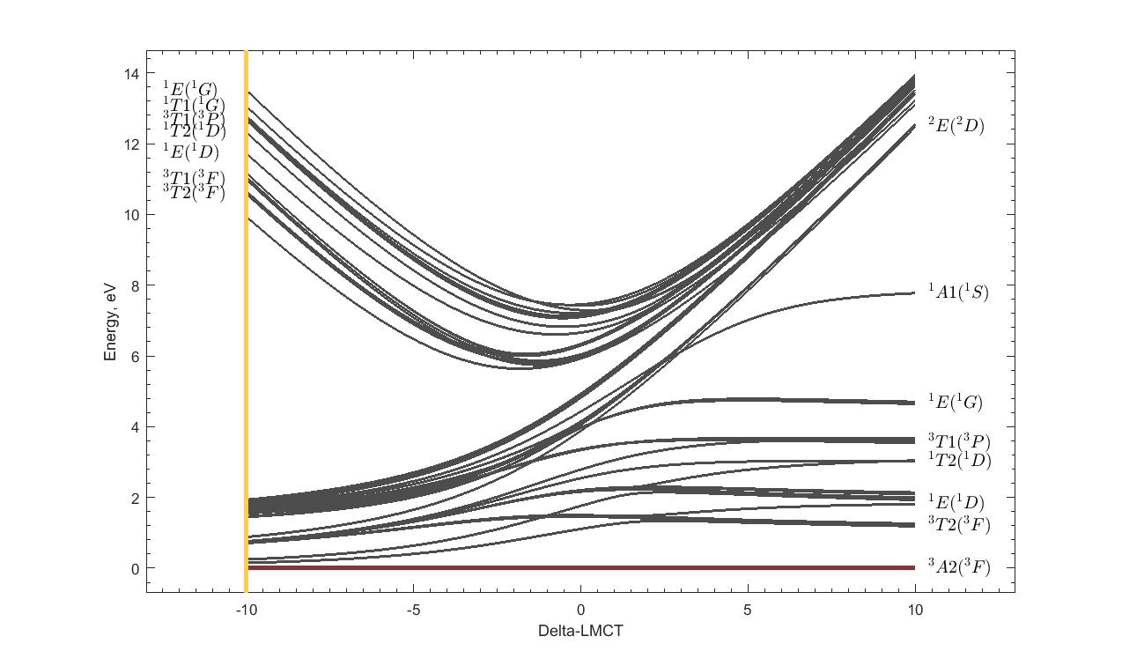
Tanabe-Sugano diagrams with charge transfer
Tanabe-Sugano with Charge transfer
α 3d⁸ + β 3d⁹L
NiO
Cu³⁺

Slide 67
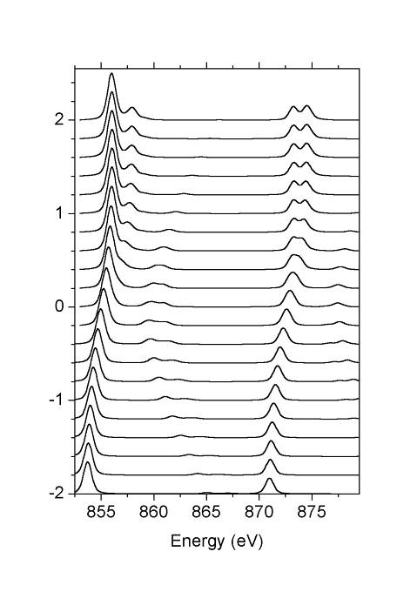
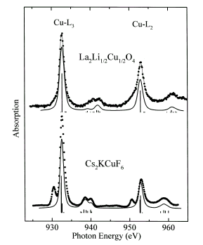
Charge transfer effects in XAS
Charge Transfer effects
3d⁸ + 3d⁹L
Δ=10
30% 3d⁸
¹A₁
Δ=5
NiO
Δ=0
La₂Li_{½}Cu_{½}O₄
30% 3d⁸
³A₂
Δ=-5
Δ=-10
Chem. Phys. Lett. 297, 321 (1998)

Slide 68
LMCT and MLCT: π - bonding
Fe^{III}: Ground state: 3d⁵ + 3d⁶L
3d⁶L
3d⁵
2p⁵3d⁷L
2p⁵3d⁶
Δ
Δ+U-Q ≈ Δ
with Ed Solomon (Stanford) JACS 125, 12894 (2003),
JACS 128, 10442 (2006), JACS 129, 113 (2007)

Slide 69
LMCT and MLCT: π - bonding
Fe^{III}: Ground state: 3d⁵ + 3d⁶L + 3d⁴L
2p⁵3d⁵L
2p⁵3d⁷L
2p⁵3d⁶
3d⁴L
3d⁶L
3d⁵
Δ_{π}-U+Q ≈ Δ_{π} + 2
Δ_{π}
Δ
Δ+U-Q ≈ Δ - 2
with Ed Solomon (Stanford) JACS 125, 12894 (2003),
JACS 128, 10442 (2006), JACS 129, 113 (2007)

Slide 70
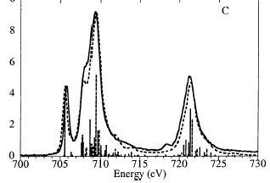
LMCT and MLCT: π - bonding
Fe^{III}(tacn)₂
Fe^{III}(CN)₆
with Ed Solomon (Stanford) JACS 125, 12894 (2003),
JACS 128, 10442 (2006), JACS 129, 113 (2007)

Slide 71
Multiplet calculations
Calculated for an atom/ion
Valence and core spin-orbit coupling
Core and valence electron-electron interaction.
Comparison with experiment
Core hole potential and lifetime
Local symmetry (crystal field)
Spin-spin interactions (molecular field)
Core hole screening effects (charge transfer)
Notes:
71

Slide 72
First Principle Multiplet calculations
Calculated for an atom/ion
Valence and core spin-orbit coupling
Core and valence electron-electron interaction.
Comparison with experiment
Core hole potential and lifetime
Local symmetry (crystal field)
Spin-spin interactions (molecular field)
Core hole screening effects (charge transfer)
Notes:
72

Slide 73
2p XAS first-principle codes
SOLIDS
Band structure multiplet (Haverkort, Green, Hariki)
Cluster DFT multiplet (Ikeno, Ramanantoanina, Delley)
MOLECULES
Restricted Active Space CI (Odelius, Kuhn)
Restricted Open-shell CI (Neese)
TDDFT/BSE
Time-Dependent DFT (Joly)
Bethe-Salpeter (Rehr, Shirley)
Multi-channel Multiple-scattering (Kruger)
Notes:
73

Slide 74
XPS

Slide 75
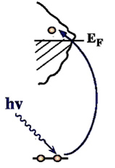
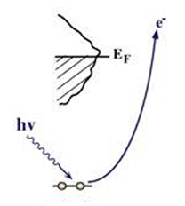
XAS and XPS
X-ray absorption and X-ray photoemission
I(ω_{FIXED})

Slide 76
Charge transfer effects in XAS and XPS
Charge transfer effects in XAS and XPS
Transition metal oxide: Ground state: 3d⁵ + 3d⁶L
Energy of 3d⁶L: Charge transfer energy Δ
3d⁶L
XPS
2p⁵3d⁵
XAS
2p⁵3d⁷L
Δ
3d⁵
Δ-Q
Ground State
Δ+U-Q ≈ Δ
2p⁵3d⁶L
2p⁵3d⁶

Slide 77
Charge transfer effects in XAS
Charge Transfer Effects in XAS
Δ+U-Q
Δ

Slide 78
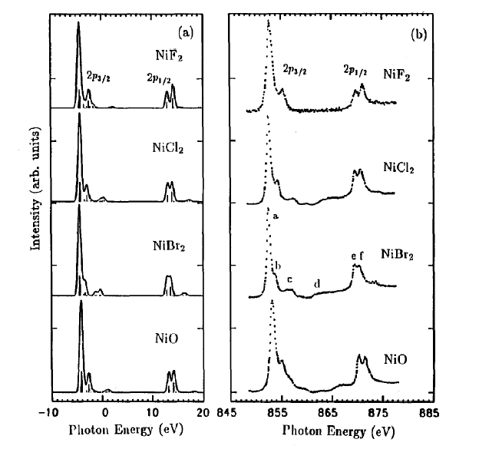
Charge transfer effects in XAS
Charge transfer
XAS = neutral
Self screened
Small charge transfer satellites

Slide 79
Charge transfer effects in XPS
Charge Transfer Effects in XPS
Δ-Q
Δ

Slide 80
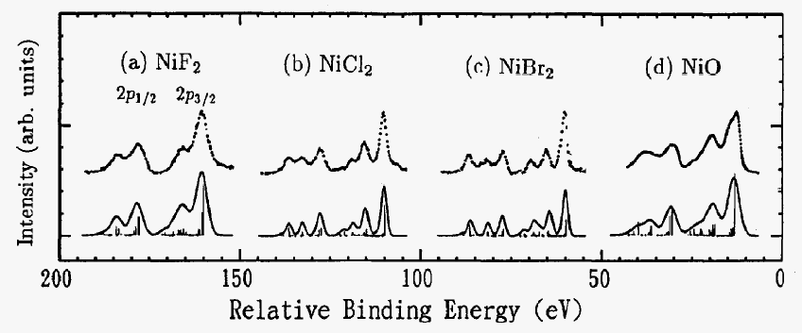
Charge transfer effects in XPS
Charge transfer effects in XPS
XAS = neutral
Self screened
Small charge transfer satellites
XPS = ionising
Large screening
Large charge transfer satellites

Slide 81
Charge transfer effects in XPS
1s and 2p XPS of Fe2O3

Slide 82
Charge transfer effects in XPS
1s and 2p XPS of Fe2O3

Slide 83
Charge transfer effects in XPS
1s and 2p XPS of Fe2O3

Slide 84
Charge transfer effects in XPS
1s and 2p XPS of Fe2O3

Slide 85
Charge transfer effects in XPS
1s and 2p XPS of Fe2O3
LDA + DMFT:
Use actual DMFT-based band structure
result to couple to the localised states
More on Thursday/friday
Phys. Rev. B.100, 075146 (2019)

Slide 86
Resonant Auger of NiO

Slide 87
Resonant Auger of NiO
Phys. Rev. B. 59, 9933 (1999)

Slide 88
Resonant Auger of NiO
3d⁸ → 2p⁵3d⁹
2p⁵3d⁹ → 3s⁰3d⁹ε
Phys. Rev. B. 59, 9933 (1999)

Slide 89
Resonant Auger of NiO
3d⁸ → 2p⁵3d⁹
3d⁹L→ 2p⁵3d¹⁰L
2p⁵3d⁹ → 3s⁰3d⁹ε
2p⁵3d¹⁰L → 3s⁰3d¹⁰ε
ONLY 2 PEAKS
Phys. Rev. B. 59, 9933 (1999)

Slide 90
Resonant Auger of NiO
Phys. Rev. B. 59, 9933 (1999)

Slide 91
Resonant Auger of NiO
Phys. Rev. B. 59, 9933 (1999)

Slide 92
Resonant Auger of NiO

