Slide 1
X-ray Absorption Spectroscopy
Introduction to XAS
XAS detection techniques
XAS spectral shape
multiplet calculations

Slide 2
X-ray Absorption Spectroscopy
Element specific
Sensitive to low concentrations
Applicable under extreme conditions
SPACE: Combination with x-ray microscopy
TIME: femtosecond XAS
RESONANCE: RIXS, RPES, R diffraction
Notes:
XAS is element specific because each element has specific binding energies for its core levels.
The XAS edge energy is essentially given by the core level binding energy.

Slide 3
Interaction of x-rays with matter
Interaction of x-rays with matter
The photon moves towards the atom

Slide 4
Interaction of x-rays with matter
Interaction of x-rays with matter
The photon is scattered by an electron
X-ray scattering
X-ray diffraction
X-ray scattering is independent of the x-ray energy

Slide 5
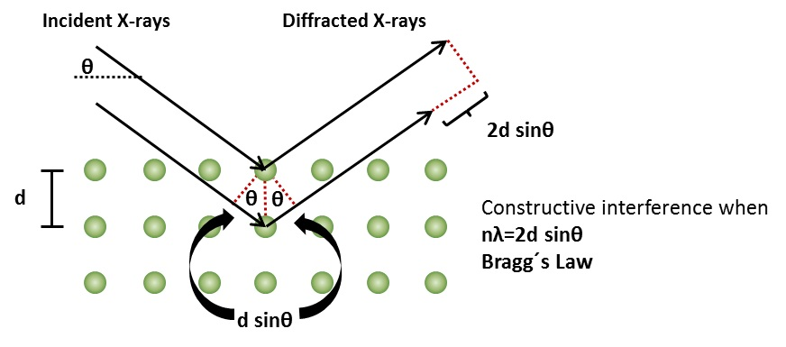
Interaction of x-rays with matter
Interaction of x-rays with matter
The photon is scattered by an electron
X-ray scattering
X-ray diffraction

Slide 6
Interaction of x-rays with matter 1
Interaction of x-rays with matter
The photon meets an electron and is annihilated

Slide 7
Interaction of x-rays with matter
Interaction of x-rays with matter
The electron gains the energy of the photon
and is turned into a blue electron.

Slide 8
Interaction of x-rays with matter
Interaction of x-rays with matter
The blue electron (feeling lonely) leaves the atom

Slide 9
Interaction of x-rays with matter
Interaction of x-rays with matter
The probability of photon annihilation determines
the intensity of the transmitted photon beam
I₀
I (XAS)
E_{k (XPS)}

Slide 10
Interaction of x-rays with matter
X-ray absorption
XAS, XPS
Elastic scattering (SAXS, XRD)
Inelastic scattering
Mn

Slide 11
X-ray absorption edges
X-ray Absorption Spectroscopy
Label
Orbital
eV
K
1s
6539
L _{I}
2s
769
L _{II}
2p_{1/2}
650
L _{III}
2p_{3/2}
639
M _{I}
3s
82
M _{II}
3p_{1/2}
47
M _{III}
3p_{3/2}
47

Slide 12
X-ray absorption edges
X-ray Absorption Spectroscopy
Label
Orbital
eV
K
1s
6539
L _{I}
2s
769
L _{II}
2p_{1/2}
650
L _{III}
2p_{3/2}
639
M _{I}
3s
82
M _{II}
3p_{1/2}
47
M _{III}
3p_{3/2}
47
BarKLa
The Nobel Prize in Physics 1917 was awarded to Charles Glover Barkla "for his discovery of the characteristic Röntgen radiation of the elements."

Slide 13
X-ray absorption edges
X-ray Absorption Spectroscopy
Label
Orbital
eV
K
1s
6539
L _{I}
2s
769
sharp
principal
diffuse
fundamental
L _{II}
2p_{1/2}
650
L _{III}
2p_{3/2}
639
M _{I}
3s
82
M _{II}
3p_{1/2}
47
J. Chem. Educ. 84, 757 (2007)
M _{III}
3p_{3/2}
47
BarKLa
The Nobel Prize in Physics 1917 was awarded to Charles Glover Barkla "for his discovery of the characteristic Röntgen radiation of the elements."

Slide 14
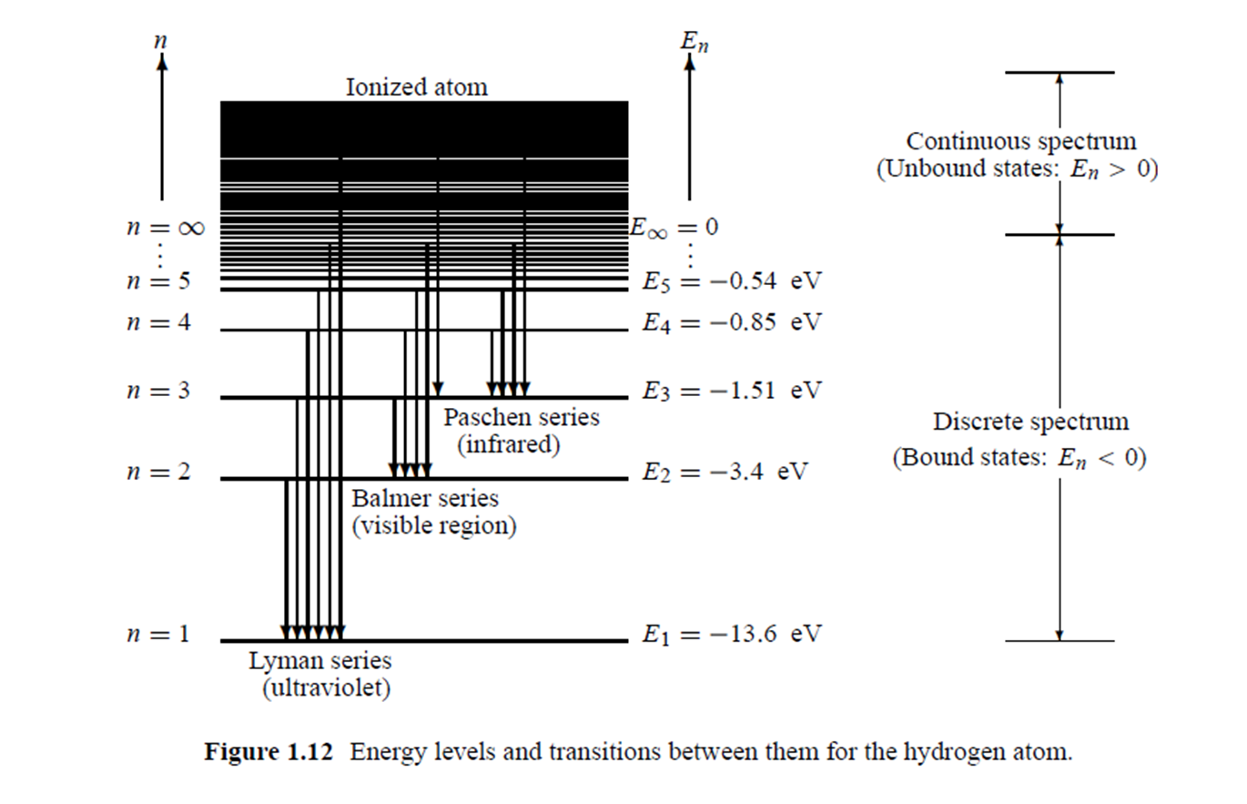
X-ray Absorption Spectroscopy
Atomic electronic structure X-ray absorption of an atom

Slide 15
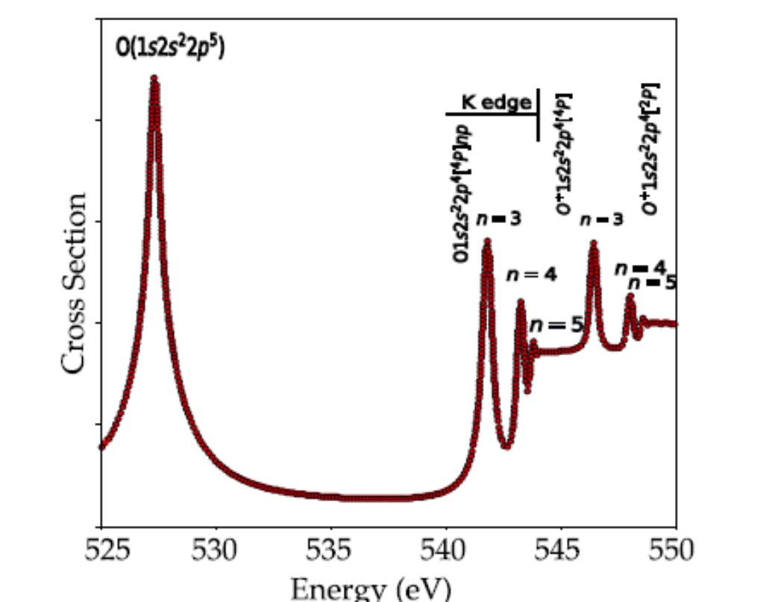
X-ray Absorption Spectroscopy
Atomic electronic structure X-ray absorption of an atom

Slide 16
X-ray Absorption Spectroscopy
Molecular electronic structure X-ray absorption of a molecule

Slide 17
XAS: spectral shape (O 1s)
Electronic structure of a transition metal oxide
Main bonding:
O2p with metal 4sp
Gives valence band and conduction band,
Mixed in character
Additional bonding
O2p with metal 3d;
Gives mixed 3d bands split by crystal field in octahedral symmetry, T2g states have pi-bonding and Eg states have sigma-bonding.
oxygen 1s core state
is localized at an oxygen atom
4sp
E_{g}
T_{2g}
O2p
O2s
O 1s ~530 eV
Notes:
17

Slide 18
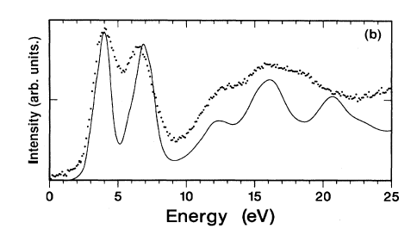
XAS: spectral shape (O 1s)
transition from oxygen 1s state
to an empty state
oxygen 1s core state
is localized at an oxygen atom
local empty DOS
dipole selection rule:
p-projected DOS
4sp
E_{g}
T_{2g}
O2p
O2s
O 1s ~530 eV
Fermi Golden Rule:
I_{XAS} = |<Φ_{f}|dipole| Φ_{i}>|² δ_{[ΔE=0]}
[Phys. Rev. B. 40, 5715 (1989); review in Chem. Rev. 120, 4056 (2020)]
Notes:
18

Slide 19
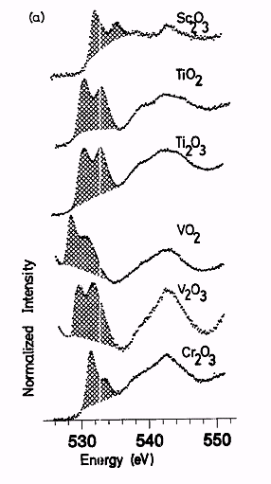
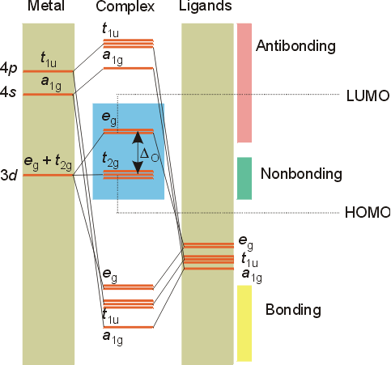
XAS: spectral shape (O 1s)
2p
2s
Phys. Rev. B.40, 5715 (1989)

Slide 20
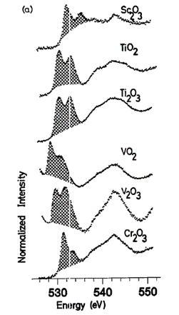
XAS: spectral shape
Electronic Structure: TiO₂
E
T₂
TiO₂: 3d⁰
E
T₂
Cr₂O₃: 3d⁰

Slide 21
XAS: spectral shape
Electronic Structure: TiO₂
E
T₂
4 >6
6
2 >3
5 >6
TiO₂: 3d⁰
E
T₂
Cr₂O₃: 3d⁰

Slide 22
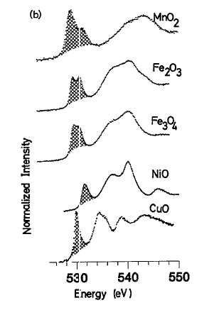
XAS: spectral shape
Electronic Structure: TiO₂
E
T₂
Fe2O3: 3d⁵
E
T₂
NiO: 3d⁸

Slide 23
XAS: spectral shape
Electronic Structure: TiO₂
E
T₂
2 >3
3
2 >3
0
0
Fe2O3: 3d⁵
E
T₂
NiO: 3d⁸

Slide 24
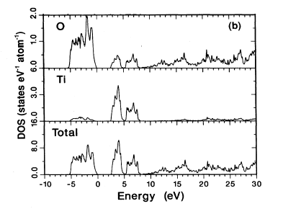
XAS: spectral shape (O 1s)
oxygen 1s > p DOS
Phys. Rev. B.40, 5715 (1989); 48, 2074 (1993)

Slide 25
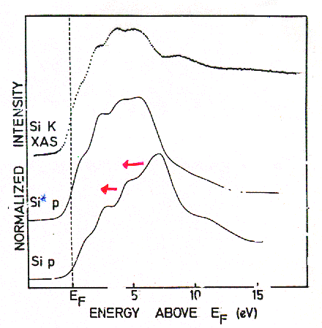
XAS: spectral shape
TiSi₂
Final State Rule: Spectral shape of XAS looks like final state DOS
Phys. Rev. B. 41, 11899 (1991)

Slide 26
XAS: spectral shape
TiSi₂
XAS codes:
Multiple scattering: FEFF, FDMNES, etc.
Band structure:
WIEN2K, Quantumespresso, etc.
Real-space DFT:
ADF,
ORCA, etc.
Phys. Rev. B. 41, 11899 (1991)

Slide 27
XAS: spectral shape (O 1s)
Crystal structure
Electronic structure calculation,
for example Density Functional Theory (DFT)
(in the presence of the core hole)
Calculation of the oxygen
p-projected local empty DOS
Compare with experiment
CODES: FEFF, Wien2K, VASP, QE, etc.

Slide 28
XAS: spectral shape (Ti 2p)
2p > 3d
4sp
E_{g}
T_{2g}
O2p
O2s
Ti 2p ~460 eV
Expect the d (and s-) projected Ti DOS
Why is experiment different?
Notes:
28

Slide 29
XAS: spectral shape (Ti 2p)
2p > 3d
4sp
E_{g}
T_{2g}
O2p
O2s
Ti 2p ~460 eV
Expect the d (and s-) projected Ti DOS
2p spin-orbit coupling (~6 eV)
Notes:
29

Slide 30
XAS: spectral shape (Ti 2p)
2p3d 2-electron integrals
4sp
E_{g}
T_{2g}
O2p
O2s
Ti 2p ~460 eV
Expect local d-projected Ti DOS
Core spin-orbit splitting
Overlap of core 2p and valence 3d states
>> many electron excitations dominate
Notes:
30

Slide 31
XAS: spectral shape (Ti 2p)
X-ray absorption
Fermi Golden Rule:
I_{XAS} = |<Φ_{f}|dipole| Φ_{i}>|² δ_{[ΔE=0]}
I_{XAS} = |< 2p⁵ 3d¹ |dipole| 3d⁰>|² δ_{[ΔE=0]}
Can NOT approximate 2p-3d interaction as extra potential
Large core hole spin-orbit coupling
Single electron (excitation) approximation breaks down :
I_{XAS} = |<3d |dipole| 2p>|² ρ

Slide 32
XAS: spectral shape (O 1s)
X-ray absorption
Fermi Golden Rule:
I_{XAS} = |<Φ_{f}|dipole| Φ_{i}>|² δ_{[ΔE=0]}
I_{XAS} = |< 1s¹ 2p⁵ |dipole| 2p⁴>|² δ_{[ΔE=0]}
Can neglect local 2p-2p interaction
Can approximate 1s-2p interaction as extra potential
No core hole spin-orbit coupling
Single electron (excitation) approximation :
I_{XAS} = |<2p |dipole| 1s>|² ρ

Slide 33
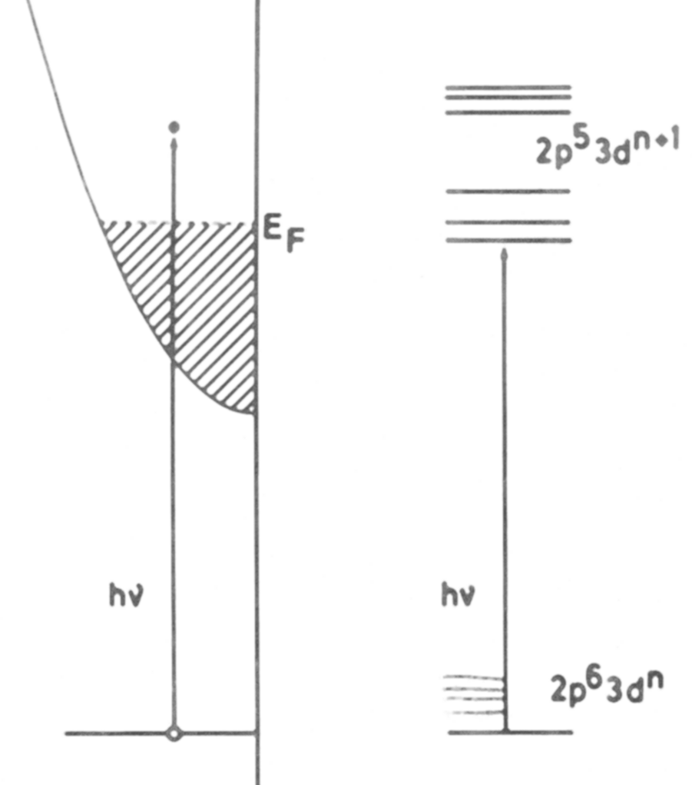
XAS
XAS: two models
Single Particle:
1s edges
(DFT codes, TD-DFT)
Total energy:
2p, 3s, 3p edges
(Multiplet codes)

Slide 34
X-ray absorption & Auger
X-ray Absorption Spectroscopy
Decay of 3d/valence electron to 3p core state
Energy used to excite a 3d/valence electron
Auger electron spectroscopy
Notes:
34

Slide 35
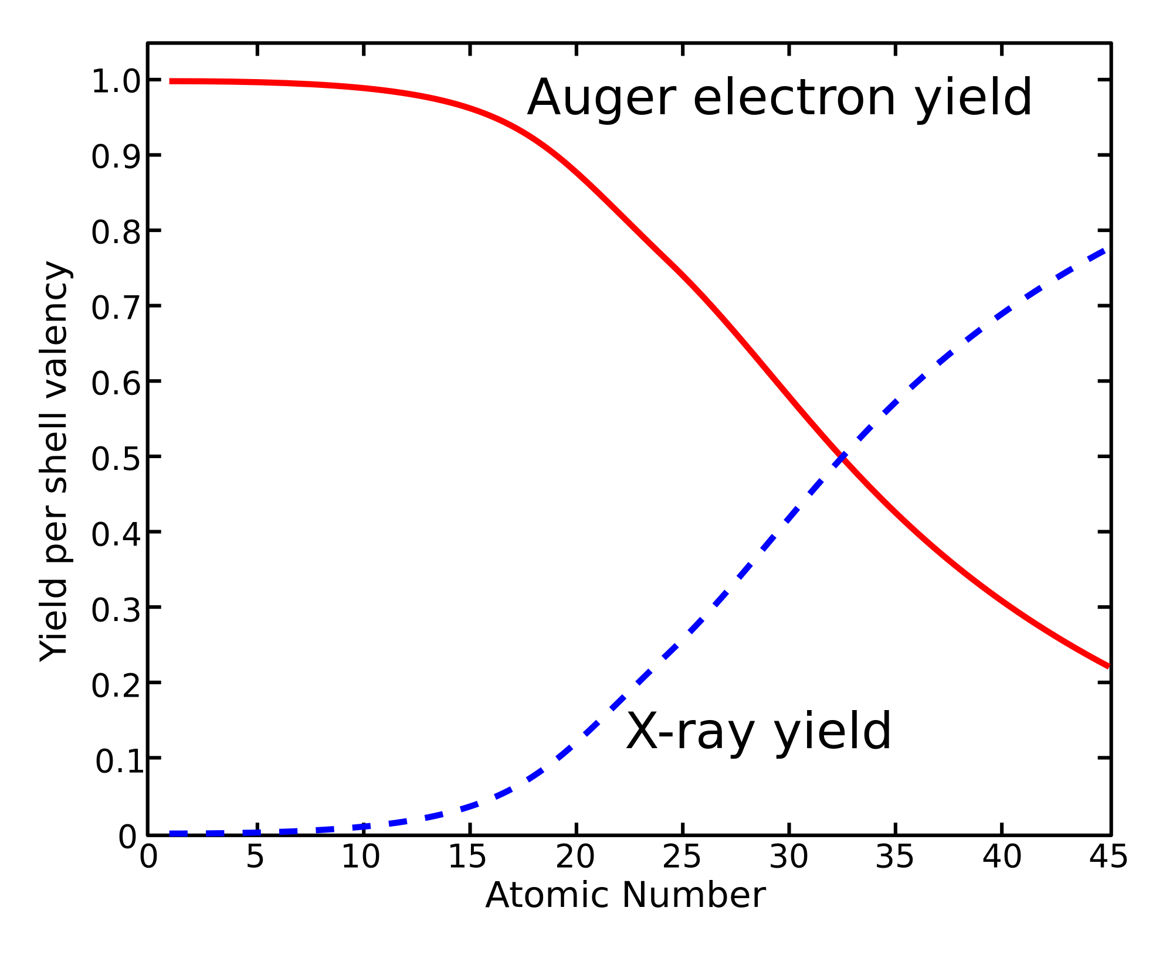
X-ray Absorption Spectroscopy
1s core state
Notes:
35

Slide 36
XAS: detection techniques

Slide 37
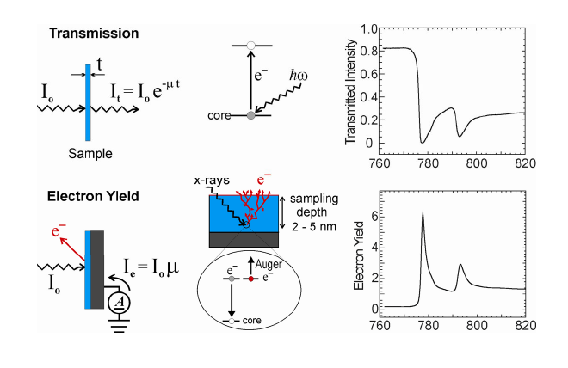
XAS: detection techniques
Use decay channels as detector
Uniform thickness
Uniform concentration of absorbing element
Thin enough for photons

Slide 38
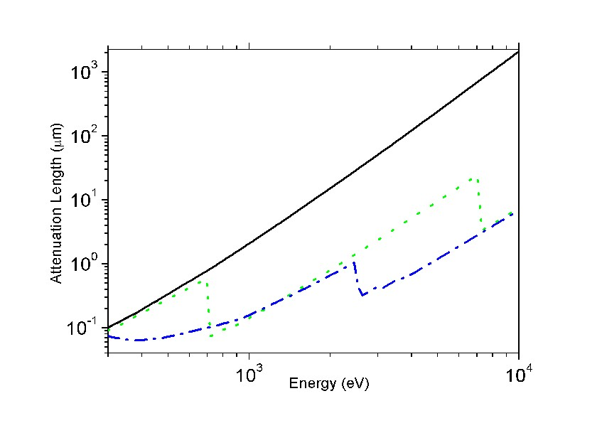
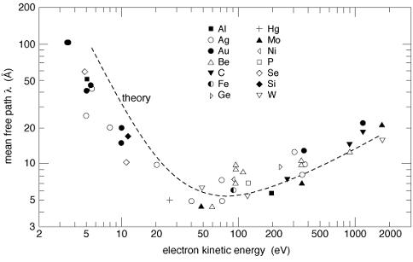
XAS: detection techniques
X-ray penetration lengths &
electron escape depths
100-1000 nm
(CXRO, but 20 nm for L edges)
1-5 nm

Slide 39
XAS: detection techniques
Use decay channels as detector
X-ray penetrate 1000 nm (λ_{X})
Electrons escape from 5 nm (λ_{E})
Number of core holes created in first 5 nm is proportional to μ
I_{TEY} ~ 1 / λ_{X} = μ_{X}

Slide 40
XAS: detection techniques
Transmission
(pinhole, saturation > thin samples)
Electron Yield
(surface sensitive)
Fluorescence Yield
(saturation & self-absorption:
> dilute samples)
[L edges are intrinsically distorted]

Slide 41
XAS: spectral shape
Interpretation of spectral shapes
Notes:
41

Slide 42
XAS
XAS: two models
Single Particle:
1s edges
(DFT codes, TD-DFT)
Total energy:
2p, 3s, 3p edges
(Multiplet codes)

Slide 43
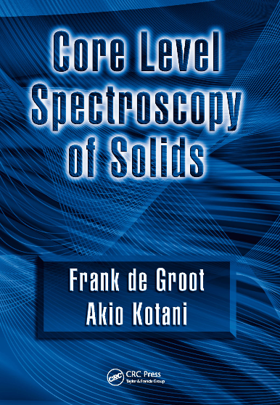
CHARGE TRANSFER MULTIPLETS
Charge Transfer Multiplet program
Used for the analysis of XAS, EELS,
Photoemission, Auger, XES
involving d and f-shells
ATOMIC PHYSICS
⇓
GROUP THEORY
⇓
MODEL HAMILTONIANS
Notes:
The TT-multiplets program can be used to explain the spectral shapes of all core level spectroscopies. XAFS, photoemission, auger, etc.
The program combines three advanced computer codes, an atomic physics code to describe all atomic interactions, a group theory code to describe the local symmetry (think of crystal fields) and model Hamiltonians to describe many body effects correlated systems.
AS A SIDE REMARK I WOULD LIKE TO MENTION that the active site in a catalyst is a perfect example of a correlated system. (in biocatalysis this is often realised)
The integrated program gives accurate descriptions of core level spectra, from a set of uniform electronic structure parameters.
The program is important for all of the new spectroscopies that I will describe.
The program is distributed from my homepage and it is used at some 50 institutes worldwide.

Slide 44
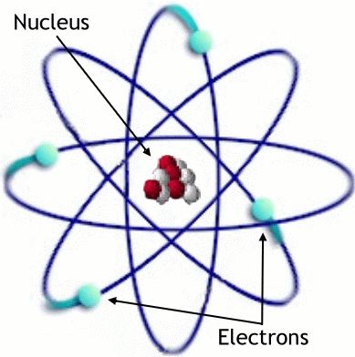
ATOMIC MULTIPLETS
Atomic Multiplet Theory
ΗΨ=EΨ
Kinetic Energy
Nuclear Energy
Electron-electron interaction
Spin-orbit coupling

Slide 45
ATOMIC MULTIPLETS
Atomic Multiplet Theory
ΗΨ=EΨ
X X
Kinetic Energy
Nuclear Energy
Electron-electron interaction
Spin-orbit coupling

Slide 46
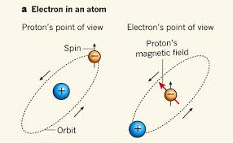
Spin-orbit coupling

Slide 47
Spin-orbit coupling
Term Symbols
H 2p orbital 0.00004 eV
Na 3p orbital 0.002 eV
Room temperature 0.025 eV
Ni 3d orbital 0.05 eV
Gd 4f orbital 0.2 eV
Shallow core hole
Ni 2p orbital 10 eV
Deep core hole
Pt 2p orbital 2000 eV

Slide 48
Term Symbol
Term symbols
^{2S+1}L_{J}

Slide 49
Term Symbols
Term symbols
Term symbols of a 2p¹3d¹ configuration
2p¹ → ²P_{1/2}, ²P_{3/2} (S=1/2, L=1)
3d¹ → ²D_{3/2}, ²D_{5/2} (S=1/2, L=2)

Slide 50
Term Symbols
Term symbols
Term symbols of a 2p¹3d¹ configuration
2p¹ → ²P_{1/2}, ²P_{3/2} (S=1/2, L=1)
3d¹ → ²D_{3/2}, ²D_{5/2} (S=1/2, L=2)
2p¹3d¹
→ S_{max} = S₁ + S₂ = 1
→ S_{min} = |S₁ - S₂| = 0
→ L_{max} = S₁ + S₂ = 3
→ L_{min} = |S₁ - S₂| = 1
→ S and L: steps of 1
→ S = {0,1}; L = {1,2,3}

Slide 51
Term Symbols
Term symbols
Term symbols of a 2p¹3d¹ configuration
2p¹3d¹
→ S = {0,1}; L = {1,2,3}
→ ¹P
→ ¹D
→ ¹F
→ ³P
→ ³D
→ ³F

Slide 52
Term Symbols
Term symbols
Term symbols of a 2p¹3d¹ configuration
2p¹3d¹
→ S = {0,1}; L = {1,2,3}
→ ¹P₁
→ ¹D₂
→ ¹F₃
→ ³P₀₁₂
→ ³D₁₂₃
→ ³F₂₃₄

Slide 53
2p XAS of TiO₂
Atomic multiplets: 2p XAS of Ti⁴⁺
2p XAS of Ti⁴⁺ ions
Ground state of Ti⁴⁺ is 3d⁰
Dipole transition 3d⁰→2p⁵3d¹
Ground state symmetry: ¹S₀
Final state symmetry: ²P⊗²D gives
¹P, ¹D, ¹F, and ³P, ³D, ³F

Slide 55
3d⁰ XAS calculation
Atomic multiplets: 2p XAS of Ti⁴⁺
Spin-orbit = 4.0 eV
Electron-electron = 5.0 eV
Spin-orbit = 0.4 eV
Electron-electron = 9 eV

Slide 56
Term Symbols and XAS
Atomic multiplets: 2p XAS of Ti⁴⁺
    Ti^{IV} ion in TiO₂:
    Ground state: 3d⁰
    Final state: 2p⁵3d¹
    Dipole transition: p-symmetry
    3d⁰-configuration: ¹S,
    2p¹3d⁹-configuration: ²P⊗²D = ^{1,3}PDF
    ,

Slide 57
Term Symbols and XAS
Atomic multiplets: 2p XAS of Ti⁴⁺
    Ti^{IV} ion in TiO₂:
    Ground state: 3d⁰
    Final state: 2p⁵3d¹
    Dipole transition: p-symmetry
    3d⁰-configuration: ¹S,
    2p¹3d⁹-configuration: ²P⊗²D = ^{1,3}PDF
    transition: ¹S ⊗¹P = ¹P
    possible final states: ¹P ,

Slide 58
Term Symbols and XAS
Atomic multiplets: 2p XAS of Ti⁴⁺
    Ti^{IV} ion in TiO₂:
    Ground state: 3d⁰
    Final state: 2p⁵3d¹
    Dipole transition: p-symmetry
    3d⁰-configuration: ¹S, j=0
    2p¹3d⁹-configuration: ²P⊗²D = ^{1,3}PDF j’=0,1,2,3,4
    p-transition: ¹P Δj=+1,0,-1
    ground state symmetry: ¹S₀
    possible final states: ¹P₁,³P₁,³D_{1,}

Slide 59
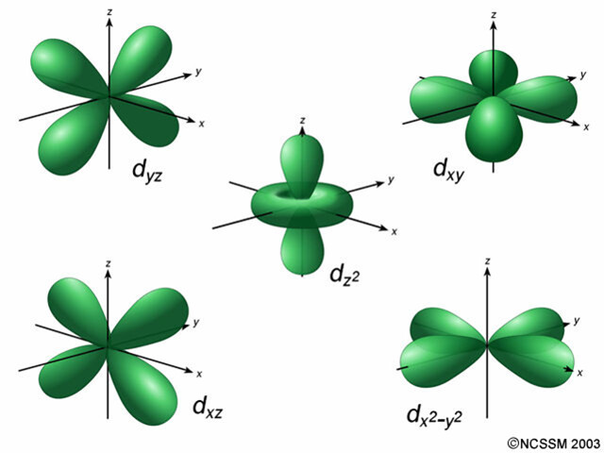
ATOMIC MULTIPLETS 3d¹
5 orbitals (each spin-up or spin-down) >> total 10 states
No electron-electron interaction: all states have the same energy
Quantum numbers: L=2 and S=½, notation as term symbol: ^{2S+1}L= ²D

Slide 60
ATOMIC MULTIPLETS 3d¹
Spin-orbit coupling couples L and S quantum numbers to a total quantum number J
J_{max}= L+S = 5/2, J_{min}= |L-S|= 3/2, Integer steps of J.
Two term symbols: L=2, S=½, and J = 5/2 >> notation as term symbol: ^{2S+1}L_{J}= ²D_{5/2}
L=2, S=½, and J = 3/2 >> notation as term symbol: ^{2S+1}L_{J}= ²D_{3/2}

Slide 61
ATOMIC MULTIPLETS 3d¹
Atomic Multiplet Theory
electron-electron
interaction
spin-orbit
coupling
3d¹
²D
²D_{3/2}
²D_{5/2}
(~50 meV)

Slide 62
ATOMIC MULTIPLETS 3d²
5 spin-up orbitals give 4 + 3 + 2 + 1 = 10 paired 3d² states
5 spin-down orbitals give 10 paired down-down 3d² states
There are 5x5 = 25 up-down states
In total 10+10+25 = 45 states
Can also be calculated as 10 x 9 / 2 = 45 states
Electron-electron interaction is different for different orbital combinations
There will be a number of different states with different energies.
Analysis shows that the states are ¹S, ³P, ¹D, ³F and ¹G

Slide 63
ATOMIC MULTIPLETS 3d²
Atomic Multiplet Theory
electron-electron
Interaction
(~2 eV)
spin-orbit
coupling
(~50 meV)
3d²
¹S
³F
¹G
³P
¹D
¹S₀
³P₂
¹G₄
³P₁
³P₀
³F₄
³F₂
³F₃
¹D₂
    Ground state:
    Given by Hunds rules
    max S
    max L
    min J (if less than half full)

Slide 64
ATOMIC MULTIPLETS 3d⁸
Atomic Multiplet Theory
electron-electron
Interaction
(~2 eV)
spin-orbit
coupling
(~50 meV)
3d⁸
¹S
³F
¹G
³P
¹D
¹S₀
³P₂
¹G₄
³P₁
³P₀
³F₄
³F₂
³F₃
¹D₂
    Ground state:
    Given by Hunds rules
    max S
    max L
    max J (if more than half full)

Slide 65
X-ray absorption from 3d⁸ to 2p⁵3d⁹
Atomic Multiplet Theory
2p⁵3d⁹
¹P
³F
¹D
³P
³D
¹P₁
³P₂
¹D₂
³P₁
³P₀
³F₄
³F₂
³F₃
³D₃
¹F
¹F₃
³D₁
³D₂
Dipole selection rule:
ΔJ=-1, 0 or +1
3d⁸
¹S
³F
¹G
³P
¹D
¹S₀
³P₂
¹G₄
³P₁
³P₀
³F₄
³F₂
³F₃
¹D₂

Slide 66
X-ray absorption from 3d⁸ to 2p⁵3d⁹
Atomic Multiplet Theory
2p⁵3d⁹
¹P
³F
¹D
³P
³D
¹P₁
³P₂
¹D₂
³P₁
³P₀
³F₄
³F₂
³F₃
³D₃
¹F
¹F₃
³D₁
³D₂
Dipole selection rule:
ΔJ=-1, 0 or +1
3d⁸
¹S
³F
¹G
³P
¹D
¹S₀
³P₂
¹G₄
³P₁
³P₀
³F₄
³F₂
³F₃
¹D₂

Slide 67
2p XAS of NiO with atomic multiplets
Atomic multiplets

Slide 68
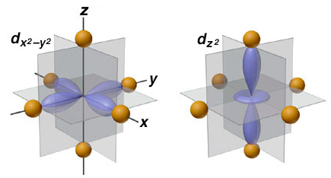
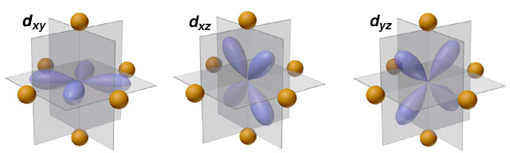
crystal field effect
Crystal Field Effects
e_{g} states
t_{2g} states

