Slide 1
CHARGE TRANSFER MULTIPLETS
Charge Transfer Multiplet program
Used for the analysis of all core level spectroscopies
involving d and f-shells
Write down all core level spectroscopies
Excitation
Decay
Resonances/scattering
Notes:
The TT-multiplets program can be used to explain the spectral shapes of all core level spectroscopies. XAFS, photoemission, auger, etc.
The program combines three advanced computer codes, an atomic physics code to describe all atomic interactions, a group theory code to describe the local symmetry (think of crystal fields) and model Hamiltonians to describe many body effects correlated systems.
AS A SIDE REMARK I WOULD LIKE TO MENTION that the active site in a catalyst is a perfect example of a correlated system. (in biocatalysis this is often realised)
The integrated program gives accurate descriptions of core level spectra, from a set of uniform electronic structure parameters.
The program is important for all of the new spectroscopies that I will describe.
The program is distributed from my homepage and it is used at some 50 institutes worldwide.

Slide 2
X-ray spectroscopies
3d⁸ + ω
XAS
XPS
2p⁵3d⁹
2p⁵3d⁸+e’

Slide 3
X-ray spectroscopies
3d⁸ + ω
XAS
XPS
2p⁵3d⁹
2p⁵3d⁸+e’
XES
3d⁸ + ω’
RIXS

Slide 4
X-ray spectroscopies
3d⁸ + ω
XAS
XPS
2p⁵3d⁹
2p⁵3d⁸+e’
XES
AES
3d⁸ + ω’
3p⁴3d⁹+e’
RIXS
RAES

Slide 5
X-ray spectroscopies
3d⁸ + ω
XAS
XPS
2p⁵3d⁹
2p⁵3d⁸+e’
XES
AES
3d⁸ + ω’
3p⁴3d⁹+e’
3d⁷ + e’
RIXS
RAES
RPES

Slide 6
X-ray spectroscopies
3d⁸ + ω
XAS
XPS
2p⁵3d⁹
2p⁵3d⁸+e’
XES
XES
AES
3d⁸ + ω’
3p⁴3d⁹+e’
3d⁷ + e’
3d⁷ +e’+ω’
RIXS
RAES
RPES
XES

Slide 7
X-ray spectroscopies
3d⁸ + ω
XAS¹
XPS²
2p⁵3d⁹
2p⁵3d⁸+e’
XES³
XES
AES⁴
IXS⁸
3d⁸ + ω’
3p⁴3d⁹+e’
3d⁷ + e’
3d⁷ +e’+ω’
RIXS⁵
RAES⁶
RPES⁷
XES

Slide 8
Electron spectroscopies
3d⁸ + e
APS
2p⁵3d¹⁰

Slide 9
Electron spectroscopies
3d⁸ + e
APS
2p⁵3d¹⁰
XES
3d⁹ + ω’
RIPES

Slide 10
Electron spectroscopies
3d⁸ + e
APS
2p⁵3d¹⁰
XES
AES
3d⁹ + ω’
3d⁸+e’
RIPES
REELS

Slide 11
Electron spectroscopies
3d⁸ + e
RIXS
RAES
RPES
XES
RIPES
REELS
APS⁹
EELS¹²
2p⁵3d¹⁰
XES
AES
3d⁹ + ω’
3d⁸+e’
RIPES¹⁰
REELS¹¹

Slide 12
Resonant spectroscopies
RIXS (ω,ω’)
RAES
RPES
XES
RIPES
REELS
(+ coincidences)
(+ polarizations)
(+ momentum)
(+ time, space)
RIXS
X-ray out (ω’)
X-ray in (ω)

Slide 13
Resonant spectroscopies
RIXS (ω,ω’)
RAES (ω,e’)
RPES
XES
RIPES
REELS
(+ coincidences)
(+ polarizations)
(+ momentum)
(+ time, space)
RAES
Electron out (e’)
X-ray in (ω)

Slide 14
Resonant spectroscopies
RIXS (ω,ω’)
RAES (ω,e’)
RPES (ω,e’)
XES (ω’,e’)
RIPES
REELS
(+ coincidences)
(+ polarizations)
(+ momentum)
(+ time, space)
XES
Electron out (e’)
X-ray out (ω’)

Slide 15
Resonant spectroscopies
RIXS (ω,ω’)
RAES (ω,e’)
RPES (ω,e’)
XES (ω’,e’)
RIPES (e,ω’)
REELS (e,e’)
(+ coincidences)
(+ polarizations)
(+ momentum)
(+ time, space)
XES
Electron out (e’)
X-ray out (ω’)

Slide 16
CHARGE TRANSFER MULTIPLETS
Charge Transfer Multiplet program
Used for the analysis of XAS, EELS,
Photoemission, Auger, XES
involving d and f-shells
ATOMIC PHYSICS
⇓
GROUP THEORY
⇓
MODEL HAMILTONIANS
Notes:
The TT-multiplets program can be used to explain the spectral shapes of all core level spectroscopies. XAFS, photoemission, auger, etc.
The program combines three advanced computer codes, an atomic physics code to describe all atomic interactions, a group theory code to describe the local symmetry (think of crystal fields) and model Hamiltonians to describe many body effects correlated systems.
AS A SIDE REMARK I WOULD LIKE TO MENTION that the active site in a catalyst is a perfect example of a correlated system. (in biocatalysis this is often realised)
The integrated program gives accurate descriptions of core level spectra, from a set of uniform electronic structure parameters.
The program is important for all of the new spectroscopies that I will describe.
The program is distributed from my homepage and it is used at some 50 institutes worldwide.

Slide 17
3d XAS of rare earths
4f electrons are localized
No effect of surroundings (crystal field < lifetime broadening)
3d XAS is self screened > no charge transfer effect
Initial state
electron-electron interaction.
Valence spin-orbit coupling
Final state
+ core hole – valence hole ‘multiplet’ interaction.
+ core hole spin-orbit coupling

Slide 18
3d XAS of rare earths
Nd³⁺ 4f³ system: ground state is ⁴I_{9/2}

Slide 19
2p XAS of 3d transition metal oxides
3d electrons are less localized
Effect of surroundings (crystal field effect)
3d XAS is self screened > weak charge transfer effect
Initial state
electron-electron interaction.
valence spin-orbit coupling
crystal field effect
Final state
core hole – valence hole ‘multiplet’ interaction.
core hole spin-orbit coupling
crystal field effect

Slide 20
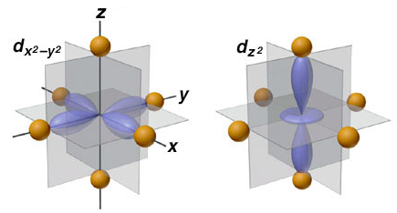
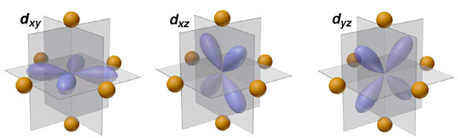
crystal field effect
Crystal Field Effects
e_{g} states
t_{2g} states

Slide 21
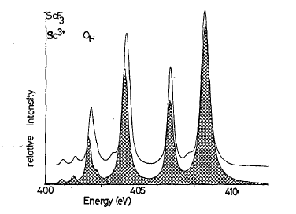
2p XAS of ScF3 with crystal field multiplets
Comparison with Experiment
PHYS. Rev. B. 41, 928 (1990)

Slide 22
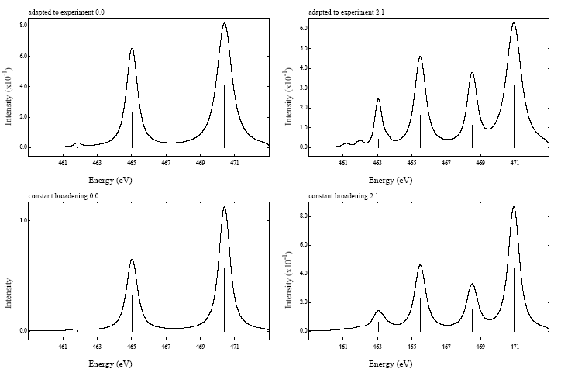
X-ray absorption from 3d⁰ to 2p⁵3d¹
Atomic Multiplet Theory
2p⁵3d¹
¹P
³F
¹D
³P
³D
¹P₁
³P₂
¹D₂
³P₁
³P₀
³F₄
³F₂
³F₃
³D₃
¹F
¹F₃
³D₁
³D₂
Dipole selection rule:
ΔJ=-1, 0 or +1
J=J’≠0
3d⁰
¹S
¹S₀

Slide 23
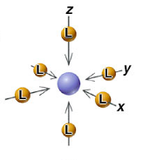
CRYSTAL FIELD EFFECT
Octahedral crystal field splitting
3d¹
²D
²E_{g}
²T_{2g}
metal ion
in free space
in symmetrical field
in octahedral ligand field
e_{g}
x²-y² z²
t_{2g}
yz xz xy
x²-y² yz z² xz xy

Slide 24
CRYSTAL FIELD EFFECT
Atomic Multiplet Theory
3d^{N}
J=0
J=4
J=1
J=2
J=3
A₁
T₂
T₁
E
A₁
E
T₂
A₂
T₂
T₁
T₁
    Branching rules:
    Same rules for any quantum number
    S, L or J

Slide 25
X-ray absorption from 3d⁰ to 2p⁵3d¹
Atomic Multiplet Theory
2p⁵3d¹
¹P
³F
¹D
³P
³D
¹P₁
³P₂
¹D₂
³P₁
³P₀
³F₄
³F₂
³F₃
³D₃
¹F
¹F₃
³D₁
³D₂
T₁
T₂
E
T₂
E
T₂
E
T₂
E
T₁
T₁
A₂
T₁
T₂
A₂
T₁
T₂
A₂
T₁
T₂
A₁
A₁
T₁
T₂
E
3d⁰
¹S
¹S₀
A₁
ee LS CFS

Slide 26
X-ray absorption from 3d⁰ to 2p⁵3d¹
Atomic Multiplet Theory
2p⁵3d¹
¹P
³F
¹D
³P
³D
¹P₁
³P₂
¹D₂
³P₁
³P₀
³F₄
³F₂
³F₃
³D₃
¹F
¹F₃
³D₁
³D₂
T₁
T₂
E
T₂
E
T₂
E
T₂
E
T₁
T₁
A₂
T₁
T₂
A₂
T₁
T₂
A₂
T₁
T₂
A₁
A₁
T₁
T₂
E
3d⁰
¹S
¹S₀
A₁
ee LS CFS
2 3 7 8 5

Slide 27
X-ray absorption from 3d⁰ to 2p⁵3d¹
Atomic Multiplet Theory
Dipole selection rule:
ΔJ=T₁
(cubic symmetry)
2p⁵3d¹
¹P
³F
¹D
³P
³D
¹P₁
³P₂
¹D₂
³P₁
³P₀
³F₄
³F₂
³F₃
³D₃
¹F
¹F₃
³D₁
³D₂
T₁
T₂
E
T₂
E
T₂
E
T₂
E
T₁
T₁
A₂
T₁
T₂
A₂
T₁
T₂
A₂
T₁
T₂
A₁
A₁
T₁
T₂
E
3d⁰
¹S
¹S₀
A₁
ee LS CFS
2 3 7 8 5

Slide 28
2p XAS of ScF3 with crystal field multiplets
Comparison with Experiment
PHYS. Rev. B. 41, 928 (1990)

Slide 29
Multiplet calculations
valence e-e interactions F_{dd}
core-valence e-e F_{pd} G_{pd}
core & valence spin-orbit ζ
crystal field 10Dq, Ds, Dt
molecular field, M or H
e-e screening κ
charge transfer Δ, U, Q
hopping T_{Γ}
ionic 3d
(4d, 5d)
4f, 5f
covalent 3d
mixed valence f
ATOMIC
SYMMETRY
BONDING

Slide 30
Multiplet calculations
valence e-e interactions F_{dd}
core-valence e-e F_{pd} G_{pd}
core & valence spin-orbit ζ
crystal field 10Dq, Ds, Dt
molecular field, M or H
e-e screening κ
charge transfer Δ, U, Q
hopping T_{Γ}
ionic 3d
(4d, 5d)
4f, 5f
3d ions
covalent 3d
mixed valence f
ATOMIC
SYMMETRY
BONDING

Slide 31
Charge transfer effects
Charge Transfer Effects
Hubbard U for a 3d⁸ ground state:
U= E(3d⁷) + E(3d⁹) – E(3d⁸) – E(3d⁸)
Ligand-to-Metal Charge Transfer (LMCT):
Δ= E(3d⁹L) – E(3d⁸)

Slide 32
Charge transfer effects
Charge Transfer Effects
Main screening mechanism in XAS of oxides:
Ligand-to-metal charge transfer
Charge transfer energy Δ is important for XAS
Hubbard U is NOT important for XAS spectral shape
(It is important for (e.g.) XPS spectral shapes)

Slide 33
Charge transfer effects in XAS and XPS
transition metal oxides
Ground state: 3d⁸ + 3d⁹L
Energy of 3d⁹L: Charge transfer energy Δ
3d⁹L
Δ
3d⁸
Ground State

Slide 34
Charge Transfer Effects
3d⁹L
Δ
3d⁸

Slide 35
Charge Transfer Effects
9
3d⁹L
Δ
8
3d⁸

Slide 36
Charge Transfer Effects
β 3d⁸ - α 3d⁹L
α 3d⁸ + β 3d⁹L
3d⁹L
Δ
3d⁸

Slide 37
Charge transfer effects
Charge Transfer Effects
NiO: Ground state: 3d⁸ + 3d⁹L
Energy of 3d⁹L: Charge transfer energy Δ
3d⁹L
3d⁸
2p⁵3d¹⁰L
2p⁵3d⁹
Δ
Δ+U-Q ≈ Δ

Slide 38
β 3d⁸ - α 3d⁹L
α 3d⁸ + β 3d⁹L
β’ c3d⁹ – α’ c3d¹⁰L
α' c3d⁹ + β’ c3d¹⁰L
Charge transfer effects
~0
~1
Δ
Δ+U-Q ≈ Δ
Intensity bonding combination: [α α’+ β β’]²
α ≈ α’ ≈ (α²+ β²⁾² =1

Slide 39
β 3d⁵ - α 3d⁶L
α 3d⁵ + β 3d⁶L
β’ c3d⁶ – α’ c3d⁷L
α' c3d⁶ + β’ c3d⁷L
Charge transfer effects
~0
~1
Δ
Δ+U-Q ≈ Δ
Intensity anti-bonding combination: [α β’- β α’]²
α ≈ α’ ≈ (αβ – βα)² =0

Slide 40
Charge transfer effects
Charge Transfer Effects
Neutral experiments are self-screened
XAS, optical, EPR, EELS, RIXS
>> small screening satellites
>> crystal field theory can be used
Ionising experiments are not self-screened
XPS, Auger,
>> large screening > large satellites
>> crystal field theory can not be used

Slide 41
Charge transfer effects in XAS and XPS
Charge transfer effects in XAS and XPS
Transition metal oxide: Ground state: 3d⁵ + 3d⁶L
Energy of 3d⁶L: Charge transfer energy Δ
3d⁶L
XPS
2p⁵3d⁵
XAS
2p⁵3d⁷L
Δ
3d⁵
Δ-Q
Ground State
Δ+U-Q ≈ Δ
2p⁵3d⁶L
2p⁵3d⁶

Slide 42
Charge transfer effects
Charge Transfer Effects
NiO: Ground state: 3d⁸ + 3d⁹L
Energy of 3d⁹L: Charge transfer energy Δ
3d⁹L
3d⁸
2p⁵3d¹⁰L
2p⁵3d⁹
Δ
Δ+U-Q ≈ Δ

Slide 43
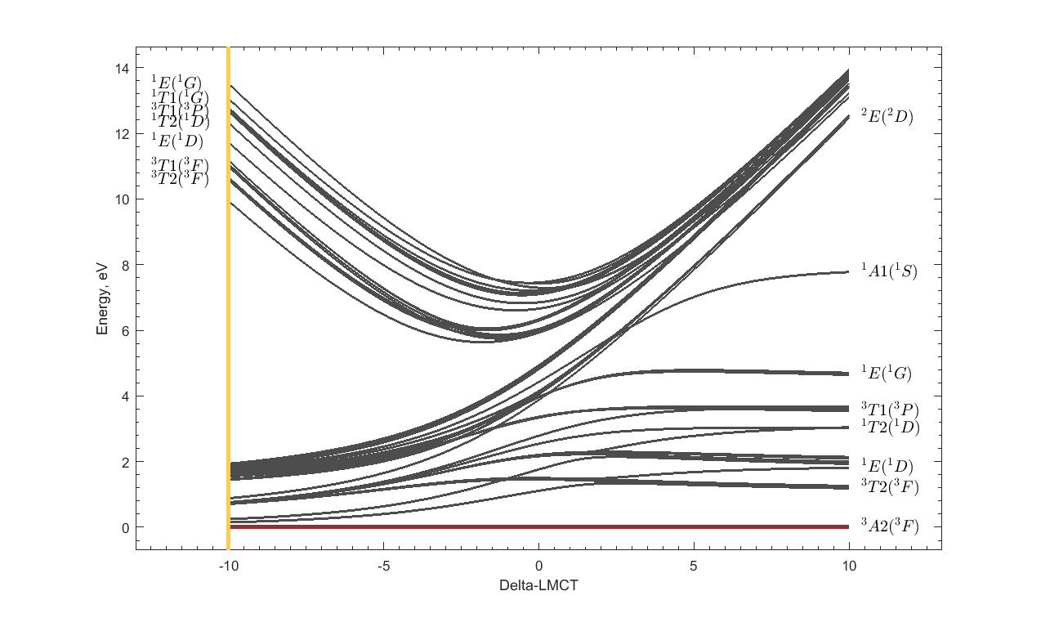
Tanabe-Sugano diagrams with charge transfer
Tanabe-Sugano with Charge transfer
α 3d⁸ + β 3d⁹L
NiO
Cu³⁺

Slide 44
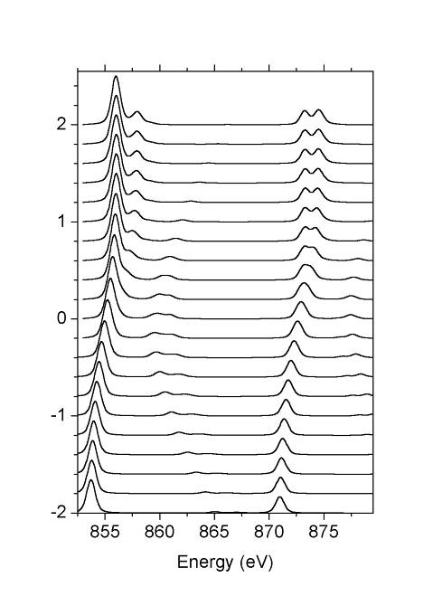
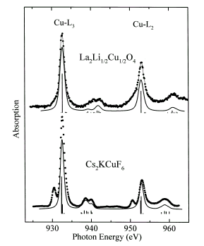
Charge transfer effects in XAS
Charge Transfer effects
3d⁸ + 3d⁹L
Δ=10
30% 3d⁸
¹A₁
Δ=5
NiO
Δ=0
La₂Li_{½}Cu_{½}O₄
30% 3d⁸
³A₂
Δ=-5
Δ=-10
Chem. Phys. Lett. 297, 321 (1998)

Slide 45
LMCT and MLCT: π - bonding
Fe^{III}: Ground state: 3d⁵ + 3d⁶L
3d⁶L
3d⁵
2p⁵3d⁷L
2p⁵3d⁶
Δ
Δ+U-Q ≈ Δ
with Ed Solomon (Stanford) JACS 125, 12894 (2003),
JACS 128, 10442 (2006), JACS 129, 113 (2007)

Slide 46
LMCT and MLCT: π - bonding
Fe^{III}: Ground state: 3d⁵ + 3d⁶L + 3d⁴L
2p⁵3d⁵L
2p⁵3d⁷L
2p⁵3d⁶
3d⁴L
3d⁶L
3d⁵
Δ_{π}-U+Q ≈ Δ_{π} + 2
Δ_{π}
Δ
Δ+U-Q ≈ Δ - 2
with Ed Solomon (Stanford) JACS 125, 12894 (2003),
JACS 128, 10442 (2006), JACS 129, 113 (2007)

Slide 47
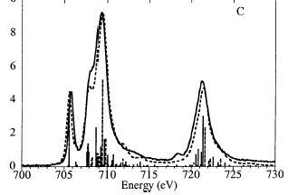
LMCT and MLCT: π - bonding
Fe^{III}(tacn)₂
Fe^{III}(CN)₆
with Ed Solomon (Stanford) JACS 125, 12894 (2003),
JACS 128, 10442 (2006), JACS 129, 113 (2007)

Slide 48
Multiplet calculations
Calculated for an atom/ion
Valence and core spin-orbit coupling
Core and valence electron-electron interaction.
Comparison with experiment
Core hole potential and lifetime
Local symmetry (crystal field)
Spin-spin interactions (molecular field)
Core hole screening effects (charge transfer)
Notes:
48

Slide 49
First Principle Multiplet calculations
Calculated for an atom/ion
Valence and core spin-orbit coupling
Core and valence electron-electron interaction.
Comparison with experiment
Core hole potential and lifetime
Local symmetry (crystal field)
Spin-spin interactions (molecular field)
Core hole screening effects (charge transfer)
Notes:
49

Slide 50
2p XAS first-principle codes
SOLIDS
Band structure multiplet (Haverkort, Green, Hariki)
Cluster DFT multiplet (Ikeno, Ramanantoanina, Delley)
MOLECULES
Restricted Active Space CI (Odelius, Kuhn)
Restricted Open-shell CI (Neese)
TDDFT/BSE
Time-Dependent DFT (Joly)
Bethe-Salpeter (Rehr, Shirley)
Multi-channel Multiple-scattering (Kruger)
Notes:
50

Slide 51
XPS

Slide 52
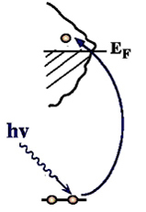
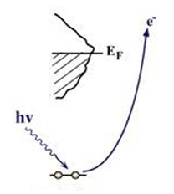
XAS and XPS
X-ray absorption and X-ray photoemission
I(ω_{FIXED})

Slide 53
Charge transfer effects in XAS and XPS
Charge transfer effects in XAS and XPS
Transition metal oxide: Ground state: 3d⁵ + 3d⁶L
Energy of 3d⁶L: Charge transfer energy Δ
3d⁶L
XPS
2p⁵3d⁵
XAS
2p⁵3d⁷L
Δ
3d⁵
Δ-Q
Ground State
Δ+U-Q ≈ Δ
2p⁵3d⁶L
2p⁵3d⁶

Slide 54
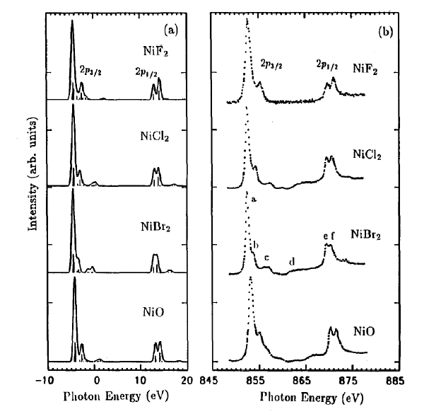
Charge transfer effects in XAS
Charge transfer
XAS = neutral
Self screened
Small charge transfer satellites

Slide 55
Charge transfer effects in XAS
Charge Transfer Effects in XAS
Δ+U-Q
Δ

Slide 56
Charge transfer effects in XPS
Charge Transfer Effects in XPS
Δ-Q
Δ

Slide 57
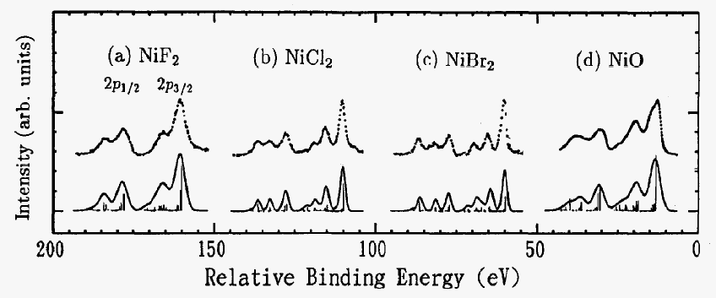
Charge transfer effects in XPS
Charge transfer effects in XPS
XAS = neutral
Self screened
Small charge transfer satellites
XPS = ionising
Large screening
Large charge transfer satellites

Slide 58
Charge transfer effects in XPS
1s and 2p XPS of Fe2O3

Slide 59
Charge transfer effects in XPS
1s and 2p XPS of Fe2O3

Slide 60
Charge transfer effects in XPS
1s and 2p XPS of Fe2O3

Slide 61
Charge transfer effects in XPS
1s and 2p XPS of Fe2O3

Slide 62
Charge transfer effects in XPS
1s and 2p XPS of Fe2O3
LDA + DMFT:
Use actual DMFT-based band structure
result to couple to the localised states
More on Thursday/friday
Phys. Rev. B.100, 075146 (2019)

Slide 63
Resonant Auger of NiO

Slide 64
Resonant Auger of NiO
Phys. Rev. B. 59, 9933 (1999)

Slide 65
Resonant Auger of NiO
3d⁸ → 2p⁵3d⁹
2p⁵3d⁹ → 3s⁰3d⁹ε
Phys. Rev. B. 59, 9933 (1999)

Slide 66
Resonant Auger of NiO
3d⁸ → 2p⁵3d⁹
3d⁹L→ 2p⁵3d¹⁰L
2p⁵3d⁹ → 3s⁰3d⁹ε
2p⁵3d¹⁰L → 3s⁰3d¹⁰ε
ONLY 2 PEAKS
Phys. Rev. B. 59, 9933 (1999)

Slide 67
Resonant Auger of NiO
Phys. Rev. B. 59, 9933 (1999)

Slide 68
Resonant Auger of NiO
Phys. Rev. B. 59, 9933 (1999)

Slide 69
Resonant Auger of NiO

