Slide 1
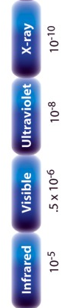
RIXS and excited states
Core level
1000 eV
1 eV
100 meV
electronic
dd, CT
magnon
phonon
Ψ0

Slide 2
RIXS and excited states
Core level
1000 eV
1 eV
100 meV
electronic
dd, CT
UV/Vis
magnon
phonon
IR
Ψ0

Slide 3
RIXS and excited states
Core level
1000 eV
1 eV
100 meV
electronic
dd, CT
(Resonant) Raman
magnon
phonon
Ψ0

Slide 4
RIXS and excited states
Core level
1000 eV
1 eV
100 meV
(Resonant) X-ray Raman
electronic
dd, CT
magnon
phonon
Ψ0

Slide 5
RIXS and excited states
Core level
1000 eV
1 eV
100 meV
(Resonant) X-ray Raman
electronic
dd, CT
RIXS
Resonant Inelastic X-ray Scattering
R-XES
Resonant X-ray Emission Spectroscopy
magnon
phonon
Ψ0

Slide 6
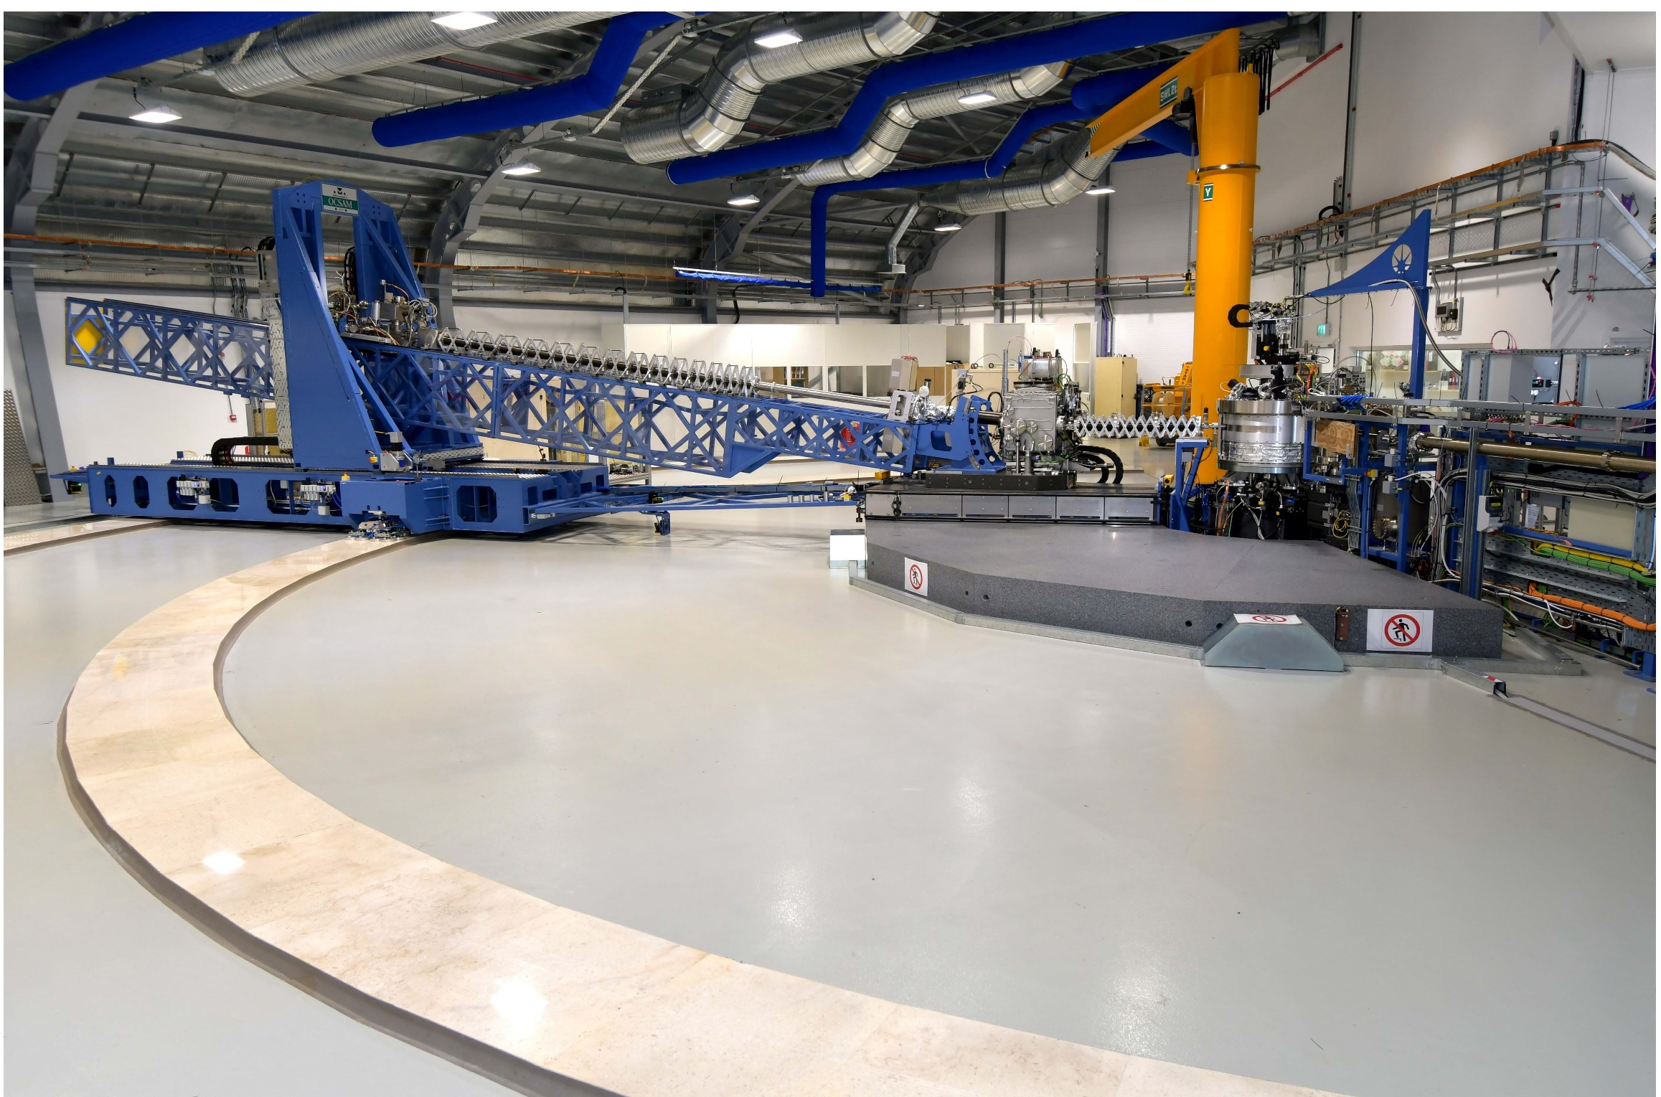
Resonant Inelastic X-ray Scattering

Slide 7
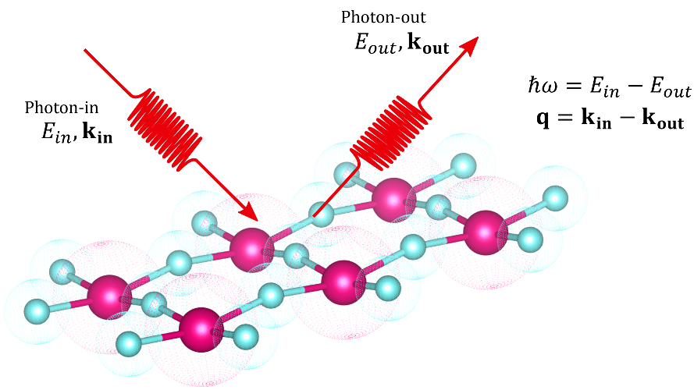

Resonant Inelastic X-ray Scattering
E_{in},, k_{in}, e_{in}
E_{out}, ,k_{out}, e_{out}
E_{in,} k_{in}, e_{in}
E_{out ,}k_{out}, e_{out}
h𝝎= E_{in} - E_{out}
q = k_{in} - k_{out}
Energy
Polarization
Momentum

Slide 8
Core-valence (electronic) RIXS
2p
electronic
dd, CT
magnon
vibrations
Ψ0

Slide 9
Cu2+ 2p3d RIXS (from 3d⁹ to 2p⁵3d¹⁰ to 3d⁹)
Atomic Multiplet Theory
ATOMIC
Dipole selection rule:
ΔJ=-1, 0 or +1
J=J’≠0
3d⁹
²D
²D_{5/2}
²D_{3/2}

Slide 10
Cu2+ 2p3d RIXS (from 3d⁹ to 2p⁵3d¹⁰ to 3d⁹)
Atomic Multiplet Theory
ATOMIC
Dipole selection rule:
ΔJ=-1, 0 or +1
J=J’≠0
2p⁵
²P
²P_{3/2}
²P_{1/2}
3d⁹
²D
²D_{5/2}
²D_{3/2}

Slide 11
Cu2+ 2p XAS (from 3d⁹ to 2p⁵3d¹⁰)
Atomic Multiplet Theory
ATOMIC
Dipole selection rule:
ΔJ=-1, 0 or +1
J=J’≠0
2p⁵
²P
²P_{3/2}
²P_{1/2}
Only L₃ edge
3d⁹
²D
²D_{5/2}
²D_{3/2}

Slide 12
Cu2+ 2p3d RIXS (from 3d⁹ to 2p⁵3d¹⁰ to 3d⁹)
Atomic Multiplet Theory
ATOMIC
Dipole selection rule:
ΔJ=-1, 0 or +1
J=J’≠0
2p⁵
²P
²P_{3/2}
²P_{1/2}
Only L₃ edge
Spin-orbit excitation
Elastic line in 2p3d RIXS
3d⁹
²D
²D_{5/2}
²D_{3/2}

Slide 13
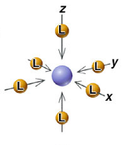
CRYSTAL FIELD EFFECT
Octahedral crystal field splitting
3d¹
²D
²E_{g}
²T_{2g}
metal ion
in free space
in symmetrical field
in octahedral ligand field
e_{g}
x²-y² z²
t_{2g}
yz xz xy
x²-y² yz z² xz xy

Slide 14
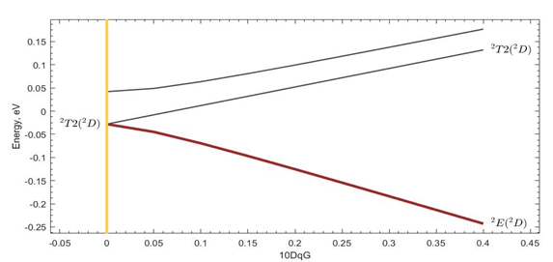
CRYSTAL FIELD EFFECT
Octahedral crystal field splitting
3d⁹
²D
²D_{5/2}
²D_{3/2}
²T_{2g (1)}
²T_{2g (2)}
²E_{g}

Slide 15
Cu2+ 2p3d RIXS (from 3d⁹ to 2p⁵3d¹⁰ to 3d⁹)
Atomic Multiplet Theory
OCTAHEDRAL
Dipole selection rule:
ΔJ=-1, 0 or +1
J=J’≠0
2p⁵
²P
²P_{3/2}
²P_{1/2}
Crystal field excitations
Elastic line in 2p3d RIXS
3d⁹
²D
²D_{5/2}
²D_{3/2}
²T_{2g (1)}
²T_{2g (2)}
²E_{g}

Slide 16
Cu2+ 2p3d RIXS (from 3d⁹ to 2p⁵3d¹⁰ to 3d⁹)
Atomic Multiplet Theory
OCTAHEDRAL
Dipole selection rule:
ΔJ=-1, 0 or +1
J=J’≠0
2p⁵
²P
²P_{3/2}
²P_{1/2}
Crystal field mixes J states
Both L₃ and L₂ edges
Crystal field excitations
Elastic line in 2p3d RIXS
3d⁹
²D
²D_{5/2}
²D_{3/2}
²T_{2g (1)}
²T_{2g (2)}
²E_{g}

Slide 17
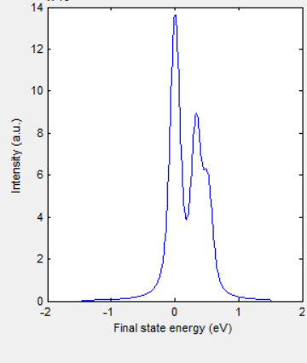
Cu2+ 2p3d RIXS (from 3d⁹ to 2p⁵3d¹⁰ to 3d⁹)
Atomic Multiplet Theory
OCTAHEDRAL
Dipole selection rule:
ΔJ=-1, 0 or +1
J=J’≠0
2p⁵
²P
²P_{3/2}
²P_{1/2}
3d⁹
²D
²D_{5/2}
²D_{3/2}
²T_{2g (1)}
²T_{2g (2)}
²E_{g}

Slide 18
Core-core RIXS
2p
3s
electronic
dd, CT
magnon
vibrations
Ψ0

Slide 19
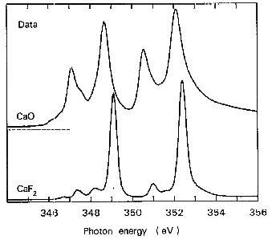
Resonant Inelastic X-ray Spectroscopy
2p3s RIXS of CaF₂
2p XAS of CaF₂
3d⁰
ω
2p⁵3d¹
ω’
3s¹3d¹

Slide 20
2p3s RIXS of CaF₂
2p3s RIXS of CaF₂
Ground state is 3d⁰
Excitation (i₀) 3d⁰ → (x) 2p⁵3d¹
Decay (x) 2p⁵3d¹ → (f) 3s¹3d¹

Slide 21
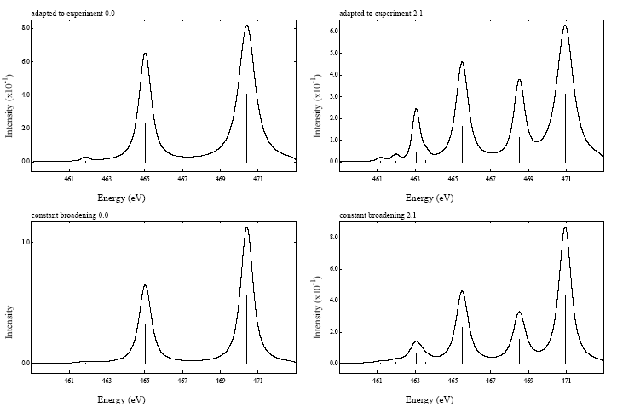
X-ray absorption from 3d⁰ to 2p⁵3d¹
Atomic Multiplet Theory
2p⁵3d¹
¹P
³F
¹D
³P
³D
¹P₁
³P₂
¹D₂
³P₁
³P₀
³F₄
³F₂
³F₃
³D₃
¹F
¹F₃
³D₁
³D₂
Dipole selection rule:
ΔJ=-1, 0 or +1
J=J’≠0
3d⁰
¹S
¹S₀

Slide 22
X-ray absorption from 3d⁰ to 2p⁵3d¹
Atomic Multiplet Theory
Dipole selection rule:
ΔJ=T₁
(cubic symmetry)
2p⁵3d¹
¹P
³F
¹D
³P
³D
¹P₁
³P₂
¹D₂
³P₁
³P₀
³F₄
³F₂
³F₃
³D₃
¹F
¹F₃
³D₁
³D₂
T₁
T₂
E
T₂
E
T₂
E
T₂
E
T₁
T₁
A₂
T₁
T₂
A₂
T₁
T₂
A₂
T₁
T₂
A₁
A₁
T₁
T₂
E
3d⁰
¹S
¹S₀
A₁
ee LS CFS
2 3 7 8 5

Slide 23
X-ray emission from 2p⁵3d¹ to 3s¹3d¹
Atomic Multiplet Theory
2p⁵3d¹
¹P
³F
¹D
³P
³D
¹P₁
³P₂
¹D₂
³P₁
³P₀
³F₄
³F₂
³F₃
³D₃
¹F
¹F₃
³D₁
³D₂
T₁
T₂
E
T₂
E
T₂
E
T₂
E
T₁
T₁
A₂
T₁
T₂
A₂
T₁
T₂
A₂
T₁
T₂
A₁
A₁
T₁
T₂
E
3s¹3d¹
¹D
³D
¹D₂
³D₁
³D₂
T₂
E
T₂
E
T₁
A₂
T₁
T₂
³D₃

Slide 24
X-ray emission from 2p⁵3d¹ to 3s¹3d¹
Atomic Multiplet Theory
2p⁵3d¹
¹P
³F
¹D
³P
³D
¹P₁
³P₂
¹D₂
³P₁
³P₀
³F₄
³F₂
³F₃
³D₃
¹F
¹F₃
³D₁
³D₂
T₁
T₂
E
T₂
E
T₂
E
T₂
E
T₁
T₁
A₂
T₁
T₂
A₂
T₁
T₂
A₂
T₁
T₂
A₁
A₁
T₁
T₂
E
3s¹3d¹
¹D
³D
¹D₂
³D₁
³D₂
T₂
E
T₂
E
T₁
A₂
T₁
T₂
³D₃
7x7 matrix
Dipole selection rule:
ΔJ=T₁ * T₁=T₁+T₂ +E +A₁

Slide 25
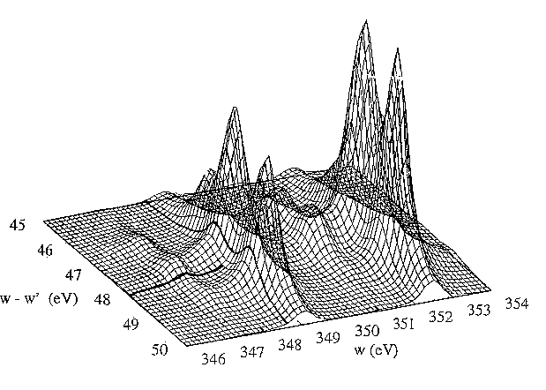
Resonant Inelastic X-ray Scattering
2p3s RIXS of CaF₂
3d⁰
ω
2p⁵3d¹
ω’
Phys. Rev. B.
53, 7099 (1996)
3s¹3d¹

Slide 26
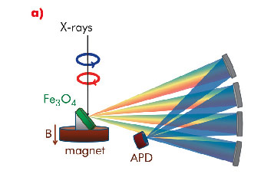
1s2p RIXS of transition metal ions
1s
2p
electronic
dd, CT
magnon
vibrations
Ψ0

Slide 27
Pre-edge and edge
Sharper pre-edge structures in 1s XAS
CoO
high-spin Co^{II}
3d⁷ [⁴T₂]
Only quadrupole peaks visible
3d⁷ → 1s¹3d⁸ → 2p⁵3d⁸

Slide 28
K edge and 1s2p RIXS
Hard x-ray RIXS
Soft x-ray edges with hard x-rays
Reduce lifetime from 1.5 to 0.2 eV
High Energy Fluorescence Detected (HERFD) XANES
Spin-polarized XAS
Range extended EXAFS
Background free FY for low concentrations
RIXS-MCD

Slide 29
K pre-edge of TM oxides (LiCoO₂)
Remove lifetime broadening with HERFD
Co K edge of LiCoO₂
low-spin Co^{III}
3d⁶ [¹A₁]
T_{2g} full
E_{g} empty

Slide 30
K pre-edge of TM oxides (LiCoO₂)
Remove lifetime broadening with HERFD
Co K edge of LiCoO₂
low-spin Co^{III}
3d⁶ [¹A₁]
T_{2g} full
E_{g} empty

Slide 31
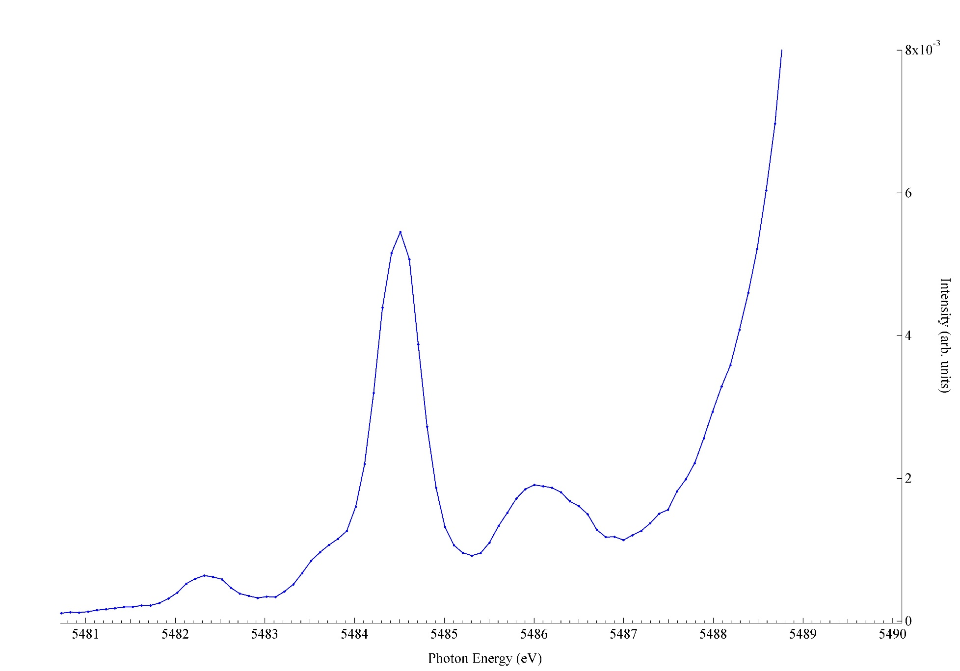
Remove lifetime broadening with HERFD
2p5d dipole
LaF₃
2p4f quadrupole
4f⁰→ 2p⁵ 4f¹
?
?

Slide 32
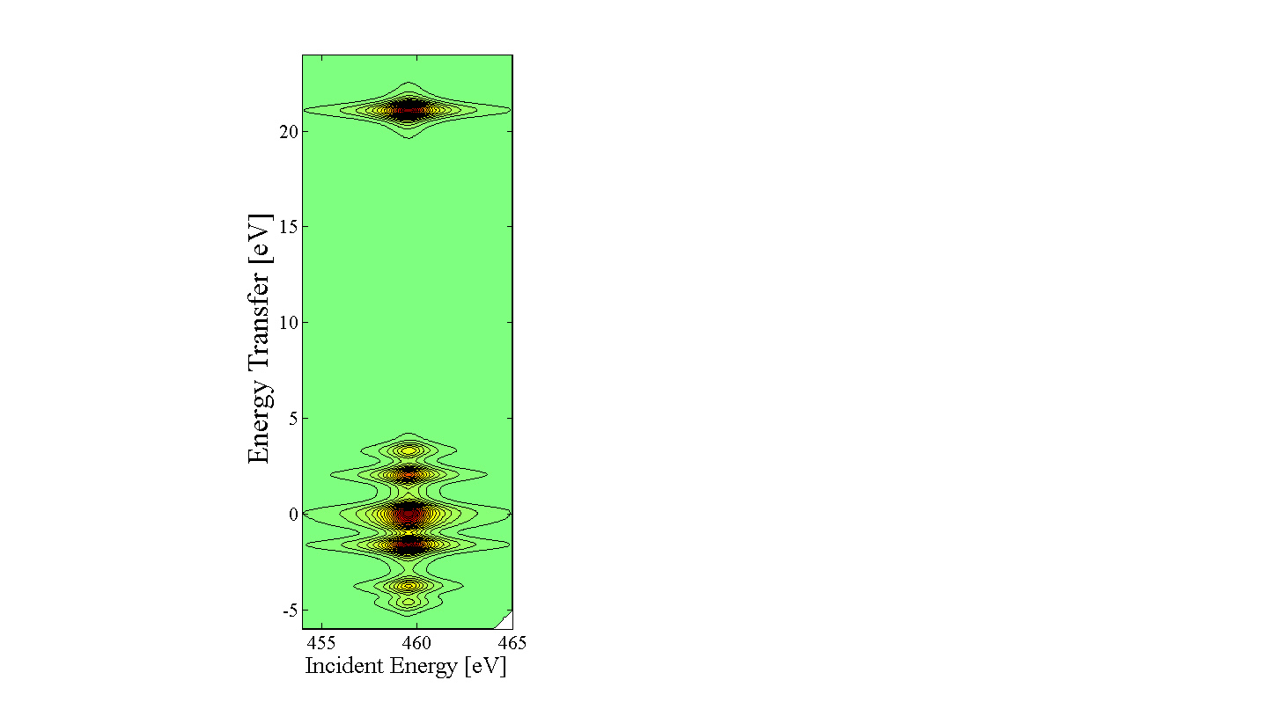
HERFD ≠ XAS
4f⁰→ 2p⁵ 4f¹ → 4d⁹ 4f¹

Slide 33
RIXS and fluorescence
One-electron (level) Total energy (state)
free electron
3d band
valence
band
core state
core hole + electron
core excitons
dd excitation
phonon
ground state
valence hole
+ electron
RIXS fluorescence
RIXS fluorescence
Notes:
33

Slide 34
RIXS and fluorescence
One-electron (level) Total energy (state)
free electron
3d band
valence
band
core state
core hole + electron
core excitons
dd excitation
phonon
ground state
valence hole
+ electron
RIXS fluorescence
RIXS fluorescence
Notes:
34

Slide 35
Resonant Inelastic X-ray Scattering

Slide 36
Resonant Inelastic X-ray Scattering
Fluorescence= XPS * XES
RIXS = XAS * XES

Slide 37
2p3d RIXS
polarization, angles
(in, sample, out)
eV
electron-electron
crystal field
charge transfer
meV
spin-orbit, magnetic
distortions
vibrations
RIXS1998:
500 meV
RIXS 2024:
8 meV
Notes:
37

Slide 38
2p3d RIXS of isolated chromium ions (ruby)
[Co^{II}W₁₂O₄₀]·
[Van Schooneveld, Hunault et al., unpublished ]

Slide 39
Multiplet challenge: 2p3d RIXS on Cr³⁺
Notes:
39

Slide 40
Resonant Inelastic X-ray Scattering
E_{in},, k_{in}, e_{in}
E_{out}, ,k_{out}, e_{out}
E_{in,} k_{in}, e_{in}
E_{out ,}k_{out}, e_{out}
h𝝎= E_{in} - E_{out}
q = k_{in} - k_{out}
Energy
Polarization
Momentum

Slide 41
Spin state of LaCoO₃
q-dep. RIXS
[Wang et al. 2018 ]
Notes:
Low-loss region of RIXS in NiO.
Ground state: 3A2
Double group: T2, not split without exchange
Echange field H splits ground state into three Ms states as H times Ms,
So three states at –H, 0, +H.
The spin-flip peak in the figure is at 2H.
H is related to the superexchaneg energy

Slide 42
Spin state of LaCoO₃
[Wang et al. 2018 ]
Notes:
Low-loss region of RIXS in NiO.
Ground state: 3A2
Double group: T2, not split without exchange
Echange field H splits ground state into three Ms states as H times Ms,
So three states at –H, 0, +H.
The spin-flip peak in the figure is at 2H.
H is related to the superexchaneg energy

Slide 43
2p3d RIXS of transition metal ions

Slide 44
Cu2+ 2p3d RIXS (from 3d⁹ to 2p⁵3d¹⁰ to 3d⁹)
Atomic Multiplet Theory
ATOMIC
Dipole selection rule:
ΔJ=-1, 0 or +1
J=J’≠0
2p⁵
²P
²P_{3/2}
²P_{1/2}
Only L₃ edge
Spin-orbit excitation
Elastic line in 2p3d RIXS
3d⁹
²D
²D_{5/2}
²D_{3/2}

Slide 45
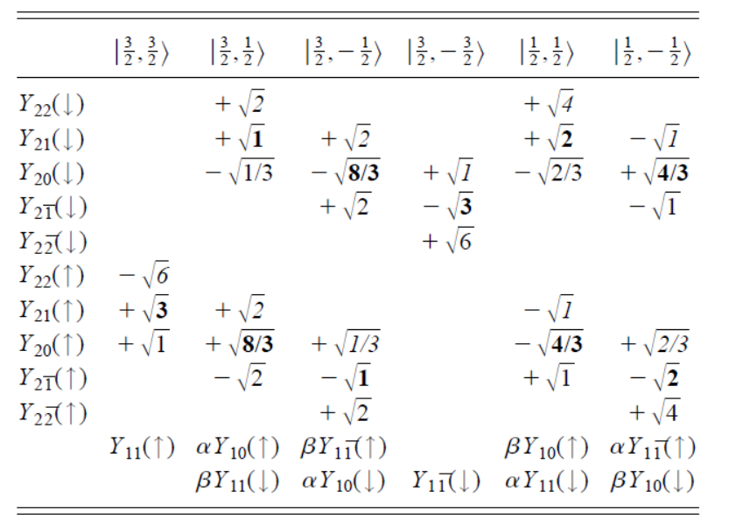
Cu2+ 2p3d RIXS (from 3d⁹ to 2p⁵3d¹⁰ to 3d⁹)
Atomic Multiplet Theory
2p orbitals
3d orbitals
[Phys. Rev. B. 57, 14584 (1998)]

Slide 46
Cu2+ 2p3d RIXS (from 3d⁹ to 2p⁵3d¹⁰ to 3d⁹)
Atomic Multiplet Theory
[Phys. Rev. B. 57, 14584 (1998)]

Slide 47
Cu2+ 2p3d RIXS (from 3d⁹ to 2p⁵3d¹⁰ to 3d⁹)
Atomic Multiplet Theory
[Phys. Rev. B. 57, 14584 (1998)]

Slide 48
Magnon 2p3d RIXS in cuprates

Slide 49
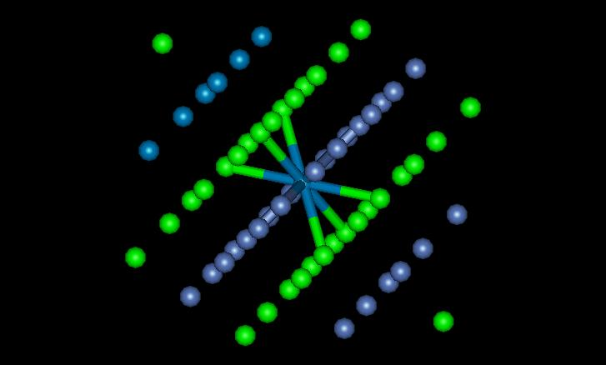

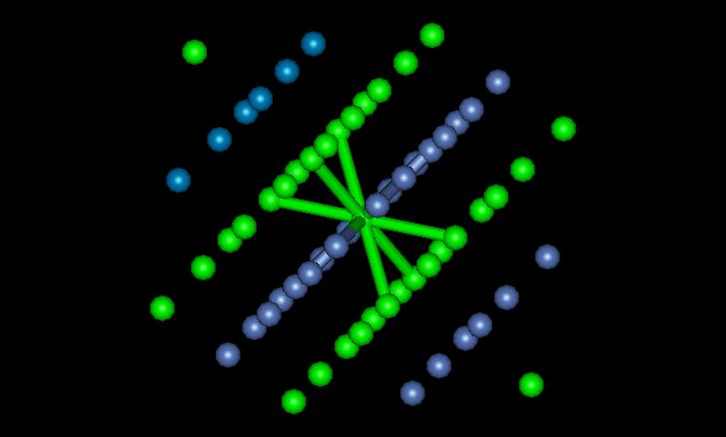
2p3d RIXS of NiO
Ni^{II} 3d⁸ [↑↑] → 2p⁵3d⁹[jj] → 3d⁸[↓↓]
Notes:
Cartoon of a spin-flip transition

Slide 50
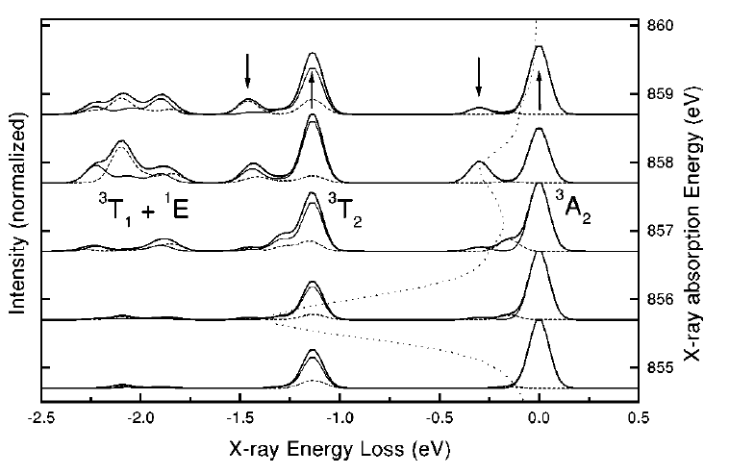
2p3d RIXS of NiO
ΔS
ΔM_{S}
‘spin-flip’
dd
spin-flip
[Phys. Rev. B. 57, 14584 (1998)]
Notes:
Low-loss region of RIXS in NiO.
Ground state: 3A2
Double group: T2, not split without exchange
Echange field H splits ground state into three Ms states as H times Ms,
So three states at –H, 0, +H.
The spin-flip peak in the figure is at 2H.
H is related to the superexchaneg energy

Slide 51
2p3d RIXS of NiO
[Phys. Rev. Lett. (2020)]
Notes:
Low-loss region of RIXS in NiO.
Ground state: 3A2
Double group: T2, not split without exchange
Echange field H splits ground state into three Ms states as H times Ms,
So three states at –H, 0, +H.
The spin-flip peak in the figure is at 2H.
H is related to the superexchaneg energy

Slide 52
2p3d RIXS of NiO
[Phys. Rev. Lett. (2020)]
Notes:
Low-loss region of RIXS in NiO.
Ground state: 3A2
Double group: T2, not split without exchange
Echange field H splits ground state into three Ms states as H times Ms,
So three states at –H, 0, +H.
The spin-flip peak in the figure is at 2H.
H is related to the superexchaneg energy

Slide 53
2p3d RIXS of Fe2O3

Slide 54
0,1 and 2-magnons in 2p3d RIXS of Fe2O3

Slide 55
0,1 and 2-magnons in 2p3d RIXS of Fe2O3

Slide 56
0,1 and 2-magnons in 2p3d RIXS of Fe2O3

Slide 57
0,1 and 2-magnons in 2p3d RIXS of Fe2O3

Slide 58
3-magnons in 2p3d RIXS of Fe2O3

Slide 59
3-magnons in 2p3d RIXS of Fe2O3

Slide 60
2p3d RIXS
polarization, angles
(in, sample, out)
eV
electron-electron
crystal field
charge transfer
meV
spin-orbit, magnetic
distortions
vibrations
RIXS1998:
500 meV
RIXS 2024:
8 meV
Notes:
60

Slide 62
Yield detection
Electron yield
Fluorescence Yield (1. dilute limit)
FY (2. state dependent decay)
No XMCD sum rules in FY
FY (3. inverse PFY)
FY (4. dips and peaks)

Slide 63
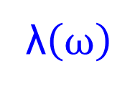
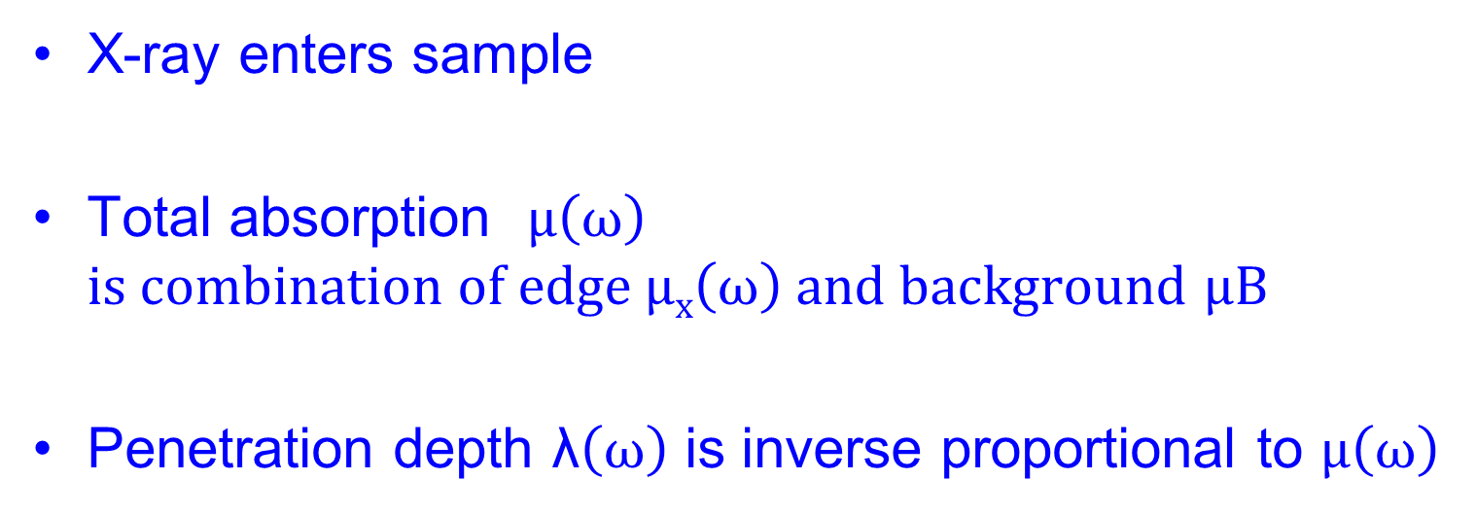
Yield detection
λ$\left(ω\right)$
X-ray enters sample
Total absorption $μ\left(ω\right)$
$is combination of edge μx\left(ω\right) and background$ $μB$
Penetration depth λ$\left(ω\right)$ is inverse proportional to $μ\left(ω\right)$

Slide 64
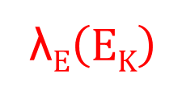
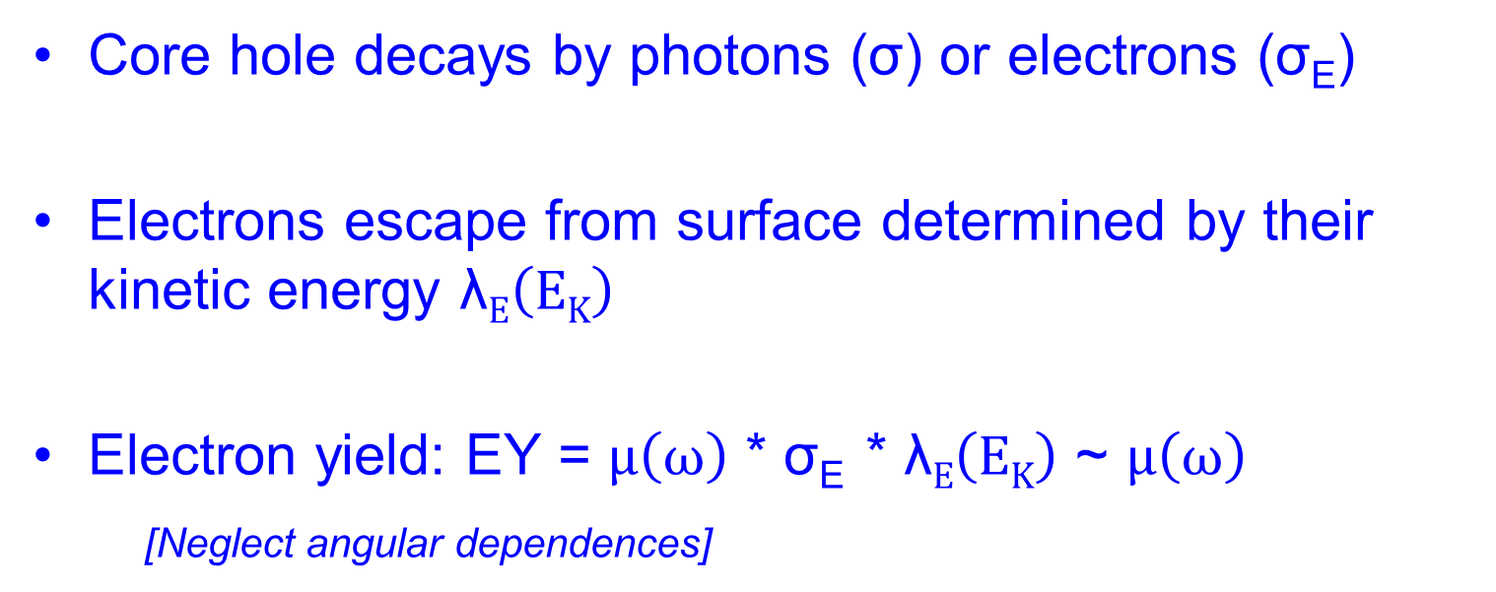
Electron Yield detection
λ$E\left(EK\right)$
λ$\left(ω\right)$
Core hole decays by photons (σ) or electrons (σ_{E})
Electrons escape from surface determined by their kinetic energy λ$E\left(EK\right)$
Electron yield: EY = $μ\left(ω\right)$ * σ_{E} * λ$E\left(EK\right)$ ~ $μ\left(ω\right)$
[Neglect angular dependences]

Slide 65
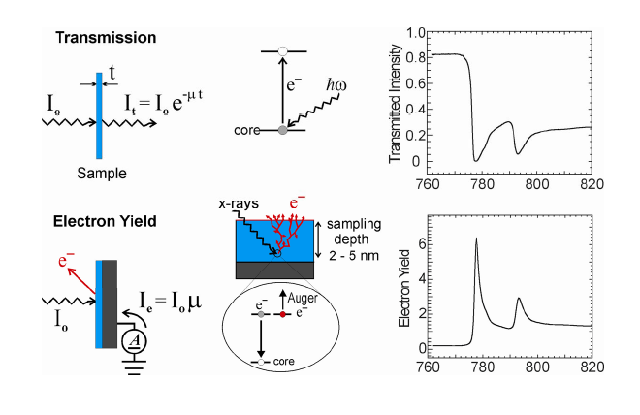
Electron Yield detection

Slide 66
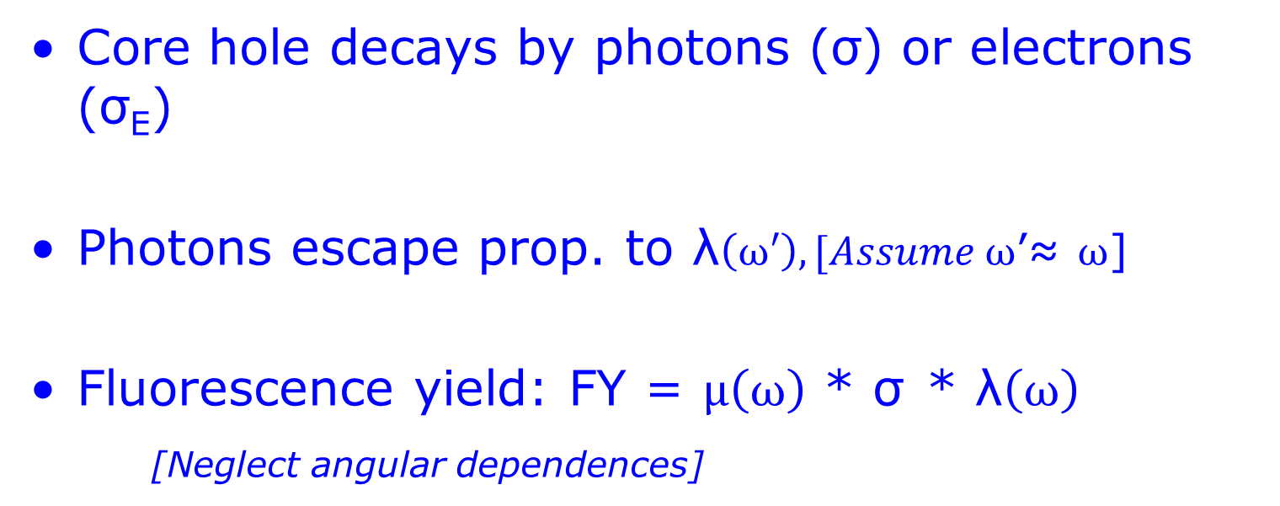
Fluorescence Yield detection
λ$\left(ω\right)$
Core hole decays by photons (σ) or electrons (σ_{E})
Photons escape prop. to λ$\left(ω′\right), [Assume ω$’≈ $ω$]
Fluorescence yield: FY = $μ\left(ω\right)$ * σ * λ$\left(ω\right)$
[Neglect angular dependences]

Slide 67
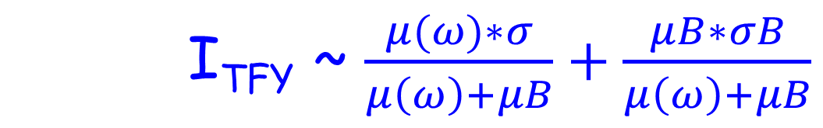
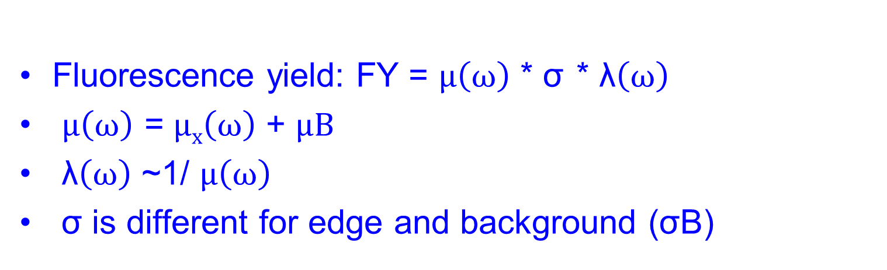
Fluorescence Yield detection
Fluorescence yield: FY = $μ\left(ω\right)$ * σ * λ$\left(ω\right)$
$μ\left(ω\right)$ = $μx\left(ω\right)$ + $μB$
λ$\left(ω\right)$ ~1/ $μ\left(ω\right)$
σ is different for edge and background (σB)
I_{TFY} ~ $\frac{μ(ω)∗σ}{μ\left(ω\right)+μB}+\frac{μB∗σB}{μ\left(ω\right)+μB}$

Slide 68
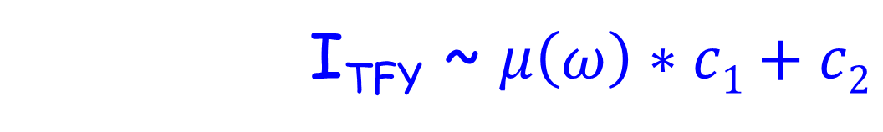
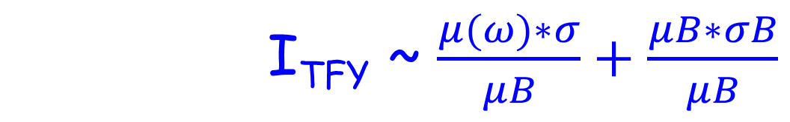
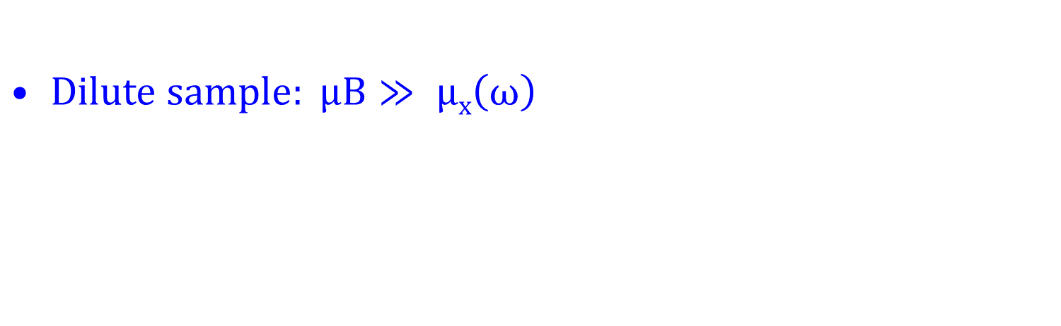
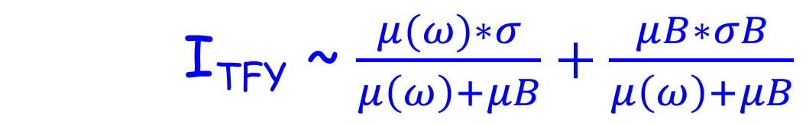
FY detection of dilute sample
I_{TFY} ~ $\frac{μ(ω)∗σ}{μ\left(ω\right)+μB}+\frac{μB∗σB}{μ\left(ω\right)+μB}$
$Dilute sample: μB≫ μx\left(ω\right)$
I_{TFY} ~ $\frac{μ(ω)∗σ}{μB}+\frac{μB∗σB}{μB}$
I_{TFY} ~ $μ\left(ω\right)∗c1+c2$

Slide 69

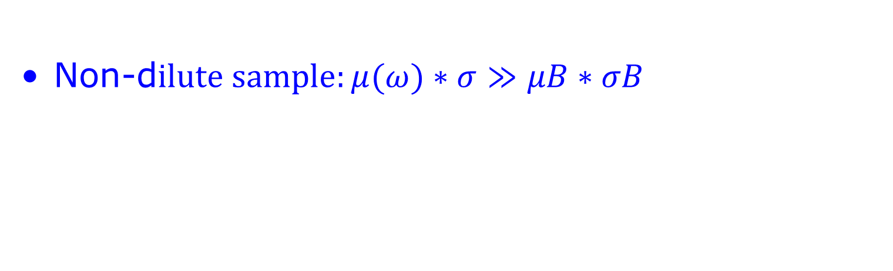
FY detection of concentrated (bulk) sample
I_{TFY} ~ $\frac{μ(ω)∗σ}{μ\left(ω\right)+μB}+\frac{μB∗σB}{μ\left(ω\right)+μB}$
Non-d$ilute sample:μ(ω)∗σ≫μB∗σB$
I_{TFY} ~ $\frac{μ(ω)}{μ\left(ω\right)+μB}$
“saturation & self-absorption”
De-saturation software
(μ(ω) based on CRXO)

Slide 70
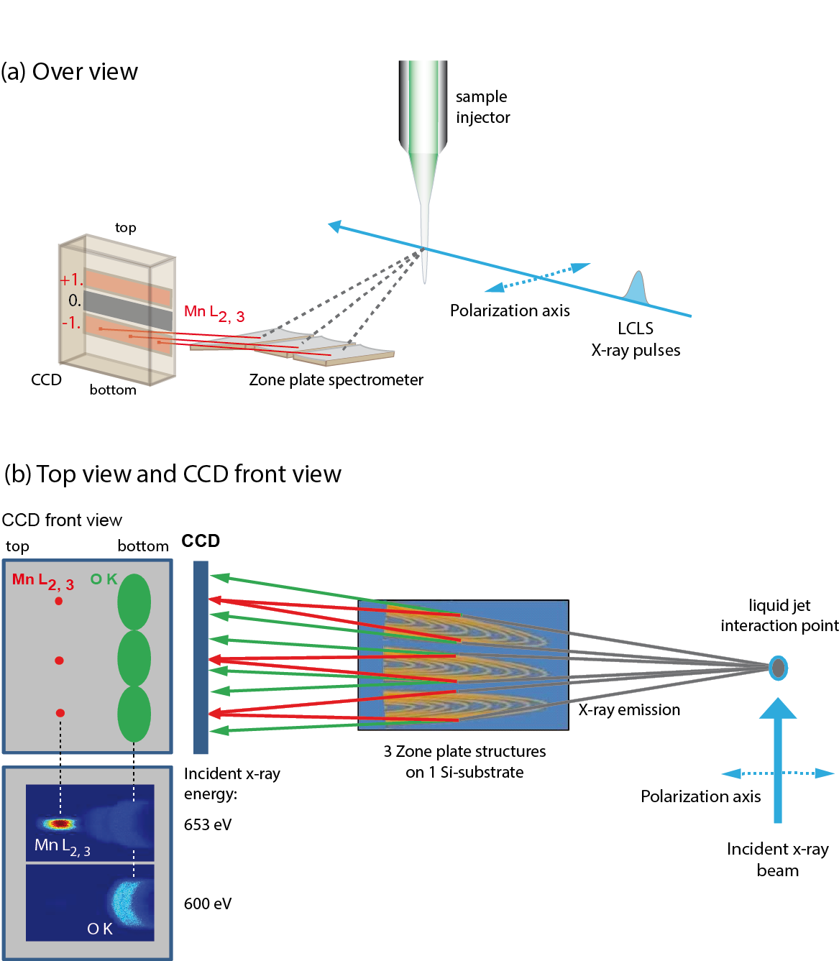
XAS of radiation sensitive sample
Single synchrotron pulselength is too long
Mitzner et al, J. Phys. Chem. Lett. 4, 3641 (2013)
Notes:
70

Slide 71
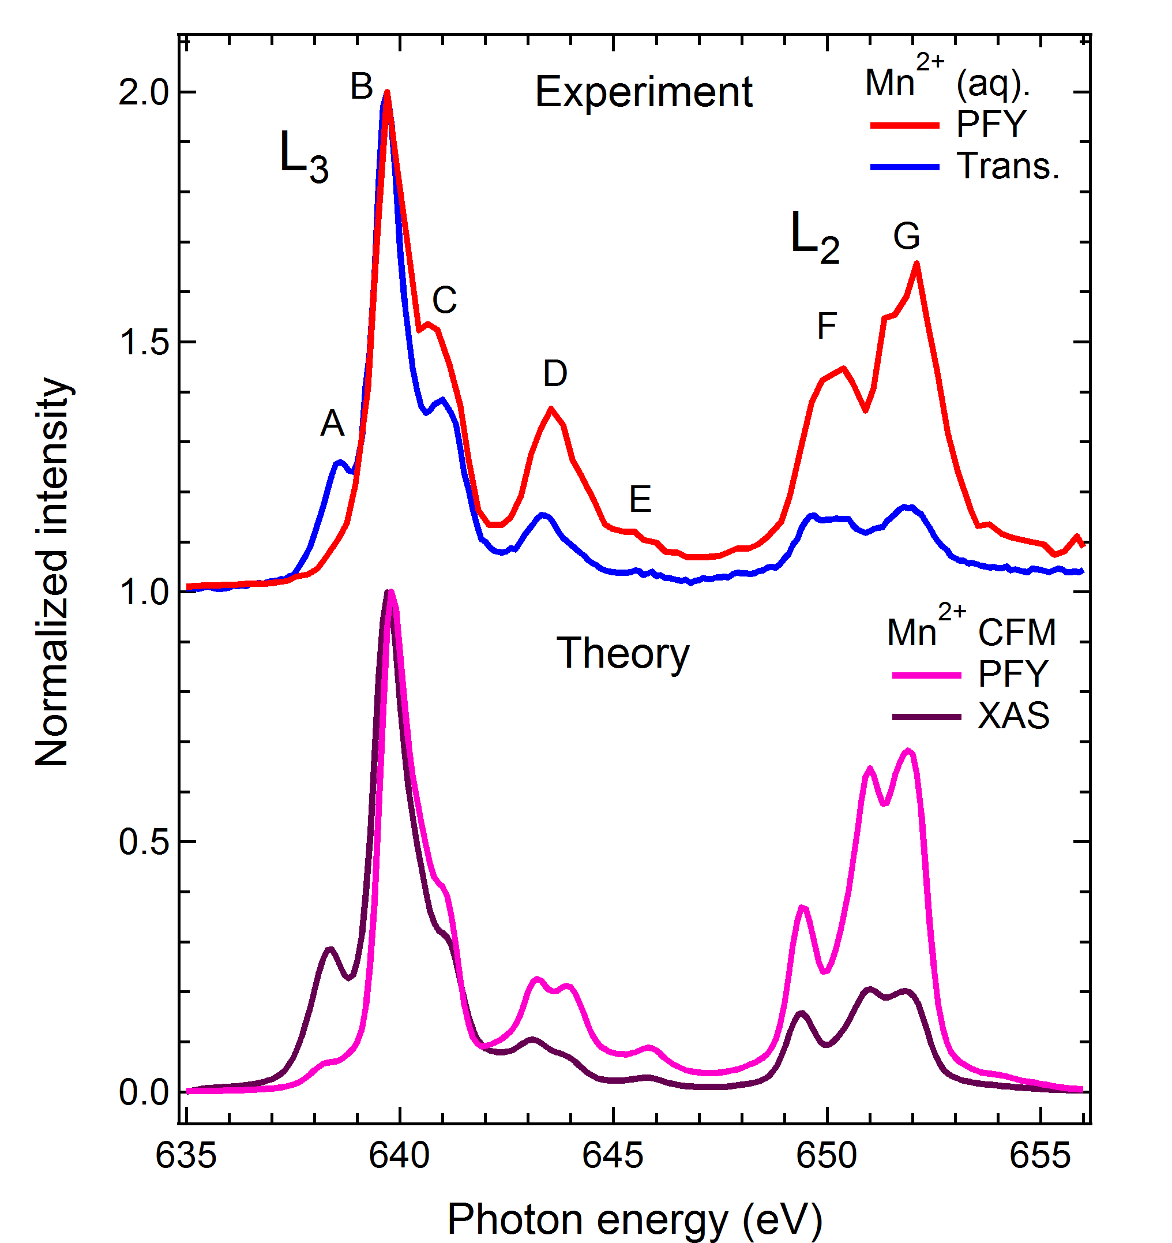
FY-XAS of radiation sensitive sample
Fluorescence does not measure XAS spectrum
Saturation ?
Mitzner et al, J. Phys. Chem. Lett. 4, 3641 (2013)
Notes:
71

Slide 72
FY-XAS of radiation sensitive sample
Fluorescence does not measure XAS spectrum
NO Saturation
State-dependent decay
Mitzner et al, J. Phys. Chem. Lett. 4, 3641 (2013)
Notes:
72

Slide 73
FY detection: State dependent decay
Yield methods assume a constant ratio between radiative and non-radiative decay
If this ratio is state (= energy) dependent then the related yield methods do not measure XAS.

Slide 74
FY detection: State dependent decay
L₃
FY
L₂
EY
Solid State Comm. 92, 991 (1994)

Slide 75
FY detection: State dependent decay
The dominant yield method is not visibly affected, thus for soft X-rays only FY is affected, not electron yield.

Slide 76

FY detection (state-dependent, dilute)
I_{TFY} ~ $\frac{μ(ω)∗σ}{μ\left(ω\right)+μB}+\frac{μB∗σB}{μ\left(ω\right)+μB}$
I_{TFY} ~ $\frac{μ(ω)∗σ(ω)}{μB}$
Main decay of 2p core hole is 2p3d RIXS
Integrate RIXS spectrum to 2p3d PFY
TFY ~ 2p3d PFY
NOTE: “RIXS” has angular dependence effects

Slide 77
XAS: transmission & FY
Mitzner et al, J. Phys. Chem. Lett. 4, 3641 (2013)
Notes:
77

Slide 78
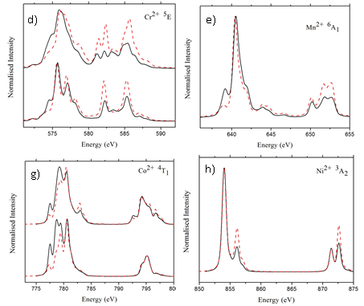
Fluorescence Yield detection
FY-XAS ≠ XAS L₂ edge increases High-energies increase
Kurian J. Phys. Cond. Matt. 24, 435602 (2012)

Slide 79
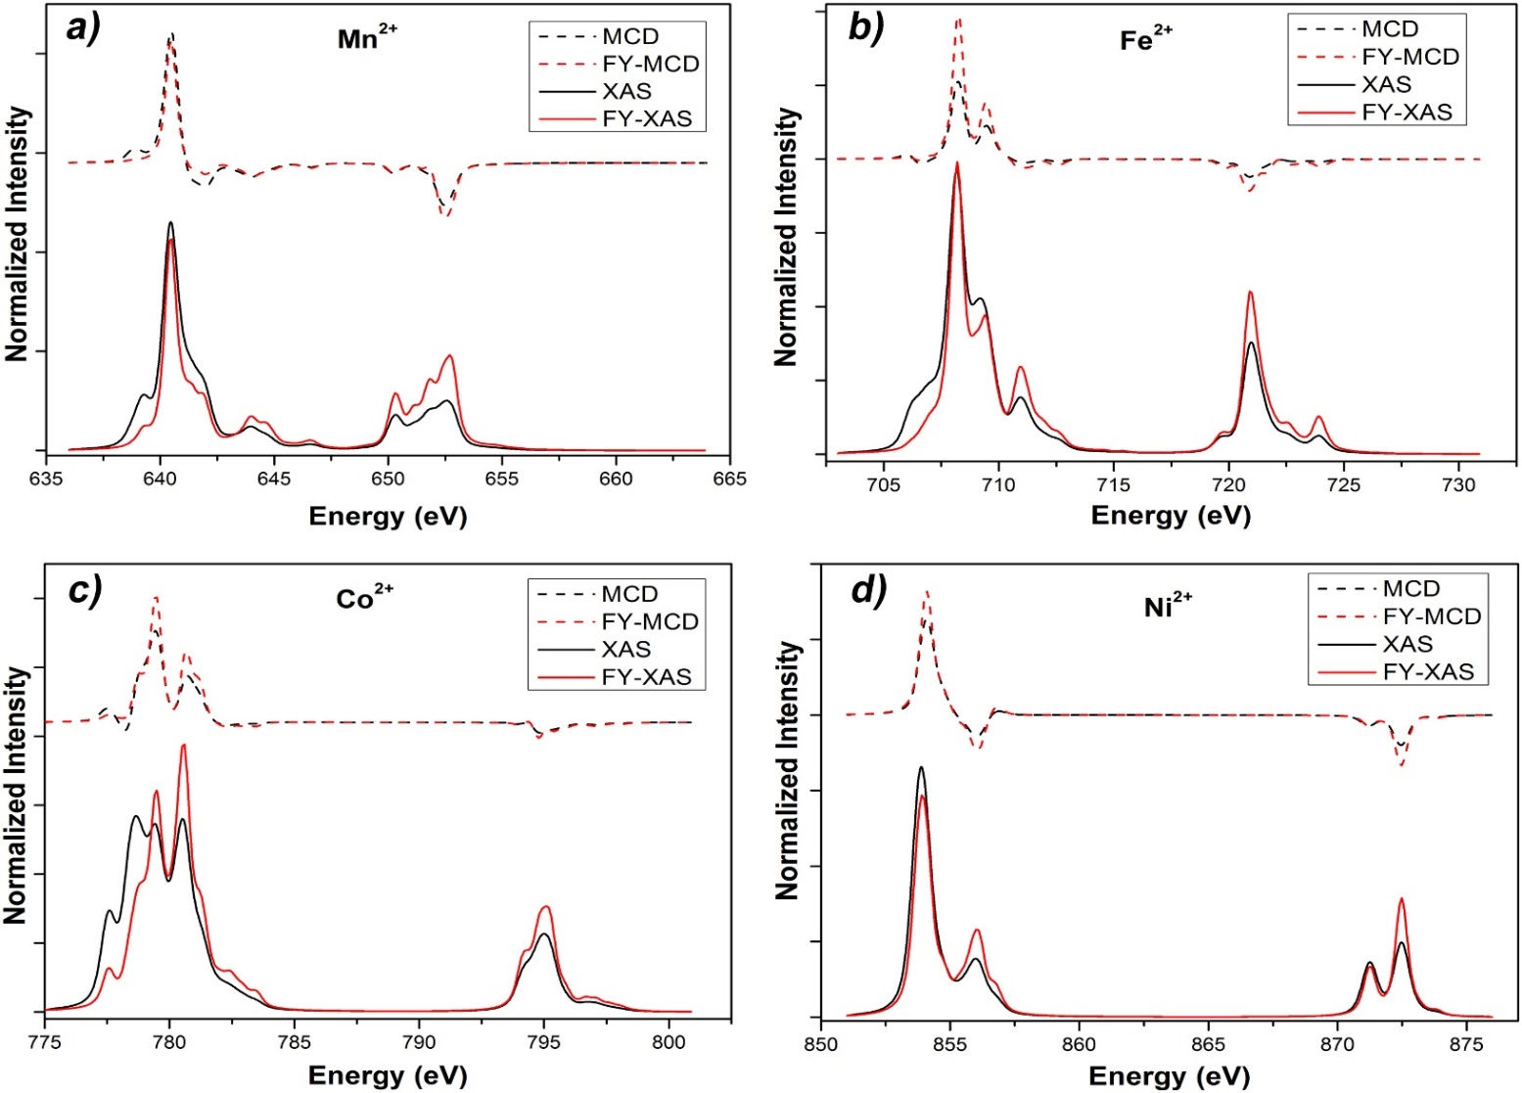
Fluorescence Yield XMCD
XMCD sum rules break down
Ni/Co 20%, Fe 30%, Mn > 100% error
Liu, Phys. Rev. B. 96, 054446 (2017)

Slide 80
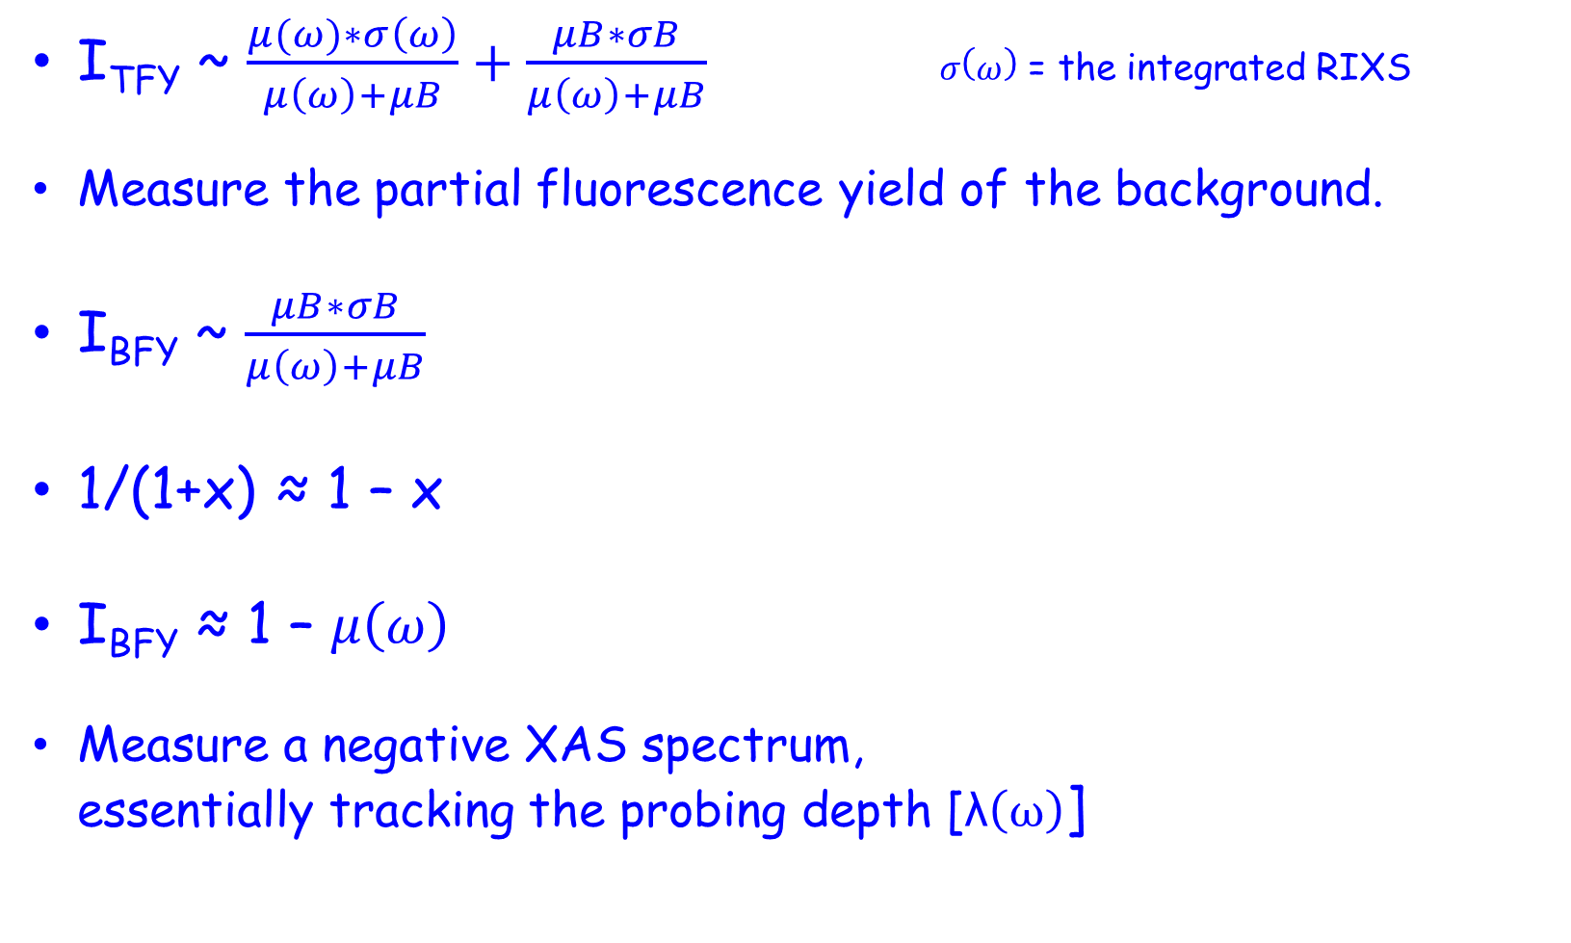
FY detection: 3 inverse PFY
I_{TFY} ~ $\frac{μ(ω)∗σ\left(ω\right)}{μ\left(ω\right)+μB}+\frac{μB∗σB}{μ\left(ω\right)+μB} σ\left(ω\right)$ = the integrated RIXS
Measure the partial fluorescence yield of the background.
I_{BFY} ~ $\frac{μB∗σB}{μ\left(ω\right)+μB}$
1/(1+x) ≈ 1 – x
I_{BFY} ≈ 1 – $μ\left(ω\right)$
Measure a negative XAS spectrum,
essentially tracking the probing depth [λ$\left(ω\right)$]

Slide 81
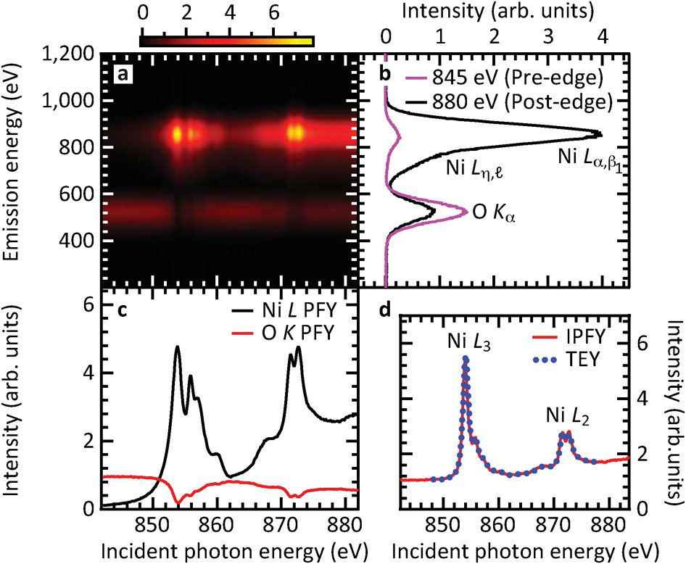
FY detection: 3 inverse PFY
Achkar ea, scientific reports 1, 82 (2011)

Slide 82

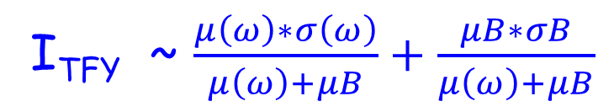
FY detection: 4 dips and peaks
Measure the total fluorescence yield
State-dependent metal PFY + IPFY
I_{TFY} ~ $\frac{μ\left(ω\right)∗σ\left(ω\right)}{μ\left(ω\right)+μB}+\frac{μB∗σB}{μ\left(ω\right)+μB}$
I_{TFY} ~ c₁ $∗ μ\left(ω\right)∗σ\left(ω\right)−\text{c}\text{2}\text{∗}μ\left(ω\right)$

Slide 83
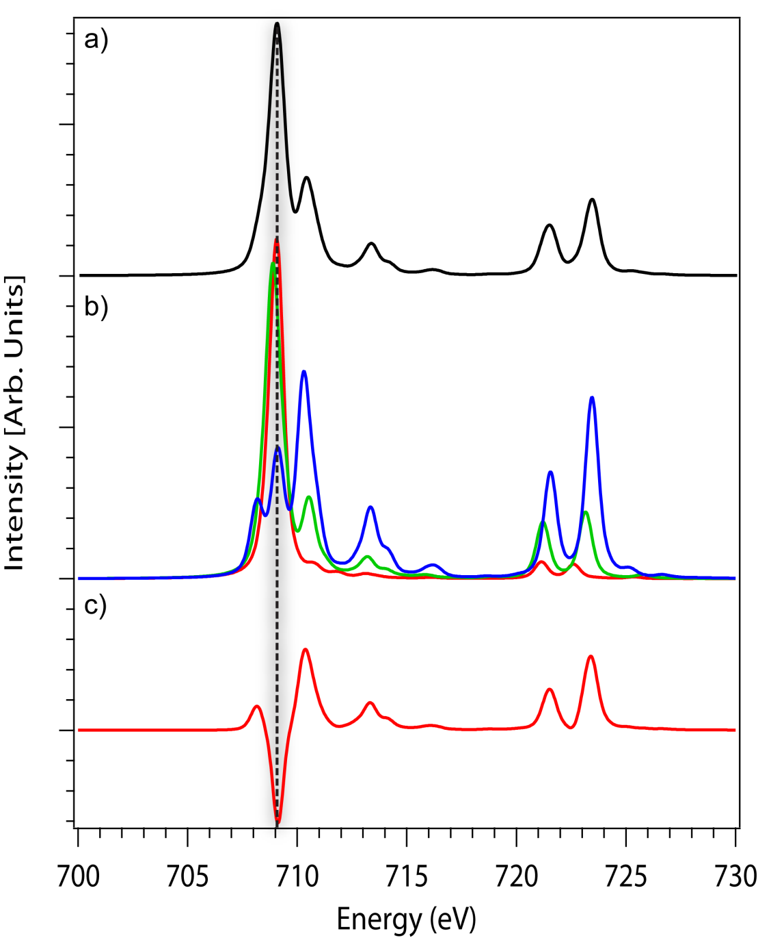
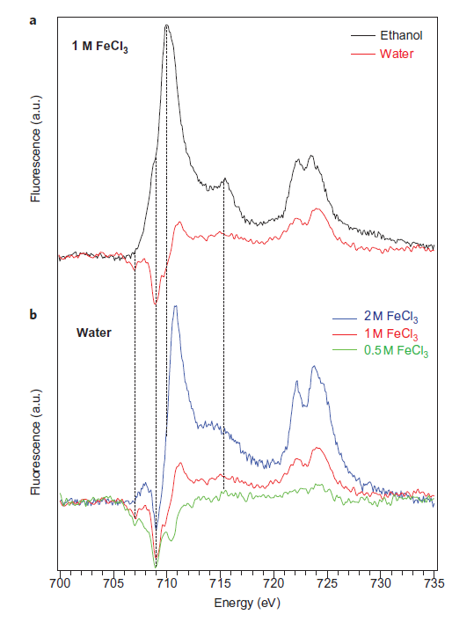
FY detection: 4 dips and peaks
Nature Chem. 4, 766 (2012) & Phys. Rev. Letter discussions (2014)

