Slide 1
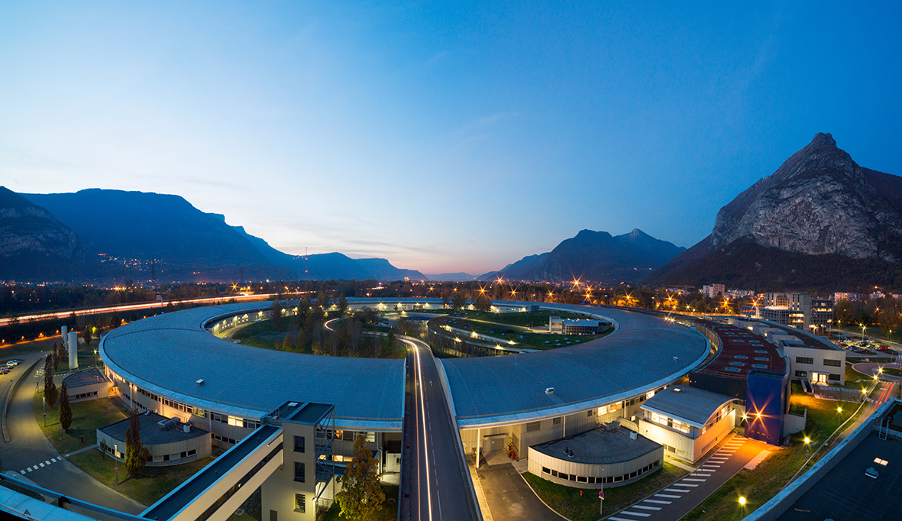
Crispy: a Python-based user interface for core-level spectroscopy calculations
Marius Retegan
Algorithms & scientific Data Analysis (ADA) Group
European Synchrotron Radiation Facility (ESRF)

Slide 2
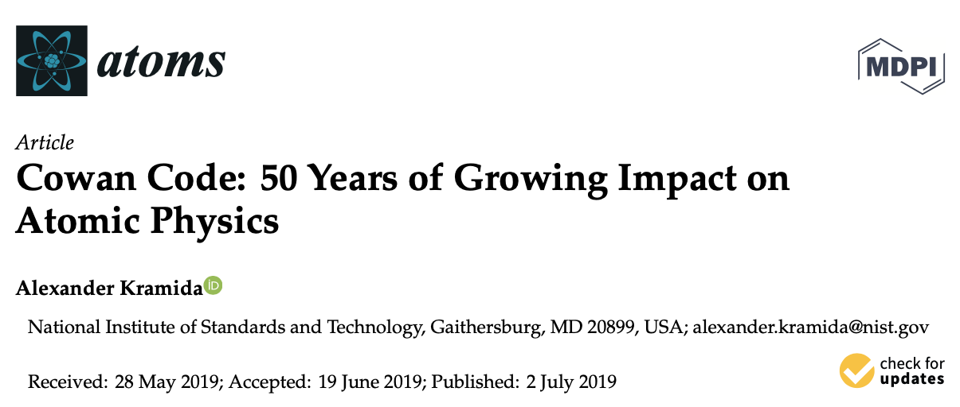
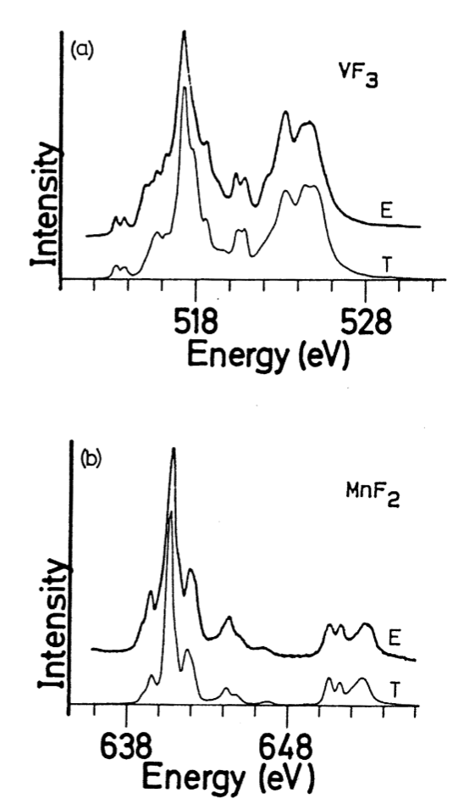
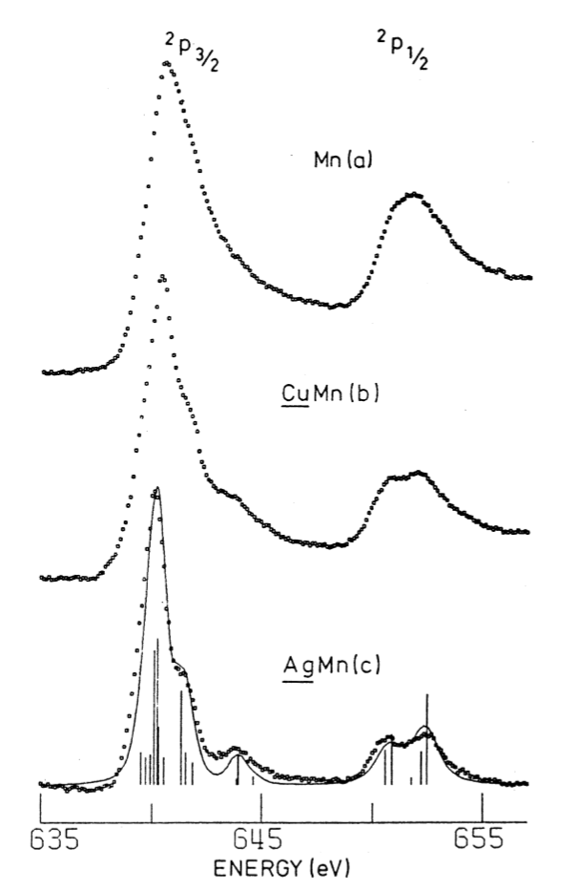
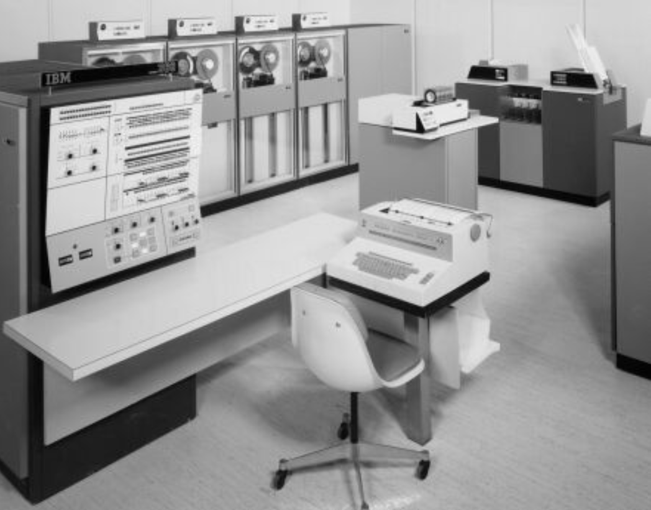
Semi-empirical multiplets: the early days
B.T. Thole et al.,
Phys. Rev. B, 1985
F.M.F. de Groot et al.,
Phys. Rev. B, 1990

Slide 3
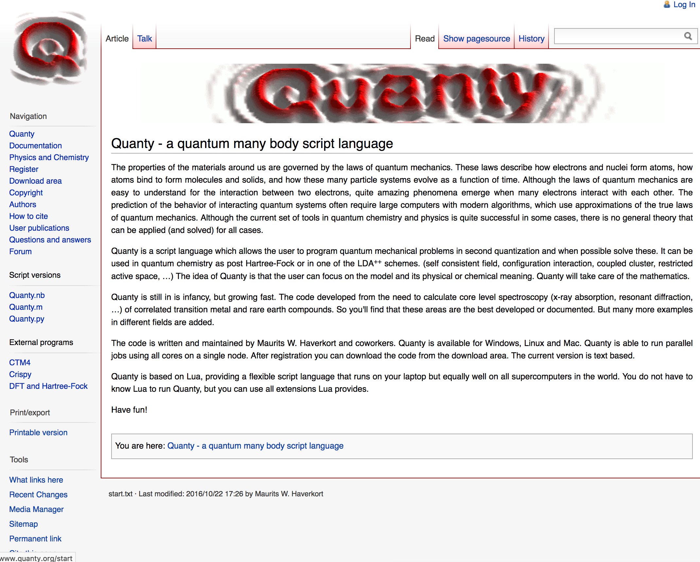
Quanty: a modern approach to multiplets calculations
Quanty is a powerful and versatile library, but…
You will have to write code to perform calculations.
The program is very forgiving and can take time to spot an error.

Slide 4
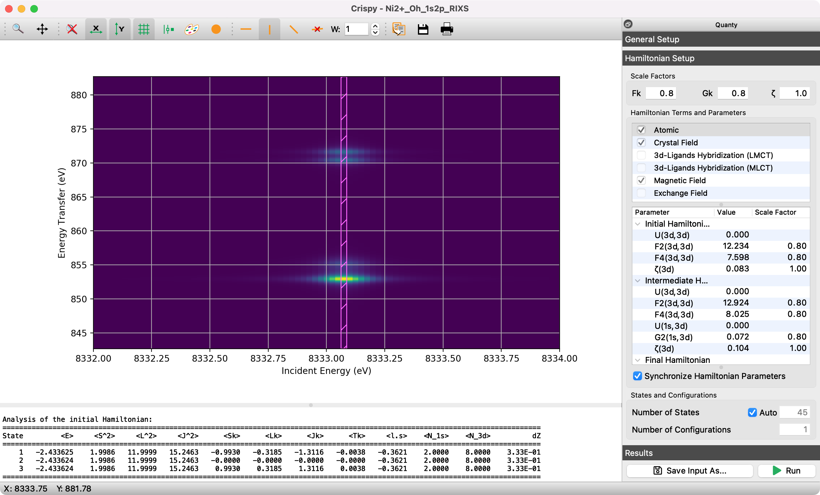
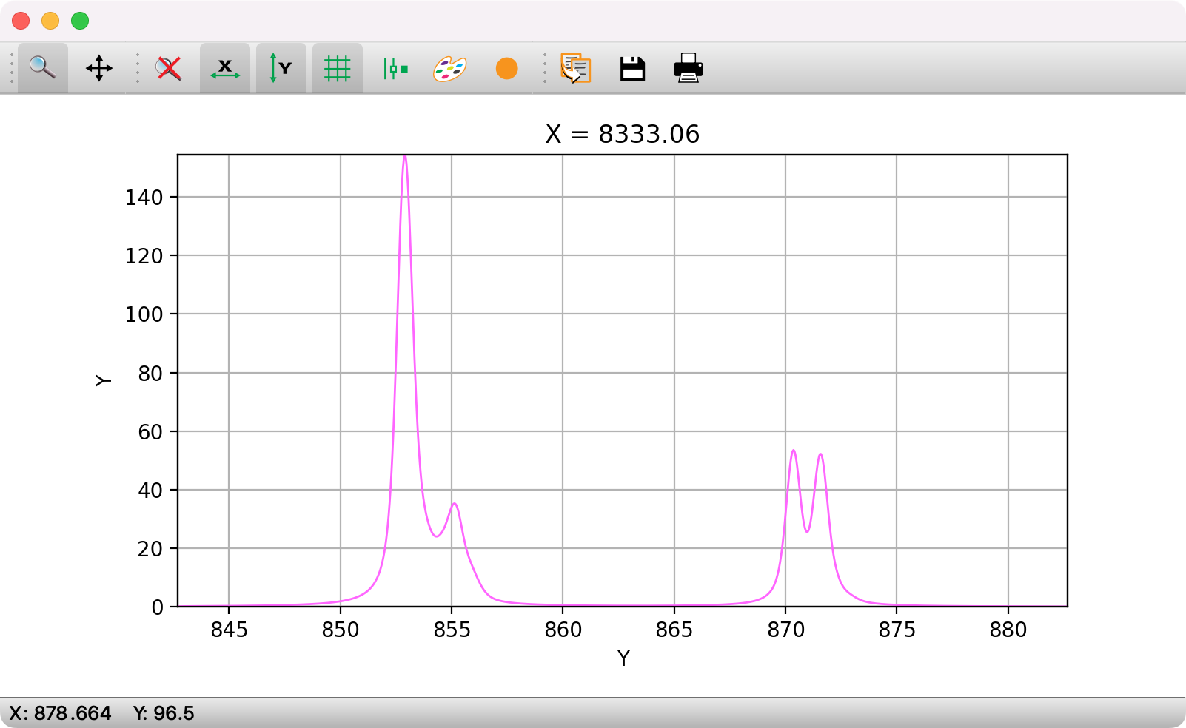

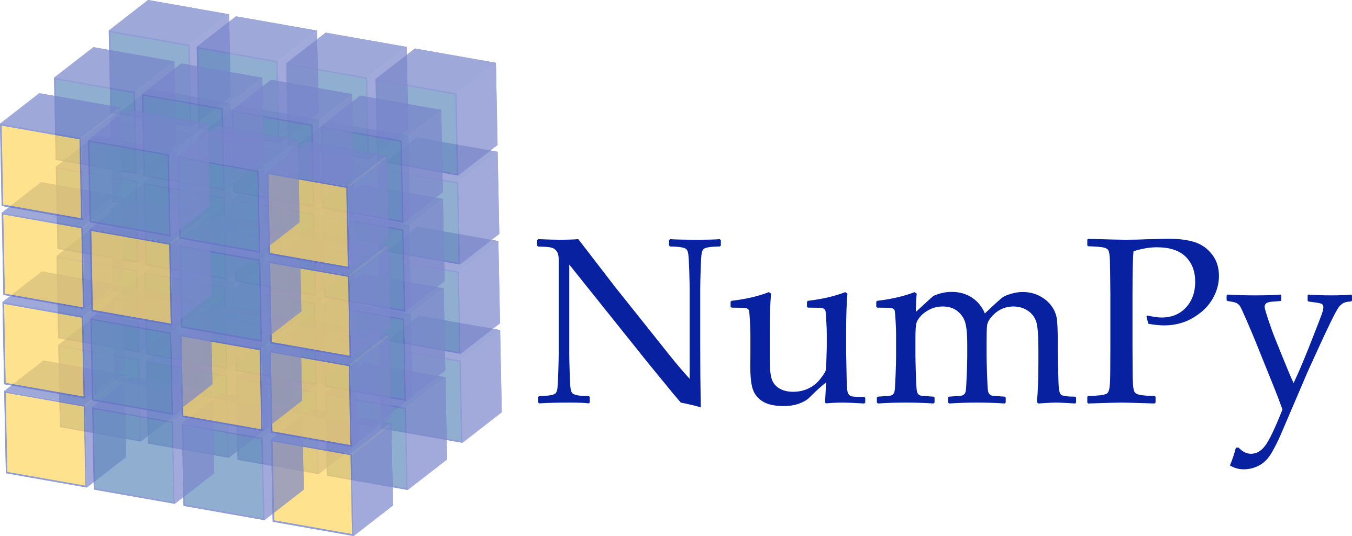


Crispy: graphical user interface for multiplet calculations
Calculations:
  transition metals, lanthanides, and actinides
  XAS, XMCD, X(M)LD, XPS, and RIXS
  many edges
  O_{h}, D_{4h}, C_{3v}, T_{d}, and D_{3h} symmetries
Additional features:
  logging console to display the progress
  dialog showing the details of a calculation
  interactive broadening
  easy-to-use installers for Windows and macOS
  Jupyter notebook interface

Slide 5


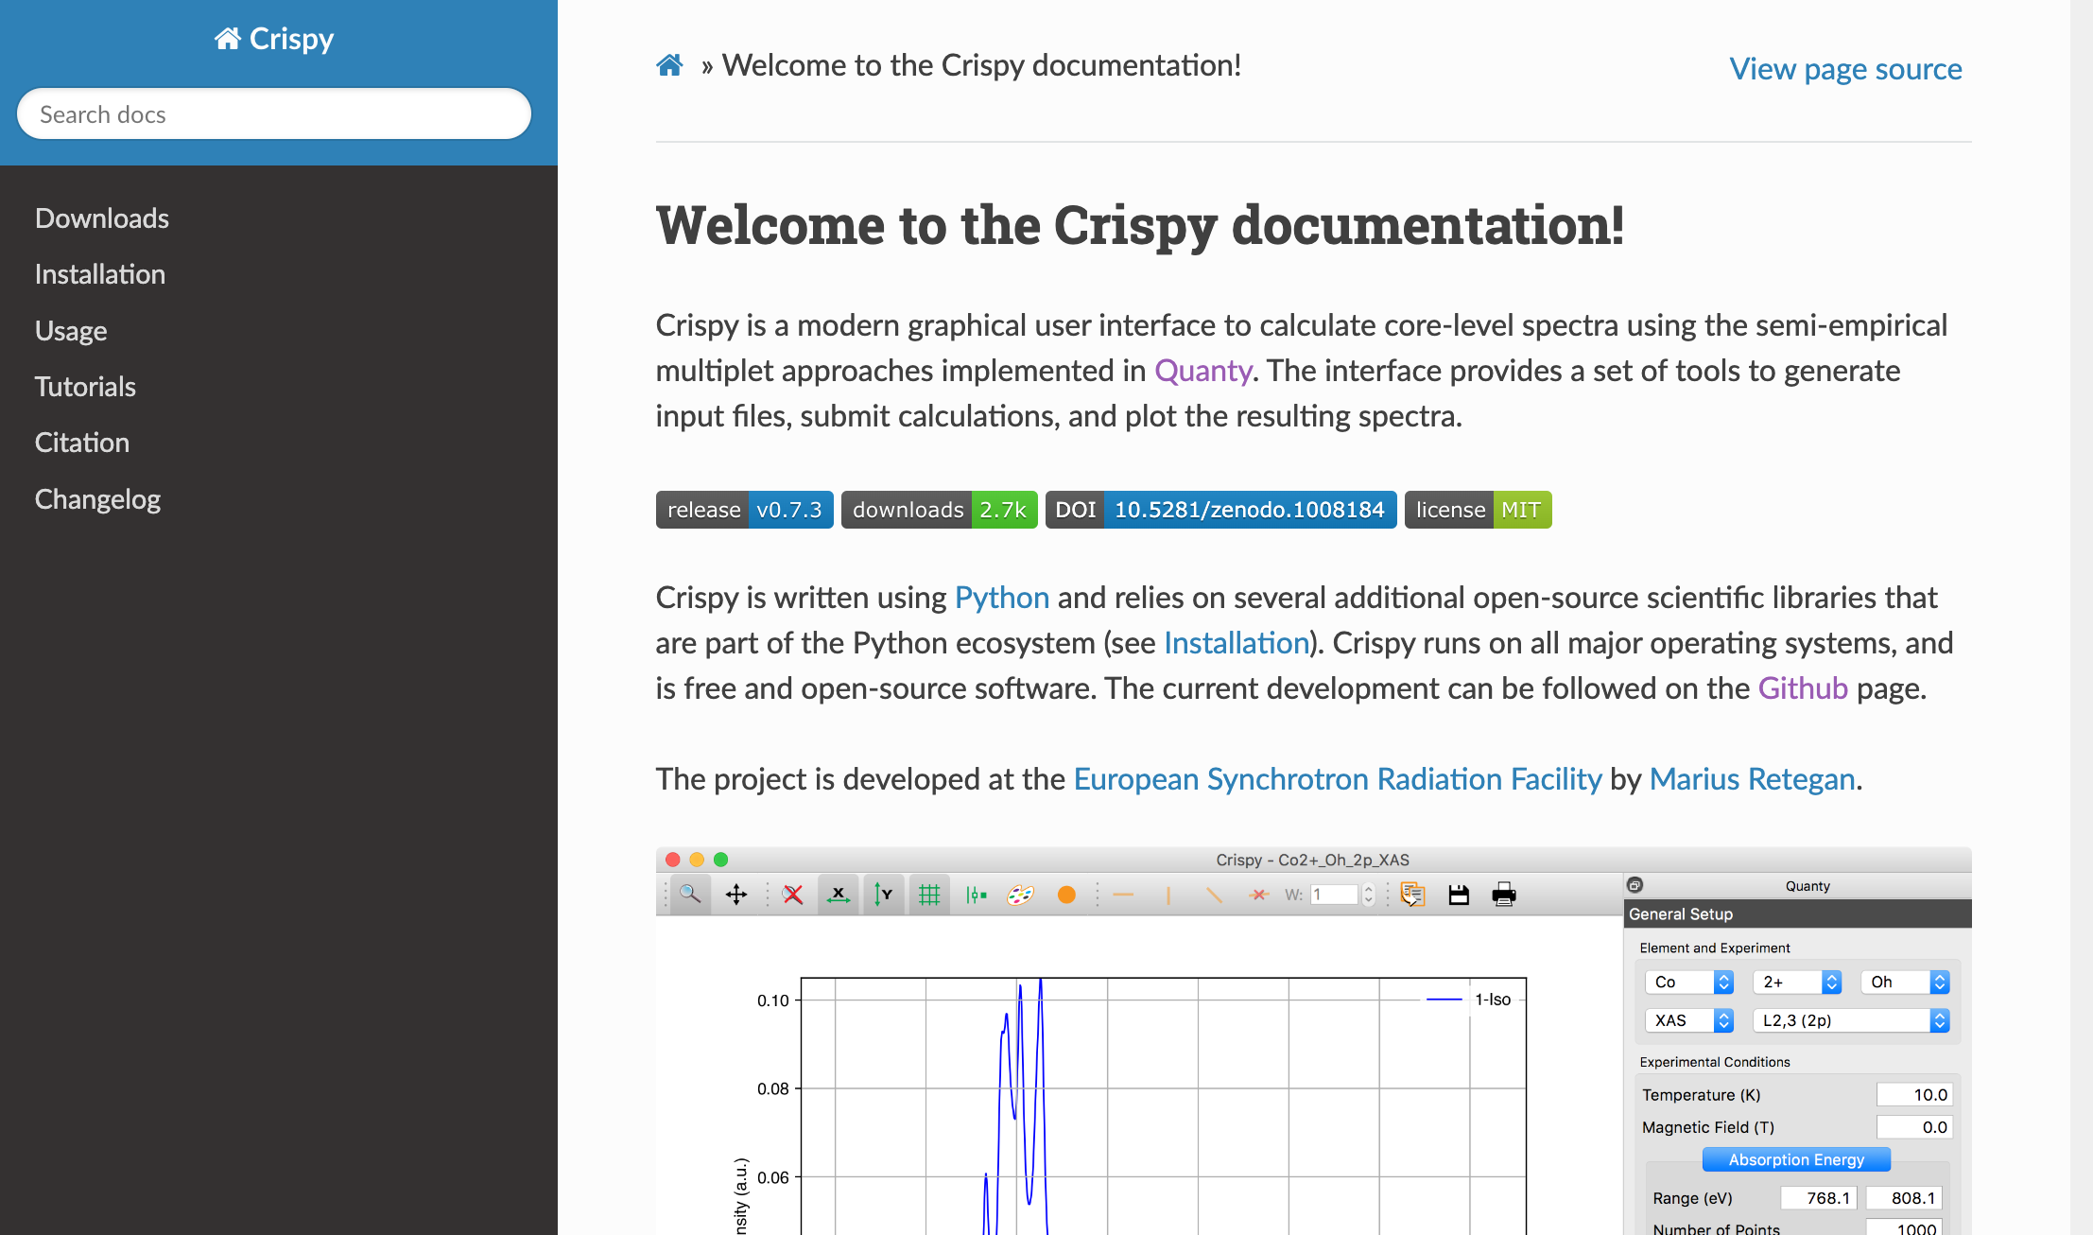
Getting the software
http://esrf.eu/computing/scientific/crispy
crispy + esrf

Slide 6
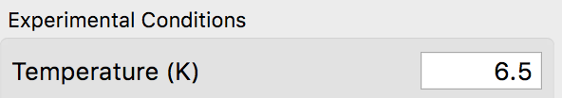
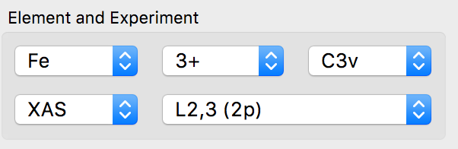
Things to remember!
Always press Return (Enter) after changing a value in any of the input boxes.
Any modification to the combo boxes will reset all parameters to default values.

Slide 7
Calculating the L_{2,3}–edge XAS spectrum of titanium(IV)

Slide 8
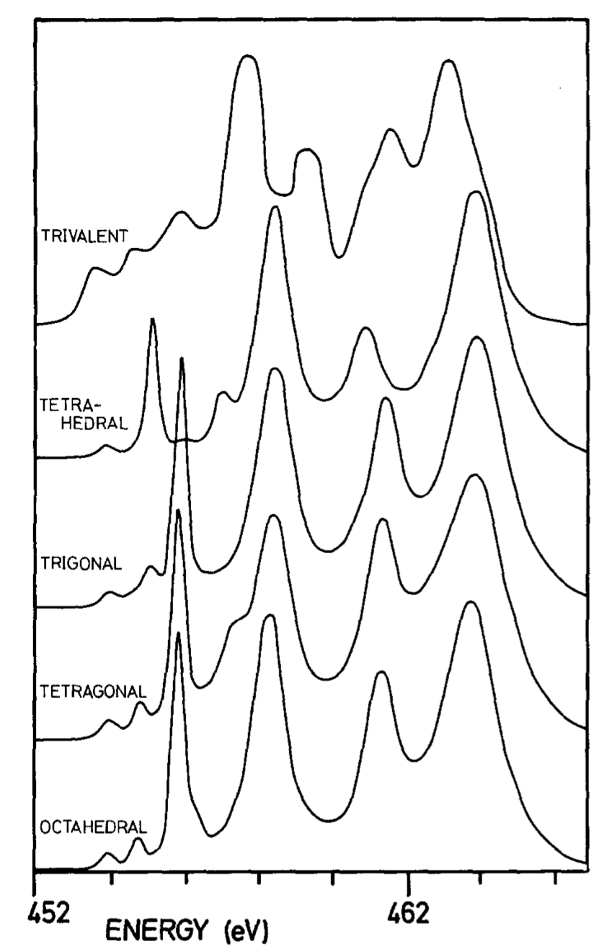
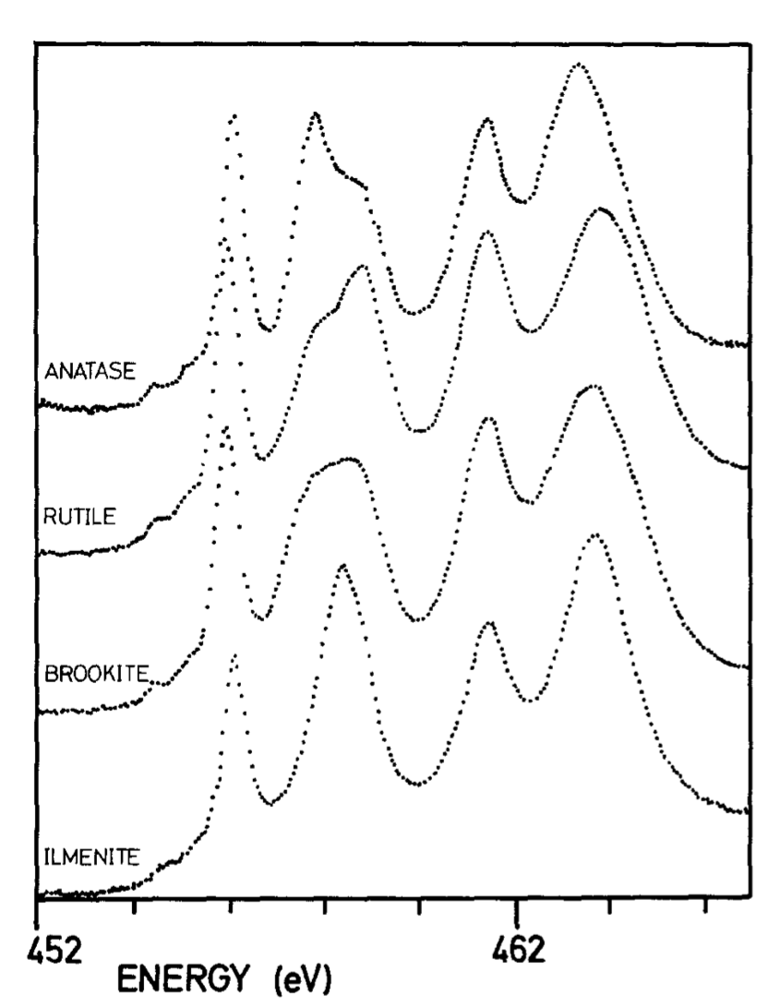
Theory and calculations
de Groot et al., J. Chem. Minerals, 1992

Slide 9
Atomic multiplets
Calculate the XAS spectrum at the L_{2,3} edges of Ti⁴⁺ in spherical symmetry. Set the Lorentzian broadening to 0.1 and the Gaussian broadening to 0.0. Leave all the other parameters to their default values. How many transitions are visible in the spectrum?
Run a calculation with the scaling of the 2p spin-orbit coupling constant, ζ(2p), set to 0.5. After the calculation finishes, set this value back to 1.0 and run a second calculation with the 3d spin-orbit coupling ζ(3d) set to 0.5. Which interaction affects the most the energy separation between the L₂ and L₃ edges? Check that the energy separation between the two edges is close to 3/2·ζ(2p).
Perform three calculations using 0.8, 0.4, and 0.0 for scaling the Slater integrals, F_{k} and G_{k}. What is the influence of electronic repulsions on the spectrum?

Slide 10
Crystal-field multiplets
Set the scaling factors for the Slater integrals back to 0.8. Re-enable the crystal field and change the 10Dq value to 2.0 eV.
Change the Lorentzian broadening to 0.2, 0.4, 460. This will apply a 0.2 eV broadening at the L₃ edge and a 0.4 eV at the L₂ edge and will change between the two broadenings at 460 eV.
Run a set of calculations with 10Dq ranging from 0 to 2.0 eV in steps of 0.5 eV. Plot the resulting spectra. What is the influence of the crystal field splitting?
Set the 10Dq value to 2.0 eV and switch off the Slater integrals and the 3d spin-orbit coupling. How many transitions does the calculated spectrum have?

Slide 11
Following spin transitions in iron compounds

Slide 12
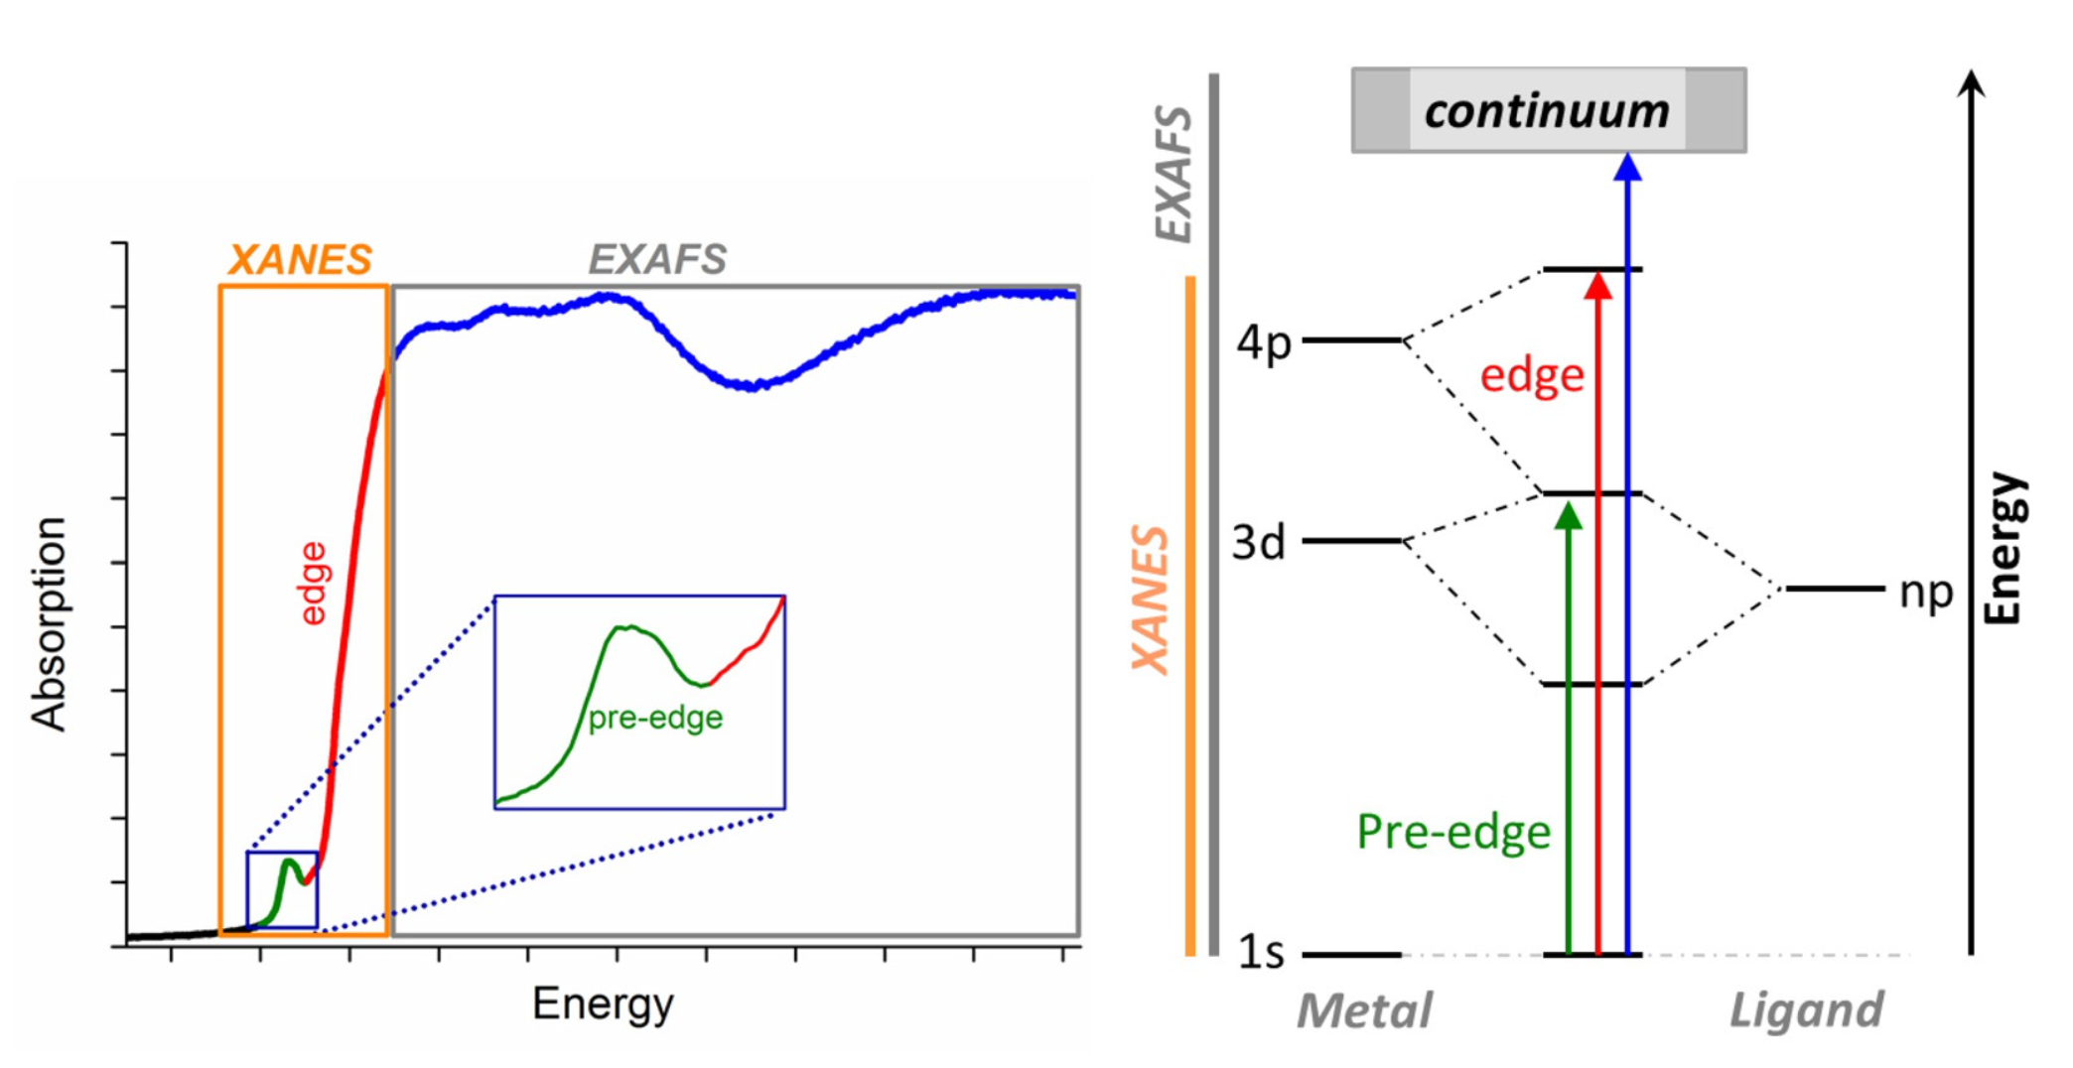
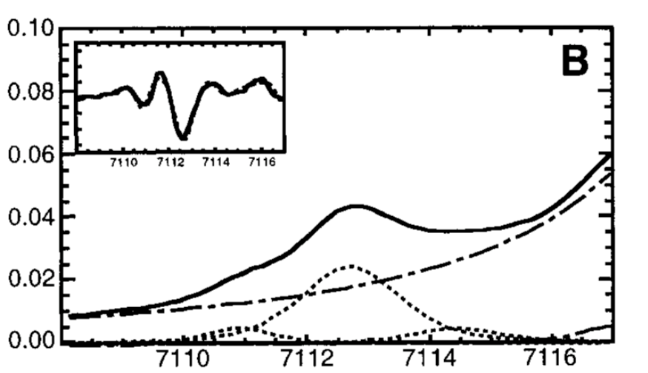
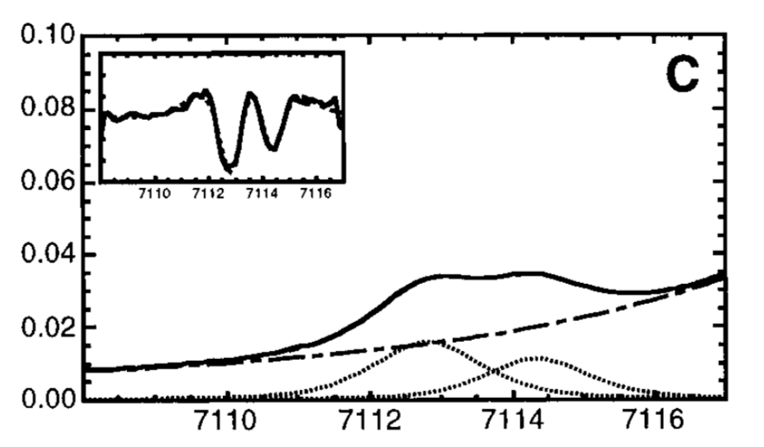
Using K pre-edge XAS to identify spin states
Westre et al., J. Am. Chem. Soc., 1997
Write down the electronic configuration of Fe³⁺. Show that there are two ways to fill the 3d orbitals, leading to a high spin (S = 5/2) and a low spin ground state (S = 1/2).
Run two K pre-edge calculations for Fe³⁺ in an octahedral crystal field, one with 10Dq set to 2.0 eV and 3.3 eV.
Change the 10Dq value from 2.6 to 3.6 eV in steps of 0.2 eV. At what value do you observe the spin transition?

Slide 13
Application of the XMCD sum-rules

Slide 14
XMCD Sum rules for L_{2,3} edges
Jafri et al., Inorg. Chem., 2016

Slide 15


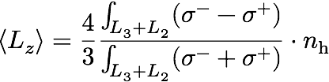
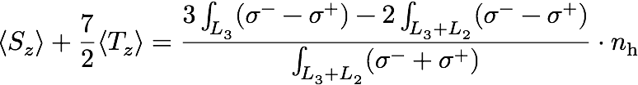
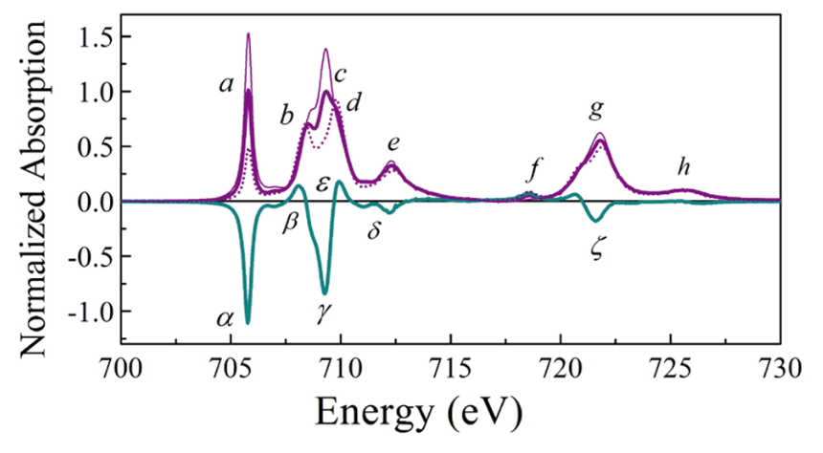
The magneto-optical sum rules

Slide 16
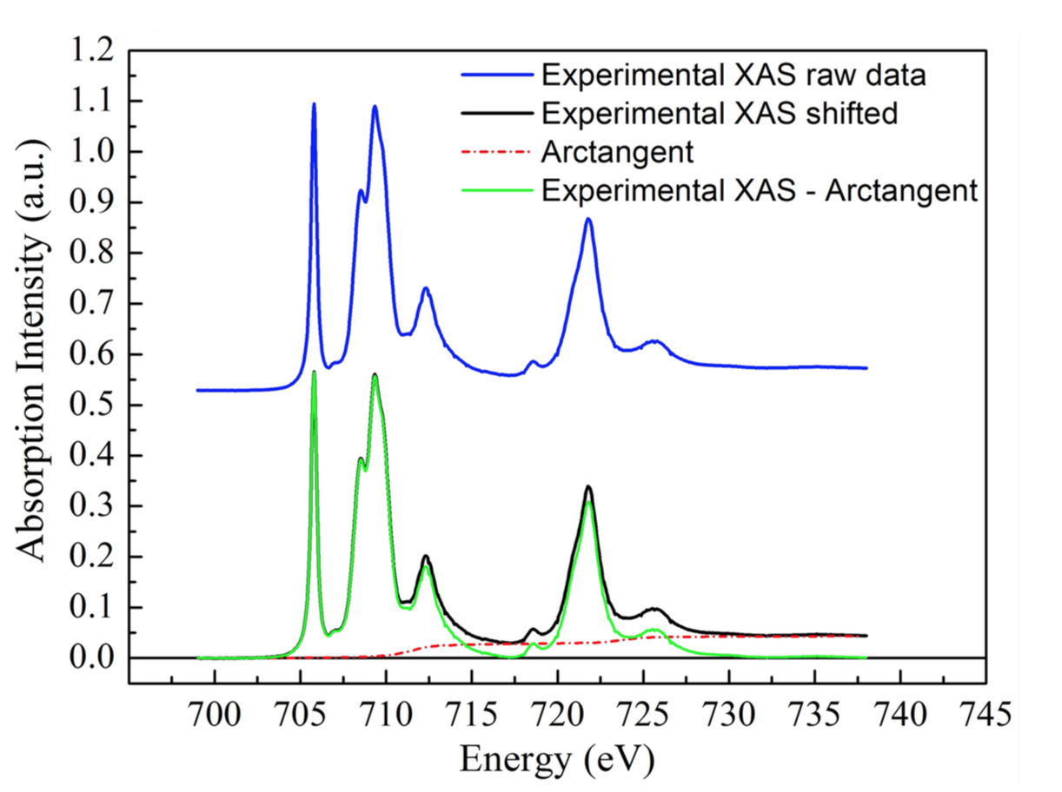
Sum rules in practice
The sum rules can provide very useful information on the magnetic electronic
structure by separating the orbit and spin parts of the magnetization.
Origin of problems in the application of the sum rules:
  Removal of the transitions towards continuum states is done by subtracting parameterized arctangent functions.
  The cutoff energy between L₃ and L₂ edges in the XMCD spectrum.
  Intermixing of L₃ and L₂.

Slide 17
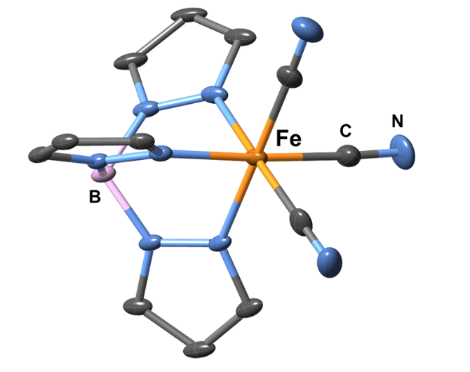
Experimental data
Experimental details:
  the metal atom in FeTp is Fe³⁺
  temperature (T = 2 K)
  magnetic field (B = 6.5 T)
Measured spectra: http://bit.ly/multiplets

Slide 18
Calculations using octahedral (Oh) symmetry
Calculate the spectrum using the following parameters:
    Lorentzian FWHM: 0.5
    Gaussian FWHM: 0.24
    scale factors: Fk = Gk = 0.7, zeta = 1.0
After the first calculation, open the “Details” dialog and normalize the spectrum to the maximum.
Increase the 10Dq value in steps of 0.5. Note the effect on the calculated spectrum. Are any features that start appearing in the spectrum for larger 10Dq? Follow the changes in the expectation value of the ⟨S_{z}⟩ operator.
Note the expectation values of the spin (S), orbital (L), and magnetic dipole (T) operators for 10Dq = 2.8 eV. How do they compare with the calculations from the original publication?
 | ⟨S_{z}⟩ | ⟨L_{z}⟩ | ⟨T_{z}⟩
Jafri et al. | −0.1786 | −0.8521 | −0.0523

Slide 19
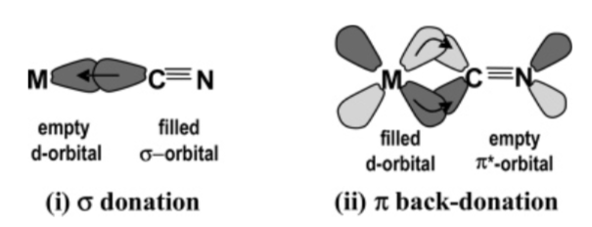
Ligand field calculation in octahedral symmetry
Add the metal-ligand hybridization charge transfer (MLCT) term with the following parameters:
Δ_{i} = 3.0, Δ_{f} = 3.4, V(e_{g}) = −0.8, V(t_{2g}) = 1.8.
Hocking et al., J. Am. Chem. Soc., 2006
Note the additional features appearing in the spectrum and the changes in the expectation values; compare them with the ones from the original publication.
 | ⟨S_{z}⟩ | ⟨L_{z}⟩ | ⟨T_{z}⟩
Jafri et al. | −0.1704 | −0.7754 | −0.0594

Slide 20
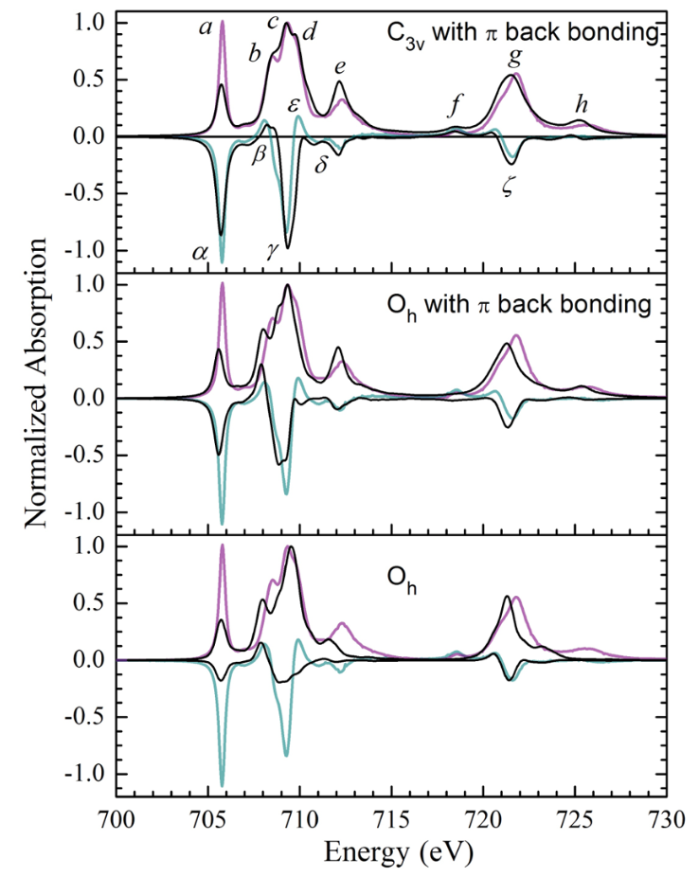
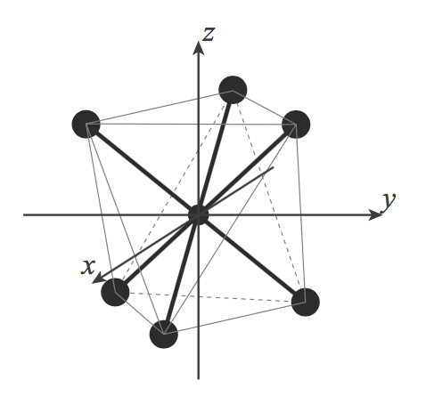
In search of the missing peak
Change the symmetry to C_{3v} and rerun the calculation using the following parameters for the crystal field:
  Dq = 0.28 eV (≡ 10Dq = 2.8 eV)
  Dσ = 0.07 eV
  Dτ = 0.12 eV
Did you manage to reproduce the feature f?
e
e_{g}
a₁
t_{2g}
e

Slide 21
Utility of multiplets calculations
What is the value of ⟨T_{z}⟩?
Test the validity of the sum rules and determine the origin of their potential failures.

Slide 22
Crystal field and covalency effects in uranates

Slide 23
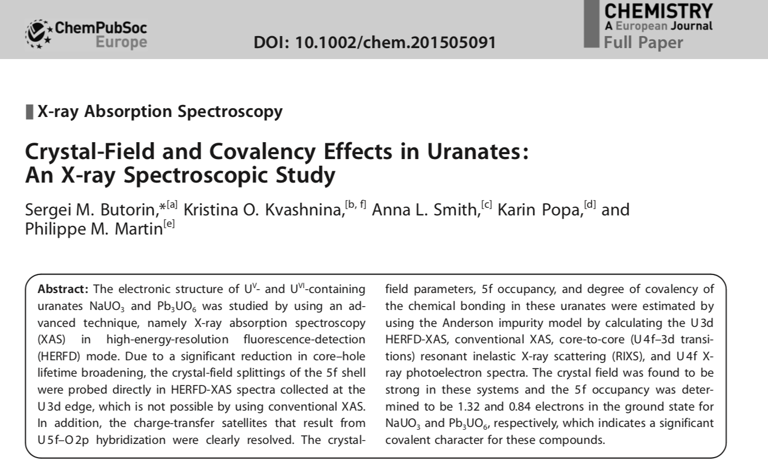
Crystal field and covalency effects in uranates

Slide 24
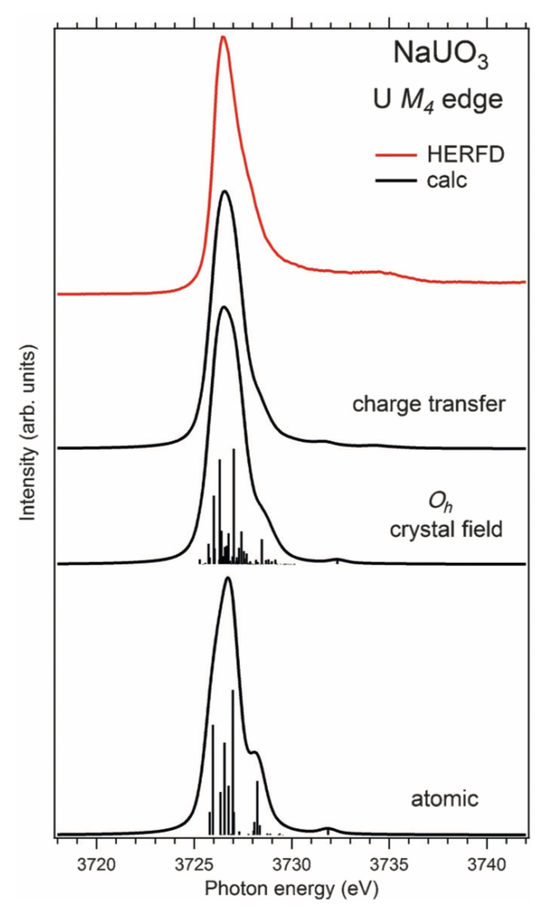
Crystal field and covalency effects in uranates
1) Calculate the atomic M₄ spectrum for U⁵⁺ using the following parameters:
  scale factors: Fk = Gk = 0.7
  Lorentzian FWHM: 0.35 eV
  Gaussian FWHM: 0.8 eV
2) Add a crystal field contribution with Wybourne’s parameters:
  B40 = 2.03 eV
  B60 = 0.17 eV
3) Finally, add the hybridization term with the ligands (LMCT):
  Δ = 4.0 eV,
  U(5f,5f) = 3.5 eV
  U(3d,5f) = 6.0 eV
  V_{i} = 1.2 eV, and V_{f} = 0.9 eV

